Slide 1

Geospatial Employer Survey: Using Results to Build Better Curriculum
Eric C. Ewert, PhD, Weber State University, AAG April, 2015
Co-PI: Michael Hernandez, PhD
Northern Utah Geospatial Technology Education Program (NUGeoTec)
The NUGTEP development project is funded through a NSF-ATE DUE-1304888 grant.

Slide 2

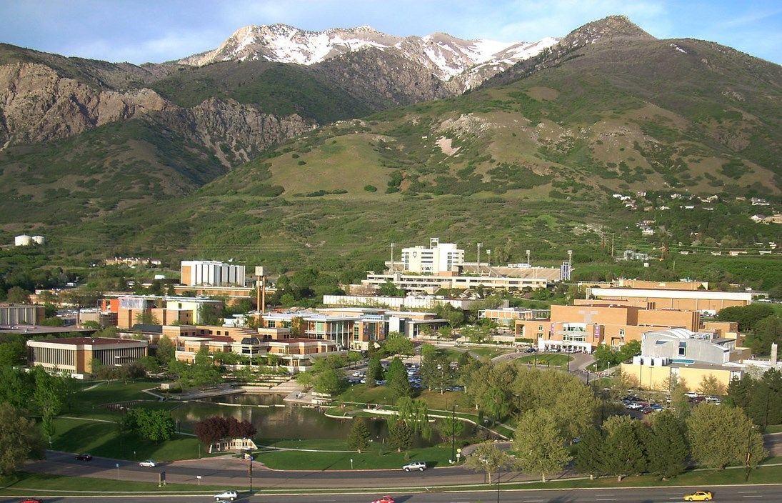
About WSU: 126-year-old, 24,000 student public university offering 250 Certificate and Degree Programs, and 11 Graduate Degrees as part of its Dual Mission (2 and 4-year)

Slide 3

Located primarily in Ogden, Utah, WSU serves northern Utah and parts of adjacent states.

Slide 4
NUGeoTec Objectives
Develop a Geospatial Training Program
Make it Two-tiered: Technician & Analyst
Be Guided by the Geospatial Technology Competency Model (U.S. Dept. Labor)
Use the Best Practices as Compiled by the National GeoTECH Center (Louisville, Kentucky)
Assemble a Geospatial Advisory Board
Administer a Workforce Needs Survey
Build Appropriate Curriculum
Offer Classes and Evaluate

Slide 5
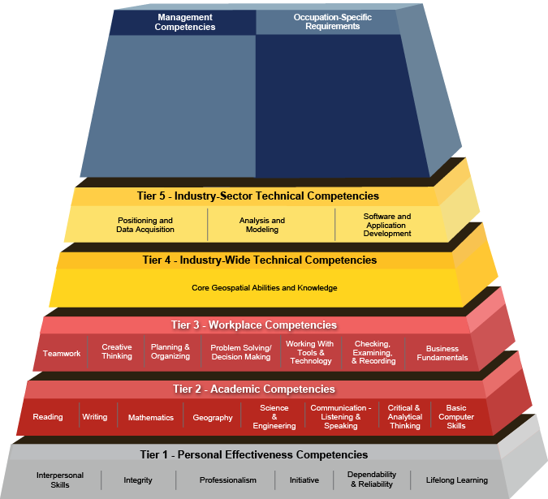
Geospatial Technology Competency Model
(US. Department of Labor and GeoTECH, 2014)
Notes:
On-line, this pyramid is interactive. By clicking on any term, more information and examples are linked.

Slide 6


GEOTECHCENTER.ORG
Notes:
The Geotech website is a vast repository of linked information.

Slide 7
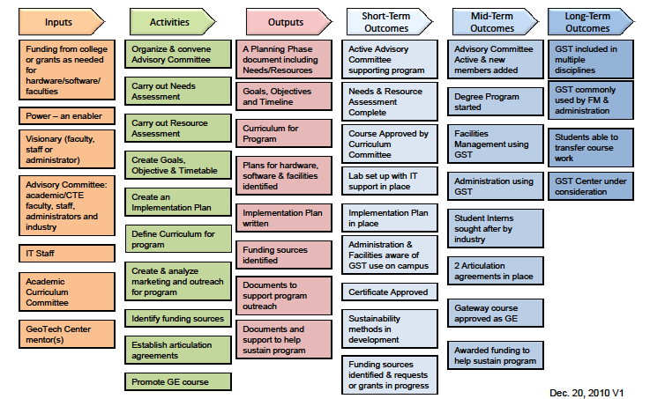
GeoSpatial Technology Logic Model Template
Notes:
Example GST Logic Model – modify to fit our needs. Short-term outcomes (1 – 2 years); Mid-term (2 – 5 years); Long-term (> 5 years)
logic model - a tool used most often by managers and evaluators of programs to evaluate the effectiveness of a program. Logic models are usually a graphical depiction of the logical relationships between the resources, activities, outputs and outcomes of a program.[1]
http://evalu-ate.org/app/webroot/files/uploads/logic_model_template.ppt
Inputs – what resources will be used to support the project?
Activities – What are the main things the project will do?
Outputs – What sort of observable/tangible results will be achieved?
Outcomes – What will occur as direct result of activities/outputs (Short-term)? Results that follow (changes in behavior, policies, practice) (Mid-term); changes in broader conditions (Long-term).

Slide 8
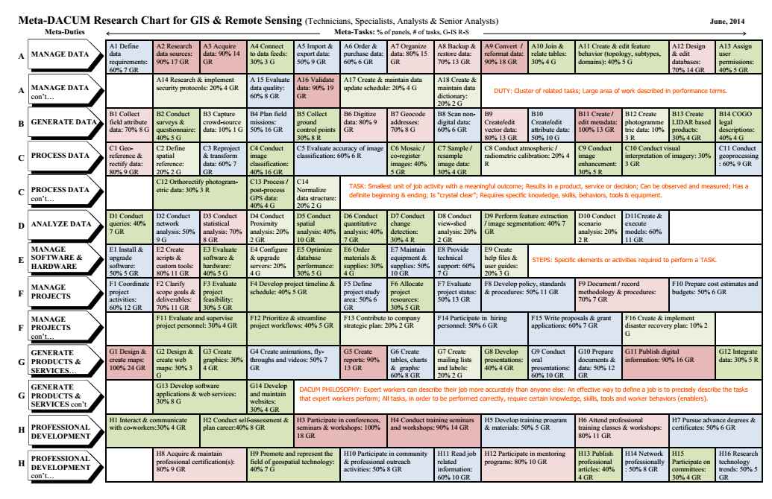
GeoTECH Center DACUM
(Developing a Curriculum)
Notes:
This is what we distilled down to craft our survey.

Slide 9
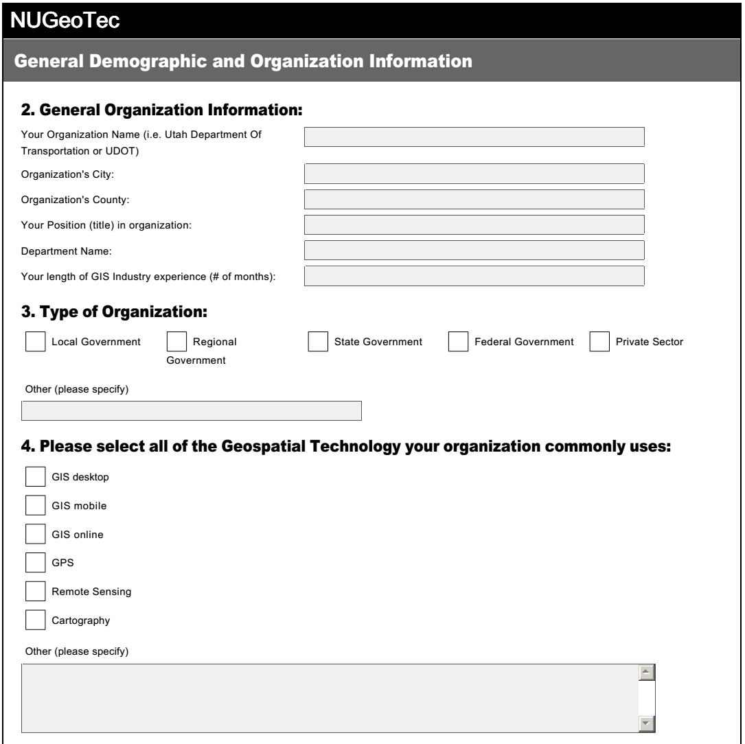
Survey
Notes:
A portion of our 12-page (screen) survey: Demographics and Technology Used

Slide 10
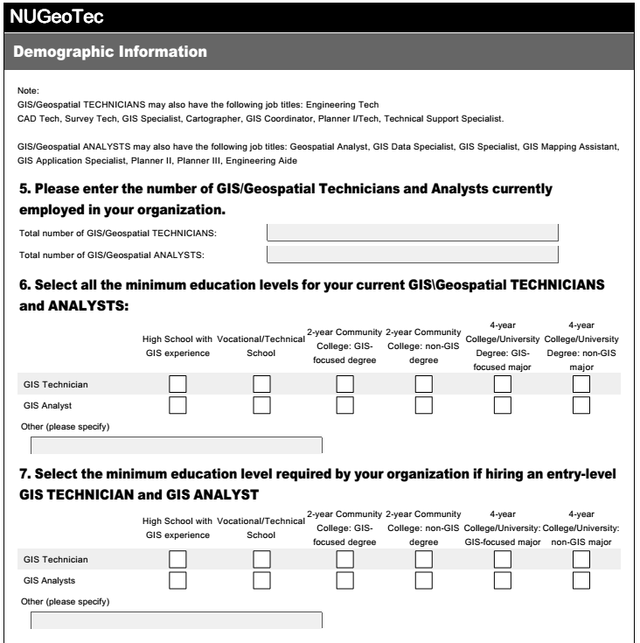
Survey
Notes:
Demographics and Educational Requirements

Slide 11
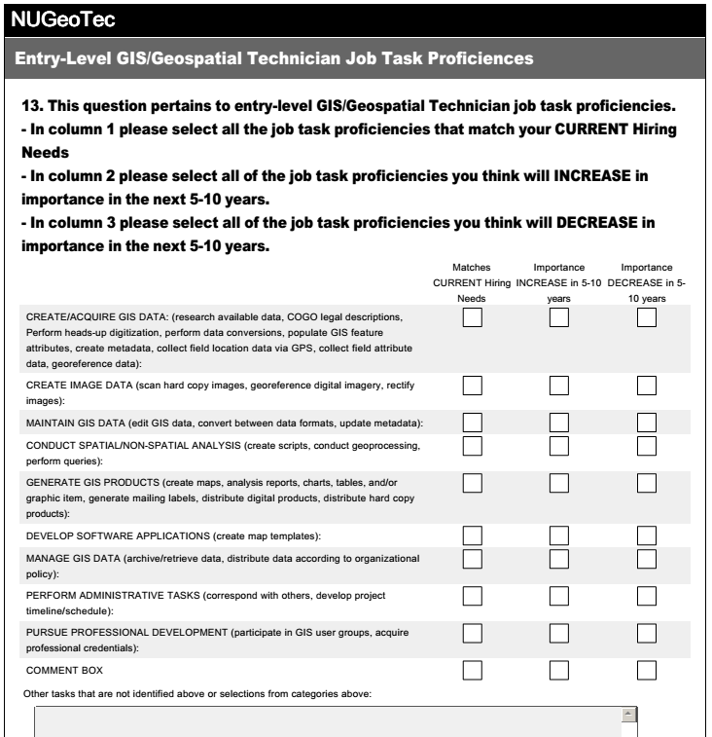
Survey
Notes:
Comparing Technician Proficiencies over time.

Slide 12
# of Respondents by County
Notes:
To obtain a picture of the current Northern Utah GIS market and these organizations’ future needs a survey was emailed to members of a Northern Utah GIS association. A total of 33 members responded to our survey over a one month period.

Slide 13
Respondents Department Categories
Notes:
The following are the individual departments for each category:
Public Works:
Public Works
Water Department
Engineering
Facilities Management
Development
Network Planning
Remote Sensing/GIS Laboratory
GIS Division
Cartography
Development Services
Information Technology
Information Systems
Information Support
Wireless/Internet
IT
Finance/Education
Training & Tech Integration
Finance

Slide 14
Respondents’ Length of GIS Experience in Years
Notes:
Total of respondents was 31, two did not answer this question.

Slide 15
Organization Type

Slide 16
Geospatial Technology By County

Slide 17
Current Minimum Education Levels of GIS Technicians by County
Notes:
No response means the respondent did not answer this question or they don’t have any GIS Technicians with these education levels.
Education levels given were:
High School with GIS Experience
Vocational/Technical School
2-year Community College (CC) GIS-focused degree
2-year Community College (CC) non-GIS degree
4-year College/University GIS-focused major
4-year College/University non-GIS major

Slide 18
Top Characteristics or Competencies Organizations Want When Hiring GIS Technicians
Notes:
Respondents were asked to list the top three characteristics or competencies they look for when evaluating entry-level GIS Technician new hires. ESRI~GIS Software was listed by 10 of the respondents, the next was desire to learn by 5 respondents and so on.

Slide 19
Basic Programming, Language, or Software Skills
Skills Organizations Expect GIS Technicians to have at time of Hire:
  Basic Python
  Basic SQL
  Basic Macro
  ArcGIS
  ArcMap
  Nomad Pathfinder Office
  Java Script
  Word/Excel

Slide 20
GIS Technician Specific Area Experience or Education not addressed in survey
“We need technicians that have experience in open source software, such as QGIS.” (Private Sector, Research/Education)
“Communication and organizational skills are an absolute must. These are difficult to teach, but students should understand that when I look to hire someone, I know I can teach them missing technical skills, but I can't teach them to communicate or be organized.” (Private Sector)
“General computer skills such as Windows XP, 7, 8 and Microsoft Office. Good communication skills (written and verbal).” (Local Government)
“A working knowledge of GPS would be very helpful for our technicians. Other wise it takes a while for them to get up to speed and gather data effectively.” (Local Government)
Notes:
Respondents were asked to list any specific functional area expertise or education they look for when hiring an entry-level GIS Technician that have not been addressed in this survey.

Slide 21
New Skills GIS Technician Will Need
5-10 years from now
“The applications for the technology continue to expand--even for our small city. Those new applications should be at least mentioned to give the students a vision of where the field could take them.” (Local Government)
“Experience with multiple platforms and systems with familiarity with cad and 3d applications.” (Research/Education)
“A physical relationship and understanding of what they are truly doing. For instance an AutoCAD technician will be far better off having had experience with technical drawing by hand. Do not lose the "old-way" and reasons of doing things on the computer.” (Private Sector)
“Some application development/programming, internet mapping skills.“ (Local Government)
“Core skills in working with ESRI software will be required. Helpful additional skills might include working with GPS, developing mapping apps, working with imagery, database management experience, etc.” (Local Government)
Notes:
Respondents were asked to list new skills (if any) that they think a GIS Technician will need to have when entering the job market 5-10 years from now.

Slide 22
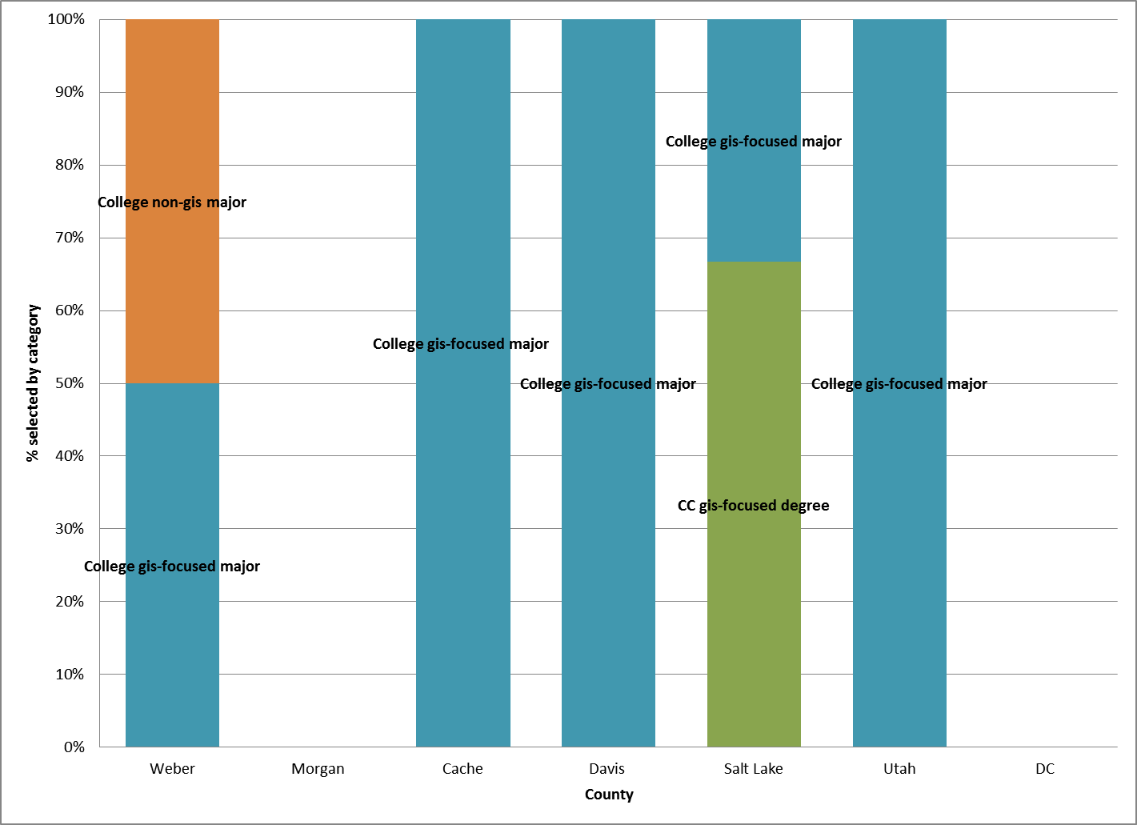
Current Minimum Education Levels of GIS Analysts by County
Notes:
No response means the respondent did not answer this question or they don’t have any GIS Analysts with these education levels.
Education levels given were:
High School with GIS Experience
Vocational/Technical School
2-year Community College (CC) GIS-focused degree
2-year Community College (CC) non-GIS degree
4-year College/University GIS-focused major
4-year College/University non-GIS major

Slide 23
Top Characteristics or Competencies Organizations Want When Hiring GIS Analysts
Notes:
Respondents were asked to list the top three characteristics or competencies they look for when evaluating GIS Analysts new hires. ArcGIS Desktop was listed by 7 of the respondents, the next was ESRI~GIS Software to learn by 6 respondents and so on.

Slide 24
Basic Programming, Language, or Software Skills
Skills Organizations Expect GIS Analysts to have at time of Hire:
  Basic Python
  Java Script
  Basic SQL
  Adobe Flex
  Basic Macro
  Integrate GIS Systems with other systems

Slide 25
New Skills GIS Analyst Will Need
5-10 years from now
“ArcGIS SDE experience, problem solving skills” (Federal Government)
“An analyst will need experience in and general knowledge of their industry in order to effectively apply GIS skills to support the industry.” (Local Government)
“I know it was mentioned, but programming skills and data management skills (ArcServer, etc.) will be vital in the next 5-10 years.” (Federal Government)
“Web programming and utilization skills.” (Research/Education)
“Mobile GIS” (Local Government)
Notes:
Respondents were asked to list new skills (if any) that they think a GIS Analyst will need to have when entering the job market 5-10 years from now.

Slide 26
Additional Comments
“I highly encourage the geospatial program to incorporate some level of student exposure to the operations/goals of different industries that use geospatial technologies.” (Local Government)
“Partnerships with other departments such as Business, Health Care, Botany, Zoology, Computer Systems, Programming, Etc. to show how GIS can benefit each of these departments and the students in their future careers.” (Local Government)
“Not all of the organizations that have to adapt GIS technology have the size or budget to hire a specialist. Non GIS specialist training is what would benefit us.” (Local Government)
“I believe that a broad-based intro to GIS would include education in working not only with ESRI software, but also some related disciplines such as survey techniques, field data collection, GPS, image processing/analysis, etc. I'd highly encourage the advanced GIS curriculum to be based on real-world industry--GIS for environmental, GIS for business, GIS for government, GIS for utilities, etc.” (Private Sector)
Notes:
Respondents were asked “do you have any additional comments that might be beneficial for Northern Utah Geospatial Technology Education Program to help in developing a valuable and effective geospatial technology education experience?” These are the comments shared.

Slide 27
Additional Comments
Knowing GIS isn’t the biggest thing I look for when I hire someone. Obviously working with others is a big deal. Most importantly is the ability to solve problems. Can the person work though an issue and find the solution to the problem is very important. Can they think through a problem and apply what they have learned and use GIS to get to the solution. I have found that sometimes students just know how to click buttons in the software but don’t understand why they are pushing certain buttons. Critical thinking and problem solving are very important. (Federal Government)
Notes:
Respondents were asked “do you have any additional comments that might be beneficial for Northern Utah Geospatial Technology Education Program to help in developing a valuable and effective geospatial technology education experience?” These are the comments shared.

Slide 28
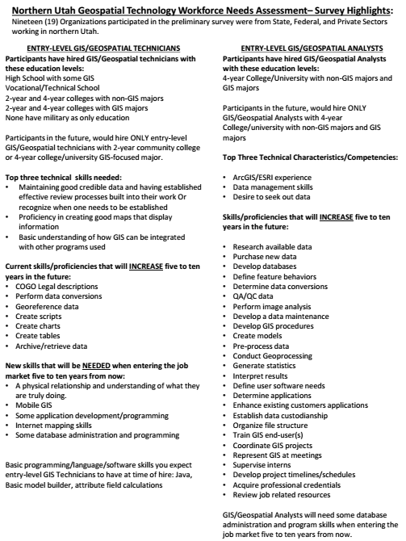
Survey
Summary
Notes:
Summary Results of the Survey.

Slide 29
Syllabus
Notes:
First of a 4-page Syllabus. Course to be offered for the first time next Autumn.

Slide 30

Website
Notes:
Our Website

Slide 31
Geospatial Employer Survey: Using Results to Build Better Curriculum
AAG April, 2015
Thanks and Questions
Eric: eewert@weber.edu
NUGeoTec:
http://www.weber.edu/nugeotec
Northern Utah Geospatial Technology Education Program (NUGeoTec)
The NUGTEP development project is funded through a NSF-ATE DUE-1304888 grant.

