Slide 1
NUGeoTec 2015 Market Assessment Results
Weber State University

Slide 2
Demographics

Slide 3
# of Respondents by County
Notes:
To obtain a picture of the current Northern Utah GIS market and these organizations’ future needs a survey was emailed to members of a Northern Utah GIS association. A total of 33 members responded to our survey over a one month period.

Slide 4
Respondent Job Title Categories
Notes:
The job titles within each category are as follows:
Administration:
GIS Administrator
GIS Manager
GIS Coordinator
GIS Database Administrator
Application Development and Technology Manager
Assistant City Manager
Director
Project Manager
Developer:
GIS Analyst
GIS Tech
GIS Programmer
GIS Developer
GIS/GPS Specialist
GIS Web Developer
GIS Training Unit Leader
GIS Planner
Field
GIS User
Field Worker
Senior Planner/Demographer
Emergency Coordinator
Bluestaker

Slide 5
Respondents Department Categories
Notes:
The following are the individual departments for each category:
Public Works:
Public Works
Water Department
Engineering
Facilities Management
Development
Network Planning
Remote Sensing/GIS Laboratory
GIS Division
Cartography
Development Services
Information Technology
Information Systems
Information Support
Wireless/Internet
IT
Finance/Education
Training & Tech Integration
Finance

Slide 6
Respondents’ Length of GIS Experience in Years
Notes:
Total of respondents was 31, two did not answer this question.

Slide 7
Organization Type

Slide 8
Geospatial technology

Slide 9
Geospatial Technology by Organization Type

Slide 10
Geospatial Technology By County

Slide 11
GIS Technicians

Slide 12
Total # of GIS Technicians Currently Employed in Respondents’ Organizations
By Organization Type
  Local Government = 13
  Regional Government = 0
  State Government = 0
  Federal Government = 1
  Private Sector = 7
  Research/Education = 2
  Total Number = 23
by County
  Weber = 6
  Morgan = 1
  Cache = 3
  Davis = 3
  Salt Lake = 3
  Utah = 6
  DC = 1
  Total Number = 23

Slide 13
Current Minimum Education Levels of GIS Technicians by Organization Type
Notes:
No response means the respondent did not answer this question or they don’t have any GIS Technicians with these education levels.
Education levels given were:
High School with GIS Experience
Vocational/Technical School
2-year Community College (CC) GIS-focused degree
2-year Community College (CC) non-GIS degree
4-year College/University GIS-focused major
4-year College/University non-GIS major

Slide 14
Current Minimum Education Levels of GIS Technicians by County
Notes:
No response means the respondent did not answer this question or they don’t have any GIS Technicians with these education levels.
Education levels given were:
High School with GIS Experience
Vocational/Technical School
2-year Community College (CC) GIS-focused degree
2-year Community College (CC) non-GIS degree
4-year College/University GIS-focused major
4-year College/University non-GIS major

Slide 15
If Hiring Today: Minimum Education Level Required for GIS Technician by Organization Type
Notes:
No response means the respondent did not answer this question or they don’t have any GIS Technicians with these education levels.
Education levels given were:
High School with GIS Experience
Vocational/Technical School
2-year Community College (CC) GIS-focused degree
2-year Community College (CC) non-GIS degree
4-year College/University GIS-focused major
4-year College/University non-GIS major

Slide 16
If Hiring Today: Minimum Education Level Required for GIS Technician by County
Notes:
No response means the respondent did not answer this question or they don’t have any GIS Technicians with these education levels.
Education levels given were:
High School with GIS Experience
Vocational/Technical School
2-year Community College (CC) GIS-focused degree
2-year Community College (CC) non-GIS degree
4-year College/University GIS-focused major
4-year College/University non-GIS major

Slide 17
GIS Technician Education Levels Well-prepared to Enter Job Market by Organization Type
Notes:
Question 8 on the survey: select those education levels that you feel are well-prepared to enter the job market – these responses are for GIS Technicians
No response means the respondent did not answer this question or they don’t have any GIS Technicians with these education levels.
Education levels given were:
High School with GIS Experience
Vocational/Technical School
2-year Community College (CC) GIS-focused degree
2-y4-year College/University GIS-focused major

Slide 18
GIS Technician Education Levels Well-prepared to Enter Job Market by County
Notes:
No response means the respondent did not answer this question or they don’t have any GIS Technicians with these education levels.
Education levels given were:
High School with GIS Experience
Vocational/Technical School
2-year Community College (CC) GIS-focused degree
2-y4-year College/University GIS-focused major

Slide 19
Top Characteristics or Competencies Organizations Want When Hiring GIS Technicians
Notes:
Respondents were asked to list the top three characteristics or competencies they look for when evaluating entry-level GIS Technician new hires. ESRI~GIS Software was listed by 10 of the respondents, the next was desire to learn by 5 respondents and so on.

Slide 20
Basic Programming, Language, or Software Skills
Skills Organizations Expect GIS Technicians to have at time of Hire:
  Basic Python
  Basic SQL
  Basic Macro
  ArcGIS
  ArcMap
  Nomad Pathfinder Office
  Java Script
  Word/Excel

Slide 21
Gis analysts

Slide 22
Total # of GIS Analysts Currently Employed in Respondents’ Organizations
By Organization Type
  Local Government = 8
  Regional Government = 0
  State Government = 0
  Federal Government = 2
  Private Sector = 5
  Research/Education = 1
  Total Number = 16
by County
  Weber = 3
  Morgan = 1
  Cache = 2
  Davis = 2
  Salt Lake = 5
  Utah = 3
  DC = 0
  Total Number = 16

Slide 23
Current Minimum Education Levels of GIS Analysts by Organization Type
Notes:
No response means the respondent did not answer this question or they don’t have any GIS Analysts with these education levels.
Education levels given were:
High School with GIS Experience
Vocational/Technical School
2-year Community College (CC) GIS-focused degree
2-year Community College (CC) non-GIS degree
4-year College/University GIS-focused major
4-year College/University non-GIS major

Slide 24
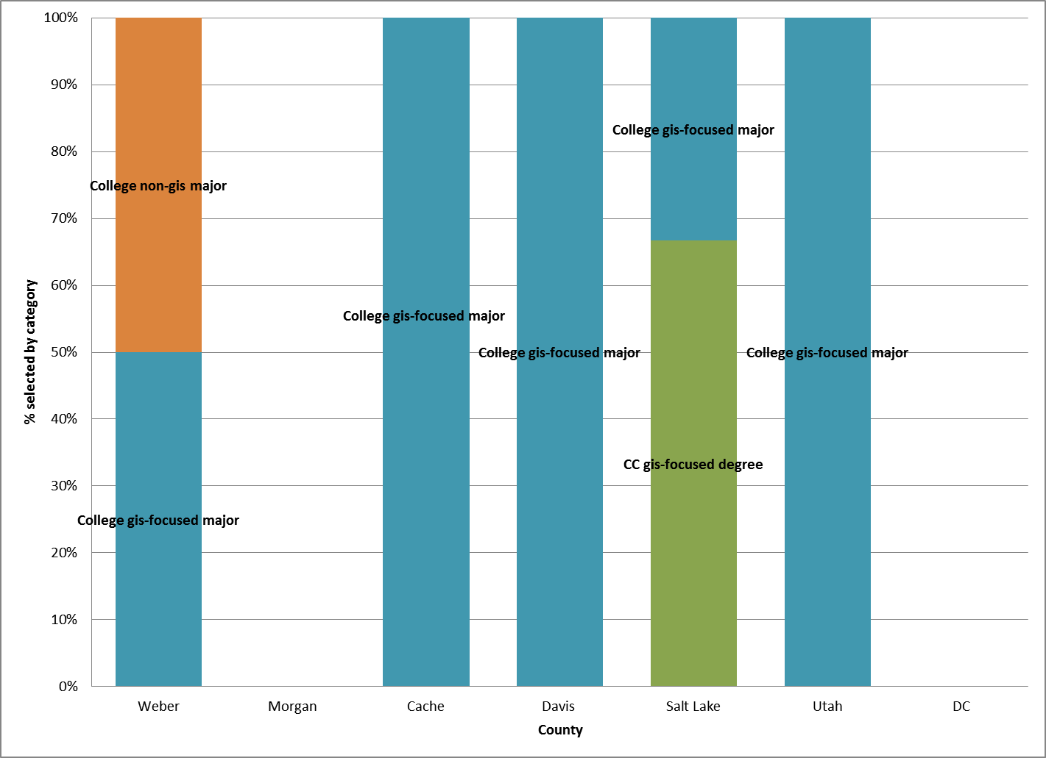
Current Minimum Education Levels of GIS Analysts by County
Notes:
No response means the respondent did not answer this question or they don’t have any GIS Analysts with these education levels.
Education levels given were:
High School with GIS Experience
Vocational/Technical School
2-year Community College (CC) GIS-focused degree
2-year Community College (CC) non-GIS degree
4-year College/University GIS-focused major
4-year College/University non-GIS major

Slide 25
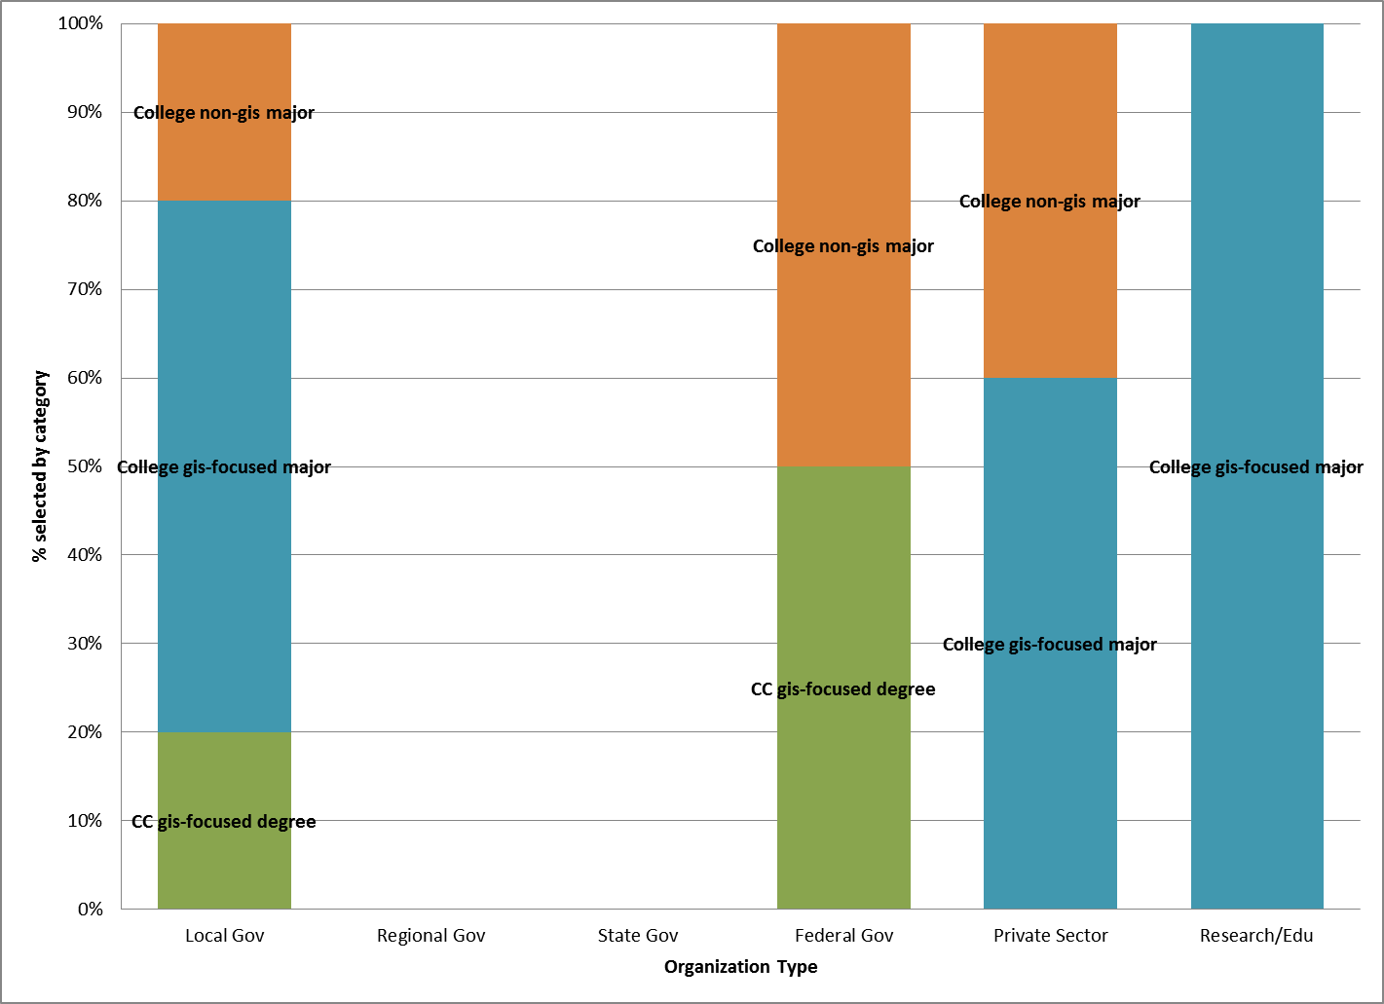
If Hiring Today: Minimum Education Level Required for GIS Analyst by Organization Type
Notes:
No response means the respondent did not answer this question or they don’t have any GIS Analysts with these education levels.
Education levels given were:
High School with GIS Experience
Vocational/Technical School
2-year Community College (CC) GIS-focused degree
2-year Community College (CC) non-GIS degree
4-year College/University GIS-focused major
4-year College/University non-GIS major

Slide 26
If Hiring Today: Minimum Education Level Required for GIS Analyst by County
Notes:
No response means the respondent did not answer this question or they don’t have any GIS Analysts with these education levels.
Education levels given were:
High School with GIS Experience
Vocational/Technical School
2-year Community College (CC) GIS-focused degree
2-year Community College (CC) non-GIS degree
4-year College/University GIS-focused major
4-year College/University non-GIS major

Slide 27
GIS Analyst Education Levels Well-prepared to Enter Job Market by Organization Type
Notes:
Question 8 on the survey: select those education levels that you feel are well-prepared to enter the job market – these responses are for GIS Analysts and are by Organization Type
No response means the respondent did not answer this question or they don’t have any GIS Analysts with these education levels.
Education levels given were:
High School with GIS Experience
Vocational/Technical School
2-year Community College (CC) GIS-focused degree
2-y4-year College/University GIS-focused major

Slide 28
GIS Analyst Education Levels Well-prepared to Enter Job Market by County
Notes:
Question 8 on the survey: select those education levels that you feel are well-prepared to enter the job market – these responses are for GIS Analysts and are by County
No response means the respondent did not answer this question or they don’t have any GIS Technicians with these education levels.
Education levels given were:
High School with GIS Experience
Vocational/Technical School
2-year Community College (CC) GIS-focused degree
2-y4-year College/University GIS-focused major

Slide 29
Top Characteristics or Competencies Organizations Want When Hiring GIS Analysts
Notes:
Respondents were asked to list the top three characteristics or competencies they look for when evaluating GIS Analysts new hires. ArcGIS Desktop was listed by 7 of the respondents, the next was ESRI~GIS Software to learn by 6 respondents and so on.

Slide 30
Basic Programming, Language, or Software Skills
Skills Organizations Expect GIS Analysts to have at time of Hire:
  Basic Python
  Java Script
  Basic SQL
  Adobe Flex
  Basic Macro
  Integrate GIS Systems with other systems

Slide 31
GIS Technician job task proficiencies (DACUM)

Slide 32
Current Hiring GIS Technician Job Task Proficiency Needs by Organization Type
Notes:
This slide shows only the organizations that selected a job task proficiency for GIS Technicians that meet their current hiring needs. Regional and State Governments did not select any job task proficiencies.

Slide 33
GIS Technicians Job Task Proficiencies Increase in Importance 5–10 years by Organization Type
Notes:
This slide shows only the organizations that selected a job task proficiency for GIS Technicians that they feel will increase in importance in the next 5 to 10 years.

Slide 34
GIS Technician Job Task Proficiencies Decrease in Importance 5–10 years by Organization Type
Notes:
This slide shows only the organizations that selected a job task proficiency for GIS Technicians that they feel will decrease in importance in the next 5 to 10 years.

Slide 35
GIS analyst job task proficiencies (DACUM)

Slide 36
Current Hiring GIS Analyst Job Task Proficiency Needs by Organization Type
Notes:
This slide shows only the organizations that selected a job task proficiency for GIS Analyst that meet their current hiring needs. Regional and State Governments did not select any job task proficiencies.

Slide 37
GIS Analyst Job Task Proficiencies Increase in Importance 5-10 years by Organization Type
Notes:
This slide shows only the organizations that selected a job task proficiency for GIS Analysts that they feel will increase in importance in the next 5 to 10 years.

Slide 38
GIS Analyst Job Task Proficiencies Decrease in Importance 5–10 years by Organization Type
Notes:
This slide shows only the organizations that selected a job task proficiency for GIS Analysts that they feel will decrease in importance in the next 5 to 10 years.

Slide 39
GIS Technician Specific Area Experience or Education not addressed in survey
“We need technicians that have experience in open source software, such as QGIS.” (Private Sector, Research/Education)
“Communication and organizational skills are an absolute must. These are difficult to teach, but students should understand that when I look to hire someone, I know I can teach them missing technical skills, but I can't teach them to communicate or be organized.” (Private Sector)
“General computer skills such as Windows XP, 7, 8 and Microsoft Office. Good communication skills (written and verbal).” (Local Government)
“A working knowledge of GPS would be very helpful for our technicians. Other wise it takes a while for them to get up to speed and gather data effectively.” (Local Government)
Notes:
Respondents were asked to list any specific functional area expertise or education they look for when hiring an entry-level GIS Technician that have not been addressed in this survey.

Slide 40
New Skills GIS Technician Will Need
5-10 years from now
“The applications for the technology continue to expand--even for our small city. Those new applications should be at least mentioned to give the students a vision of where the field could take them.” (Local Government)
“Experience with multiple platforms and systems with familiarity with cad and 3d applications.” (Research/Education)
“A physical relationship and understanding of what they are truly doing. For instance an AutoCAD technician will be far better off having had experience with technical drawing by hand. Do not lose the "old-way" and reasons of doing things on the computer.” (Private Sector)
“Some application development/programming, internet mapping skills.“ (Local Government)
“Core skills in working with ESRI software will be required. Helpful additional skills might include working with GPS, developing mapping apps, working with imagery, database management experience, etc.” (Local Government)
Notes:
Respondents were asked to list new skills (if any) that they think a GIS Technician will need to have when entering the job market 5-10 years from now.

Slide 41
New Skills GIS Analyst Will Need
5-10 years from now
“ArcGIS SDE experience, problem solving skills” (Federal Government)
“An analyst will need experience in and general knowledge of their industry in order to effectively apply GIS skills to support the industry.” (Local Government)
“I know it was mentioned, but programming skills and data management skills (ArcServer, etc.) will be vital in the next 5-10 years.” (Federal Government)
“Web programming and utilization skills.” (Research/Education)
“Mobile GIS” (Local Government)
Notes:
Respondents were asked to list new skills (if any) that they think a GIS Analyst will need to have when entering the job market 5-10 years from now.

Slide 42
Additional Comments
“I highly encourage the geospatial program to incorporate some level of student exposure to the operations/goals of different industries that use geospatial technologies.” (Local Government)
“Partnerships with other departments such as Business, Health Care, Botany, Zoology, Computer Systems, Programming, Etc. to show how GIS can benefit each of these departments and the students in their future careers.” (Local Government)
“Not all of the organizations that have to adapt GIS technology have the size or budget to hire a specialist. Non GIS specialist training is what would benefit us.” (Local Government)
“I believe that a broad-based intro to GIS would include education in working not only with ESRI software, but also some related disciplines such as survey techniques, field data collection, GPS, image processing/analysis, etc. I'd highly encourage the advanced GIS curriculum to be based on real-world industry--GIS for environmental, GIS for business, GIS for government, GIS for utilities, etc.” (Private Sector)
Notes:
Respondents were asked “do you have any additional comments that might be beneficial for Northern Utah Geospatial Technology Education Program to help in developing a valuable and effective geospatial technology education experience?” These are the comments shared.

Slide 43
Additional Comments
Knowing GIS isn’t the biggest thing I look for when I hire someone. Obviously working with others is a big deal. Most importantly is the ability to solve problems. Can the person work though an issue and find the solution to the problem is very important. Can they think through a problem and apply what they have learned and use GIS to get to the solution. I have found that sometimes students just know how to click buttons in the software but don’t understand why they are pushing certain buttons. Critical thinking and problem solving are very important. (Federal Government)
Notes:
Respondents were asked “do you have any additional comments that might be beneficial for Northern Utah Geospatial Technology Education Program to help in developing a valuable and effective geospatial technology education experience?” These are the comments shared.

