Slide 1
An Introduction to Our Services
Dr. Elizabeth Brummett, DSW MSW, LCSW

Slide 2
Blomquist Hale Benefit
Who Are We?
Local licensed therapists who are available to YOU and your household.
Blomquist Hale offers direct, face-to-face guidance to address any stressful life situation or problem.
We also offer video and phone appointments for your convenience.

Slide 3

Blomquist Hale Benefit
We Can Help With:
Marital & Family Counseling
Financial or Legal Stressors
Stress, Anxiety or Depression
Substance Abuse or Addiction
Personal & Emotional Challenges
Senior Care Planning
Support in the Workplace for Staff and Supervisors
Grief or Loss

Slide 4

Financial Counseling
Can include :
Counseling to build skills for budgeting, shopping addiction, planning for big expenses, building skills for stress related to finances, communication between family members on finances, coping with scams, and other needs that can be addressed in counseling
Referrals to financial resources for credit counseling, debt management, money management, etc.
Financial programs associated with the company you work for

Slide 5

Legal Counseling
Can include :
Referral to a legal consultation group for a free 15-minute consultations
Referrals to legal aid groups
Counseling to cope with legal stressors
Does not include counseling for court needs or legal advice from our counselors

Slide 6

Senior Planning
Can include :
Planning for the needs of a senior including yourself or a family member or someone with severe disabilities which can include connecting you with information on available services in your/their area
Supportive counseling and psychoeducation for handling the unique struggles that come with aging or caring for an aging/disabled loved one

Slide 7

Support for the Workplace
Can include :
Tailored webinars or lunch and learns for the workplace
Response/support when there are incidents that have impacted the workplace
Supervisor referrals; a supervisor referring an employee for a specific need often related to the workplace. Sometimes including an employee improvement plan, anger management, leadership skill building, and/or addressing team needs from a mental health perspective

Slide 8
How Do Supervisor Referrals Work
If a supervisor has a concern for an employee that one of our counselors can help with; they can make a referral for services with Blomquist Hale to ensure that we know what the concern is, communicate with the supervisor if requested, and respond the concern quicker
Ideally the supervisor calls with the employee to make the appointment
A release of information gives permission for Blomquist Hale to communicate with the supervisor; this may be confirmation of attendance or more
Common supervisor referral requests include but are not limited to; concern about an employee after a crisis, building leadership skills, assessing concerns and making recommendations

Slide 9

Substance Abuse
Can include :
Supervisor referrals with assessment and recommendations
Connection with substance abuse treatment facilities that meet your or your loved ones needs
Connection with resources and educational materials
Support and counseling services during treatment for family and/or the person coping with addiction
SAP Assessments available when needed

Slide 10

First Responder Services
All of our therapist are available to work with first responders and their families; we do also have therapists on our team specifically trained in treatment and support of first responders and their families; many of them are current/former first responders or part of first responder families themselves

Slide 11
Blomquist Hale Benefit
You Can Count On:
No Cost
No Copays
No Deductibles
No insurance involvement
100% Confidentiality
This benefit is available for you to use. You do not have to ask your employer for permission, and they do not have access to your information at any time even when billing.

Slide 12
Blomquist Hale Benefit
You Can Count On:
Convenient locations
We have offices in Orem, Murray, Farmington, Draper, Ogden, and Logan
Virtual Visits
- Connect with a therapist from anywhere! Via smart phone, tablet or computer.

Slide 13
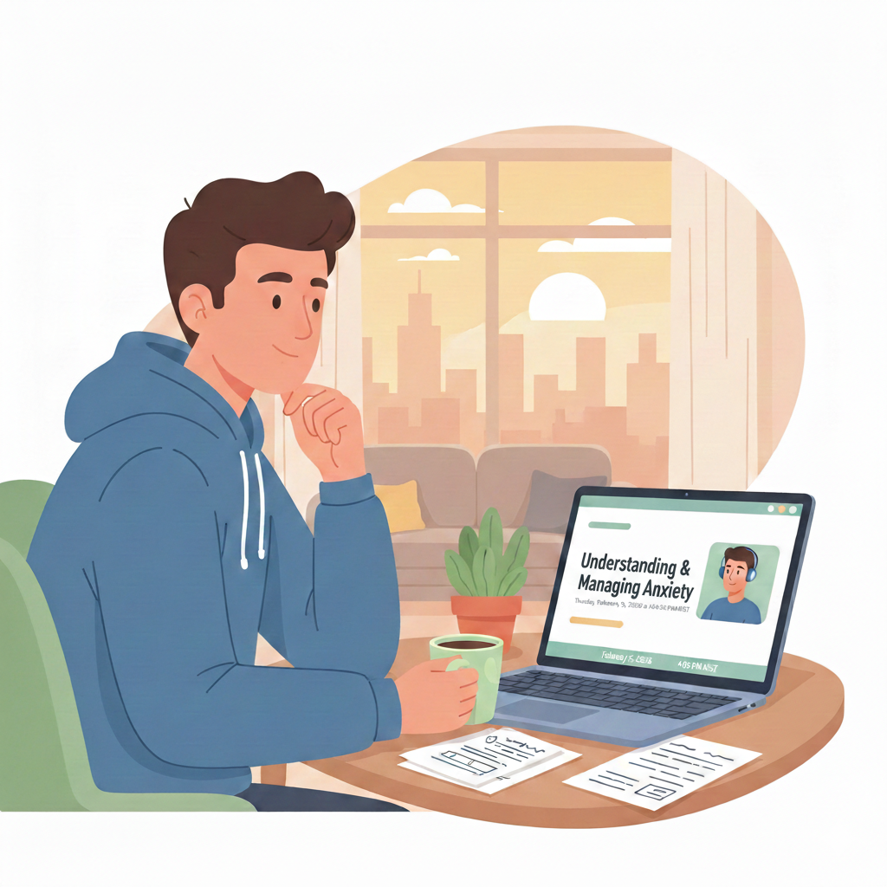
Digital Tools
Check Out Our App and YouTube Channel:
Our app is available for Android and Apple phones
You can find resources for multiple needs
Access recordings of our webinars
Request our scheduling team to give a call
Our public Youtube Channel can be found under Blomquist Hale on Youtube
Every month we host webinars on requested health topics
These webinars are recorded and posted on Youtube for the public

Slide 14
Blomquist Hale Benefit
Meeting With Our Team Is Simple!
Call to schedule an appointment at:
801.262.9619 or 1.800.926.9619

Slide 15
Questions? Comments?

