Slide 1
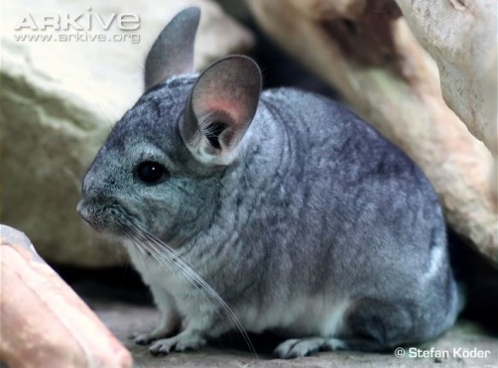
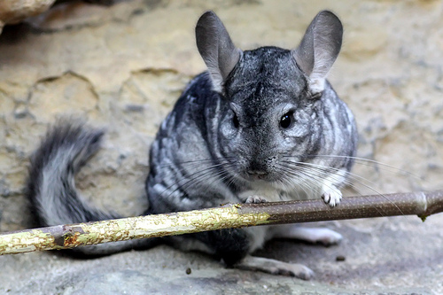
Save the Wild Chinchillas! (Chinchilla lanigera)
A chinchilla is a type of rodent native to the Andes mountains of South America (related to the porcupine and guinea pig).
Chinchillas were nearly driven to extinction for their soft fur. They have 60 hairs per follicle; humans have one hair per follicle.
Currently, wild populations are protected by law but they continue to decline due to habitat destruction and degradation.
Buy a hand-knitted hat with all proceeds going to Save the Wild Chinchillas, Inc. which is a non-profit organization focusing on wild chinchilla conservation (http://www.wildchinchillas.org/).
Donate to our cause at www.indiegogo.com/projects/save-the-wild-chinchilla .
For more information about the wild chinchillas go to www.wildchinchillas.org.
Photo by Arkive.org
Photo by mascotasdistintas.com

