Slide 1
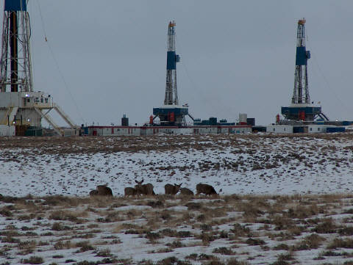
Mule Deer on the Mesa Big Game Winter Range

Slide 2
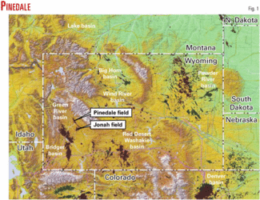
Pinedale Anticline Project Area (PAPA)
90 square miles south of Pinedale, Wyoming.
2nd Largest natural gas field in the nation with 25 trillion cubic feet of recoverable gas.
Extensive gas production began in 2000.

Slide 3
Gas Production
Well pad density is 4-16 pads per section or 2.58 km squared.
In 2000 the BLM approved a plan for 700 producing well pads, 400 miles of pipeline, and 276 miles of access roads.
All of this has caused a massive decrease in suitable habitat for many wild animal populations such as antelope, sage grouse, and mule deer.

Slide 4
Winter Range Habitat Loss
Severe habitat loss and fragmentation has caused the mule deer in this area to utilize less suitable habitat to survive the harsh Wyoming winters.
Most critical habitat is an area in the northern section of the PAPA called the “Mesa Big Game Winter Range”

Slide 5
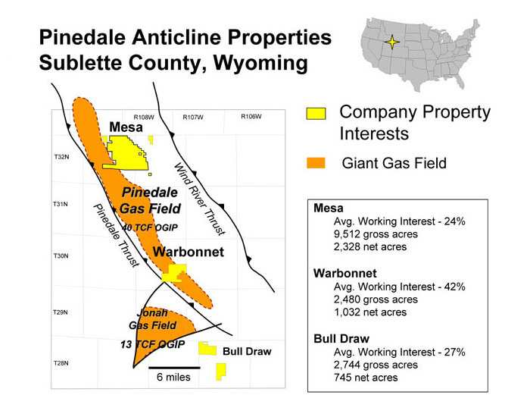
Mesa Big Game Winter Range

Slide 6
Mesa Big Game Winter Range
76,000 acres.
Vegetation consists mainly of Wyoming big sagebrush and various grass communities.
Around 5000 mule deer originally migrated 60 to 100 miles from surrounding mountain ranges to winter in this area.

Slide 7
Habitat Loss on the Mesa
Direct Habitat Loss
Indirect Habitat Loss
Caused by the building of well pads and roads
1,857 acres lost due to well pads only.
83% of the total habitat loss in due to well pads, and the other 17% is due to access roads.
The area around the wells that the mule deer will not utilize even though it is still viable habitat.
Deer only utilize habitat that is 3.2 km away from well pads on average.
Leads to massive amounts of habitat loss

Slide 8
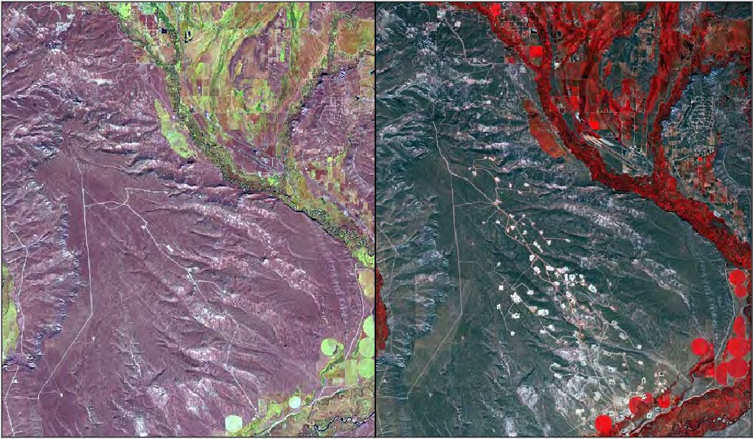
Habitat loss and fragmentation on the Mesa 1999 (Left) compared to 2009 (Right) (Sawyer 2010).

Slide 9
Change of Winter Habitat
Studies show that the abundance of deer utilizing the area has shifted since development began.
41% of the areas that were classified as high abundance have now decreased to medium or low.
40% of the low density areas before production have became high density areas of the wintering mule deer populations.

Slide 10
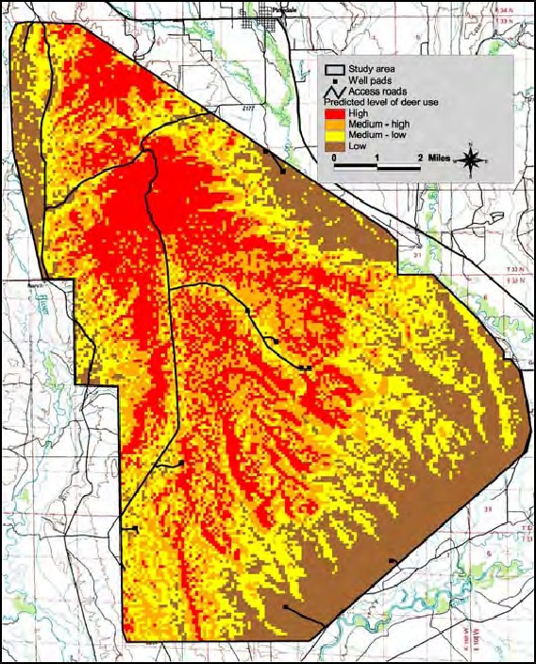
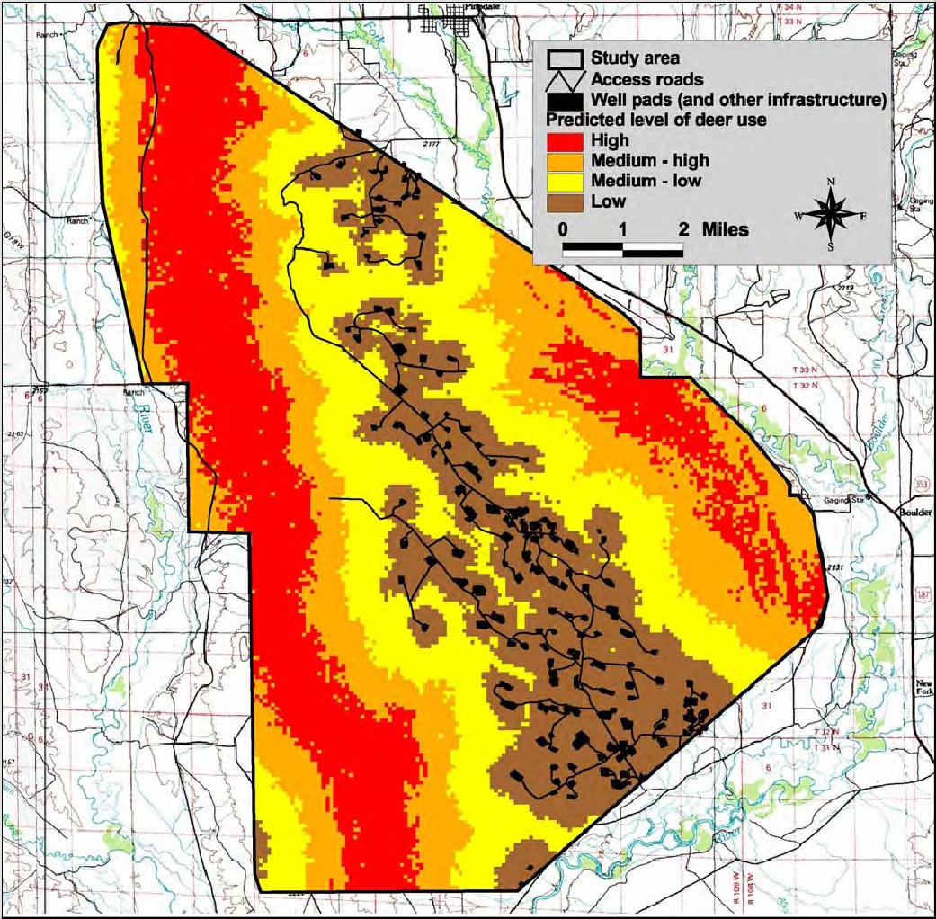
Mule deer habitat use in 1999
Mule deer habitat use in 2009

Slide 11
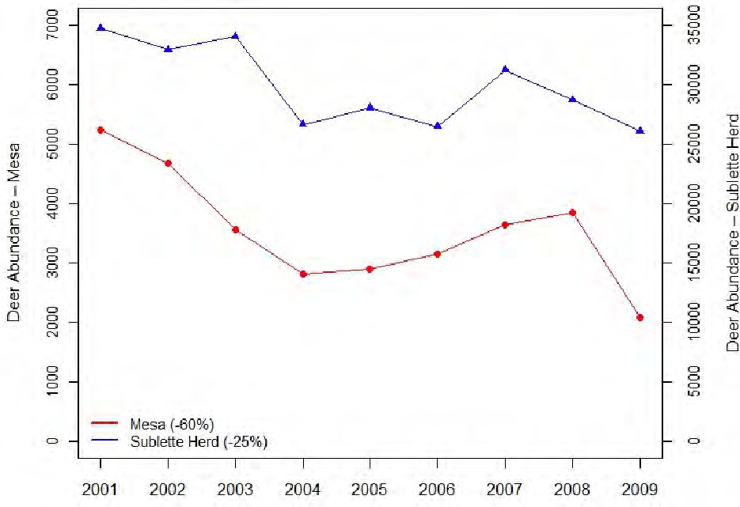
Decline of Deer Populations
The number of deer utilizing the Mesa has decreased by 60%
5,000 deer in the winter of 2008 and only 2,000 deer in the winter of 2009.

Slide 12
Management Implications
1. Utilize Directional drilling.
Directional drilling wells are able to access numerous gas pockets.
Each directional well pad disrupts 12-20 acres, but reduces the number of well pads needed along with access roads.
2. Implement strict seasonal drilling restrictions
Shut down gas production on the Mesa in the winter and do not allow any human access.

Slide 13
Letter of Concern
My letter of concern was sent to Representative Jim Roscoe from Wyoming House District 22.
He responded saying that the BLM is currently working on mitigation actions to help the deer population in this area recover, but “everyone involved is just waiting to see what they decide to do”

Slide 14
Works Cited
Wyoming Game and Fish Department. Recommendations for Development of Oil and Gas Resources Within Important Wildlife Habitats. Agency Report. Cheyenne, Wyoming, April 2010.
Sawyer, Hall, et al. "Winter Habitat Selection of Mule Deer Before and During Development of a Natural Gas Field." Journal of Wildlife Managment (2006): 396-406.
Sawyer, Hall, Matthew Kauffman and Ryan Nielson. "Influence of Well Pad Activity on Winter Habitat Selection Patterns of Mule Deer." Journal of Wildlife Managment (2008): 1052-1061.
Sawyer, Hall, Ryan Nielson and D. Strickland. Sublette Mule Deer Study (Phase 2). Monitoring plan for the BLM, Wyoming Game and Fish, and Questar Exploration and Production. Cheyenne, Wyoming: Western Ecosystems Technology, 2009.
Sawyer, Hall, Ryan Nielson. "Mule Deer Monitoring in the Pinedale Anticline Project Area 2010 Annual report." (September 14, 2010).
Wyoming Game and Fish Habitat Extension Services. "Mule Deer Habitat Extension Bulletin ." October 2002.
Williams, Peggy. "The Pinedale Anticline." Oil and Gas Investor (2001): 1-5.

