Slide 1
Conservation of Harp Seals
Harp Seals and the Canadian seal hunt
By Haylie Cox and Steffani Geary

Slide 2
About the seal
Ice flows are essential to the breeding and nursing of seals.
  Because of ice decreasing, the percentage of pregnant females dropped from 90% in the 1980’s to 70% in the 1990’s.
Diet consists of polar cod, herring, halibut and small crabs.
  Polar cod are now listed as endangered
Male reach sexual maturity around 7-8 years of age, females around 4-6 years.
  Current population is about 5.8 million worldwide
  Pups produced yearly is about 991,400 in Canada

Slide 3
Overview of the hunt
Each year, Canadian fisherman kill hundreds of thousands of Harp Seals.
Harp Seals are targeted between the ages of 2 weeks and 2-3 months. (it’s now “illegal” to kill them before 12 days of age)
The biggest controversy surrounding the hunt is the method with which they are killed.
  They are clubbed, hooked, and dragged.
  Many are still alive and conscious during the skinning process, despite what Canadian officials claim.

Slide 4
This year’s hunt
Quota for 2009 was set at 280,000
Fisherman who did not meet their quota in 2008 are allowed to kill an additional 13,095 pups
30% of pups will be killed in the Gulf of St. Lawrence, where concern has been expressed about diminishing ice flows.
  Gulf of St. Lawrence is also one of the main birthing grounds in Canada.

Slide 5
Gulf of St. Lawrence
Gulf of St. Lawrence is one of the main birthing/nursing grounds in Canada.
Remember, 30% of the seals of the seal hunt are killed at the Gulf of St. Lawrence.
With that in mind:
  Pup mortality: 220,000 pups died due to poor ice conditions in 2006 (75% mortality rate for 12 days of age and under)
  Ice conditions are worsening.
  If ice conditions continue to worsen, there will be 100% pup mortality rate.

Slide 6
Gulf of Lawrence
Canada continues to oppose the findings of scientists:
  Pup production is low, but they believe it to be scientists’ bias.
  “Ice conditions in the North Gulf are better than ever, so there is no reason to think that it would have a high pup mortality in the future.”

Slide 8
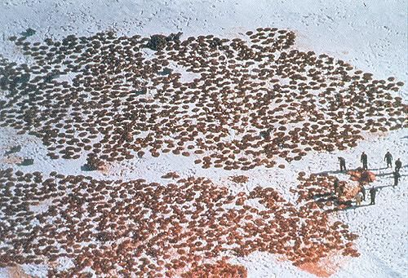
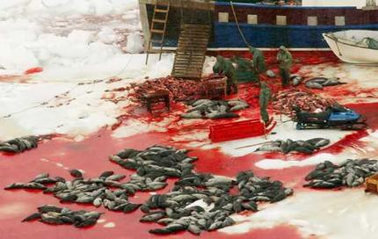
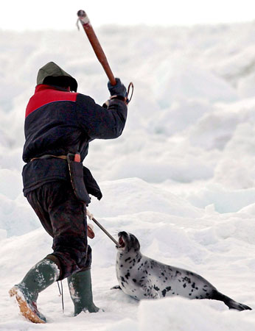
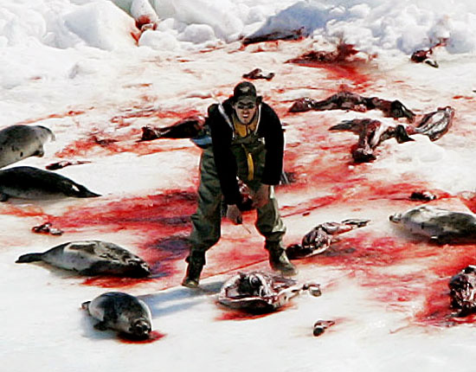

Slide 9
Canada’s conservation management plan
Set up by the Fisheries and Oceans Canada.
The plan is called the “Precautionary Approach,” and its objective is to keep the population around 80% of its current numbers.
  This is why the quota for Total Allowable Catch (TAC) is 250,000-280,000.
  Populations are monitored every 5 years.
Current management results in a low probability that human-induced mortality will cause the stock to decline below that level. –Canadian government

Slide 10
Scientists disagree
“The current monitoring scheme is unlikely to detect management failure until a large proportion of the population is lost.”
The management plan doesn’t account of the struck-and-lost seals.
  For every 1 seal that is killed and reported, it is estimated that almost one (0.82) is lost and unreported, which would result in an additional 45% over the TAC.
“Even if Canada lowers their TAC, it’s unlikely they will achieve their current conservation objective.”

Slide 11
Canadian Government
Populations only surveyed every 5 years
Maintain that killing practices are humane
Deny any stuck-and-lost and illegal activity
Illegal activity (killing before 12 days old, etc.) is recorded, but fishermen aren’t held accountable for it
VS
Scientists, Organizations
Struck-and-lost taken into account
Has been shown that some are alive and conscious when they’re skinned
Scientists have estimated struck-and-lost at 45% over the TAC , which almost doubles the total allowable killed

Slide 12
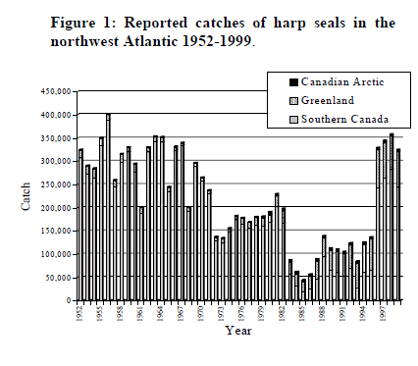

Slide 13
Raw Data
TAC 2009 was 280,000
Scientist estimate struck and lost at 0.82
280000x0.82 = 229,600+280,000
509,600
Lets add in 220,000 harp seal pups that died due to ice conditions
729,600 total pups lost
There were 991,400 pups born in Canada in 2006, lets say the pup population has increased and 1,000,000 pups were born this year
1,000,000-726,600 = 273,400
Probability half will be females 273,400/2 = 136,700 females
Scientist estimate that only 70% of females are giving birth due to poor ice conditions 136,700x0.70 = 95,690 possible births
Does this look like Canada is following their management plan???

Slide 14
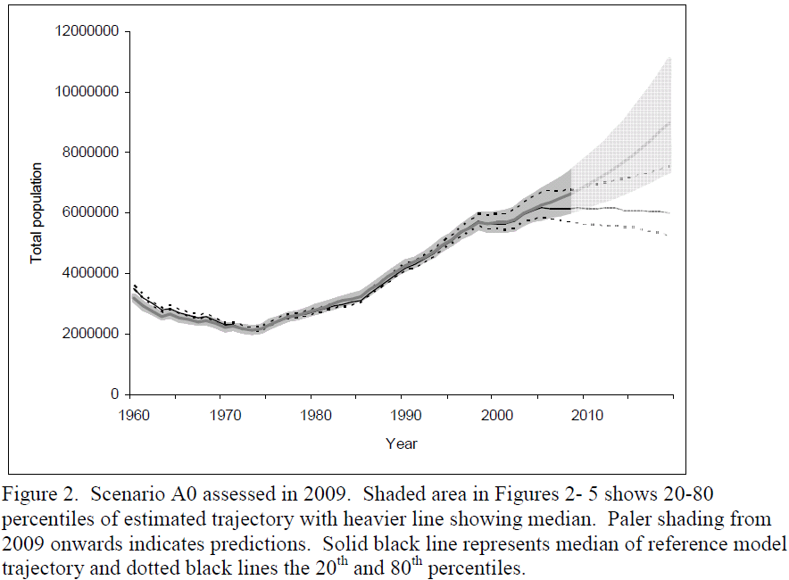

Slide 15
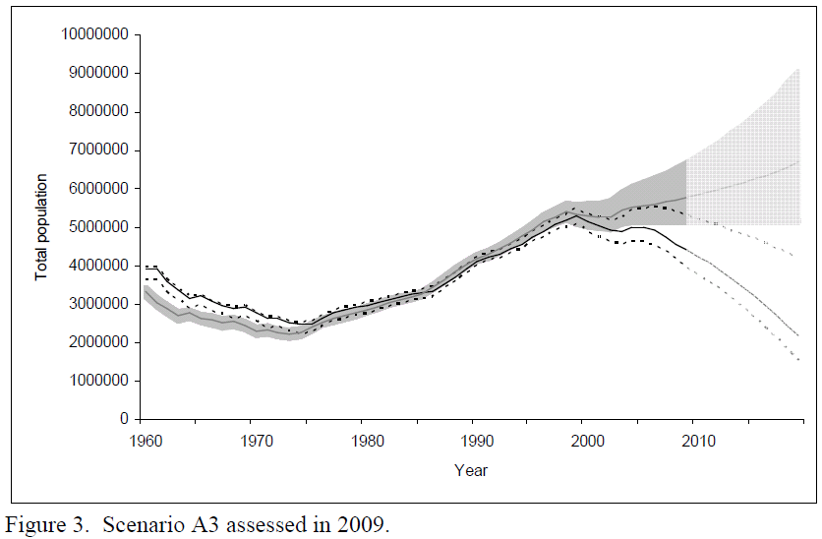

Slide 17
Civic Engagement
Encourage stores, restaurants, etc. to boycott Canadian Seafood.
Write public officials to:
  Put pressure on Canada to stop the hunt, or lower quotas.
  Persuade Canada to use more humane ways of acquiring fur (“combing”).
  Have Fisheries and Oceans Canada set up a better management plan that is followed and met!
Education

Slide 18




Organizations
If you would like more information about the Canadian seal hunt, or to find out how you can help, you can visit these organizations:
  Greenpeace
  Harpseals.org
  PETA
  Humane Society

Slide 19
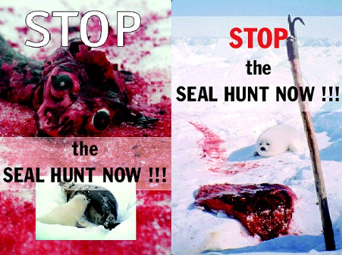

Slide 20
References
www.greenpeace.org
www.harpseals.org
www.hsus.org
http://www.dfo-mpo.gc.ca/media/npress-communique/2009/hq-ac07-eng.htm
http://marinebio.org/species.asp?id=302
http://www.pinnipeds.org/species/harp.htm
DFO. 2000. Northwest Atlantic Harp Seals. DFO Science Stock Status Report E1-01 (2000).
Johnston, D.W., Meisenheimer, P., and Lavigne, D. M. (2000). An Evaluation of Management Objectives for Canada’s Commercial Harp Seal Hunt, 1996-1998. Conservation Biology, 14 (3):729-737.
DFO, 2007. A Review of Ice Conditions and Potential Impact on Harp Seal Neonatal Mortality in March 2007. DFO Can. Sci. Advis. Sec. Sci. Resp. 2007/008.
Lairdre, Kristin L., Stirling, Ian, Lowry, Lloyed F., Wiig, Oystein, Heide-Jorgensen, Mads Peter, and Ferguson, Steven H. (2008). Quantifying the Sensitivity of Arctic Marine Mammals to climate-induced habitat change. Ecological Applications, 18(2): S97-S125.
Lavigne, David M. (1999) Estimating total kill of northwest Atlantic harp seals, 1994-1998. Marine Mammal Science, 15 (3): 871-878.
Leaper, R. and J. Matthews (2008). Implications of uncertainty for Canada’s commercial hunt of harp seals (Pagophilus groenlandicus). Nature Precedings 1798(1):1-23.

