Slide 1

Welcome to Weber!
New Faculty Academy
Kick-off !
July 9, 2020
10:30 a.m.

Slide 2

Schedule
Time | Content | Presenter
10:30-10:35 | Welcome, Session Outcomes | Colleen Packer, TLF Director
10:35 – 10:40 | Welcome to Weber Provost Introduction | Brenda Kowalewski, Associate Provost
10:40 – 10:50 | Welcome to WSU Opening Remarks | Ravi Krovi, Provost
10:50 – 10:55 | Faculty Welcome | Adrienne Andrews, Assistant Vice President for Diversity
10:55 – 11:10 | “Take Action” New Faculty Academy | Colleen
11:10 – 11:55 | Virtual Introductory Activities | Colleen
11:55 – 12:00 | Evaluation/Wrap Up | Colleen

Slide 3
Outcomes
As a result of this session, you should be able to:
Identify some basic facts about Weber State University.
Become acquainted with and identify at least three academic leaders at the University.
Develop connections with your new faculty cohort.
Identify at least one teaching strategy you could use in your teaching this semester.
Compare and contrast…
  teaching competencies you bring to WSU.
  concerns you have about teaching at WSU

Slide 4
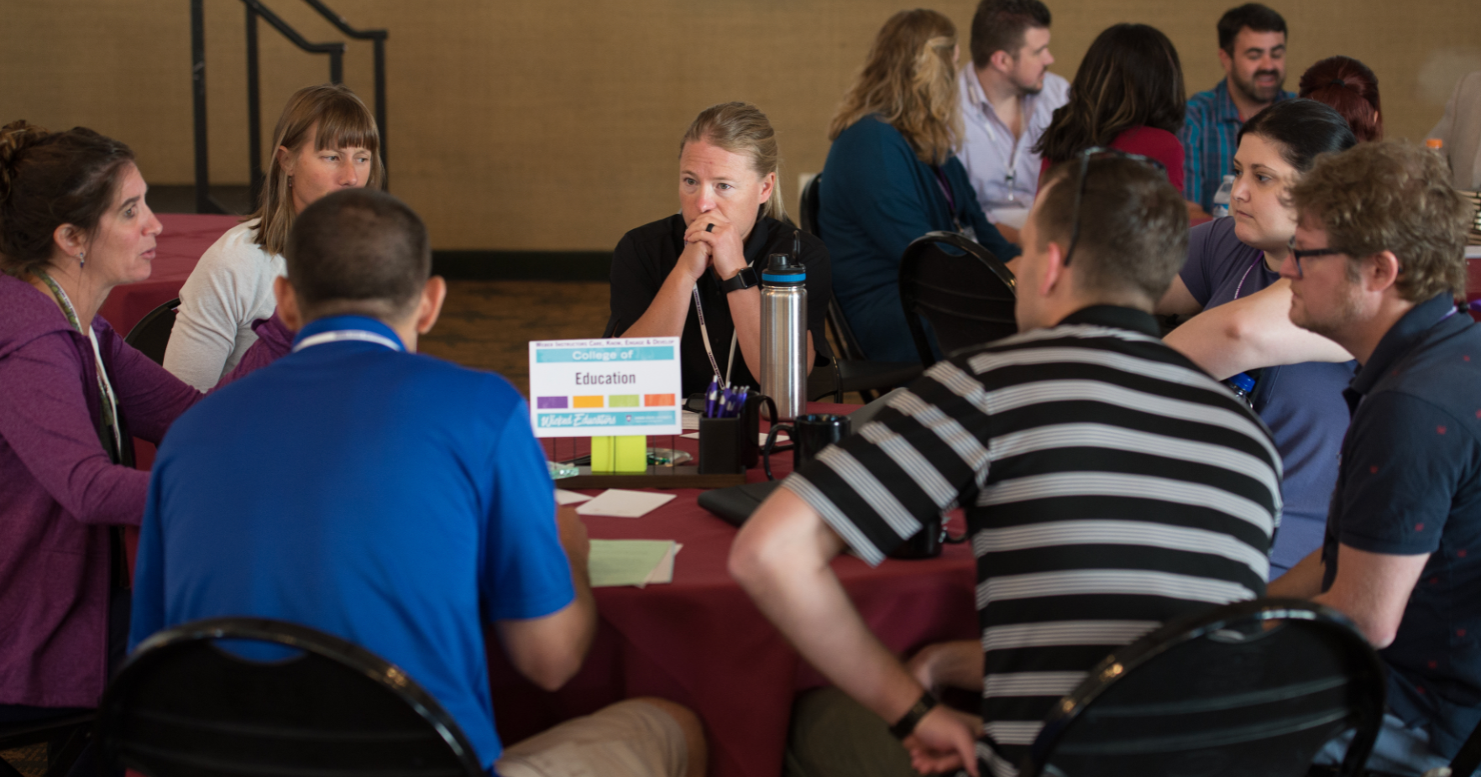
New Faculty Academy

Slide 5
New Faculty Academy
Core Sessions
Teaching
Course Design

Slide 6
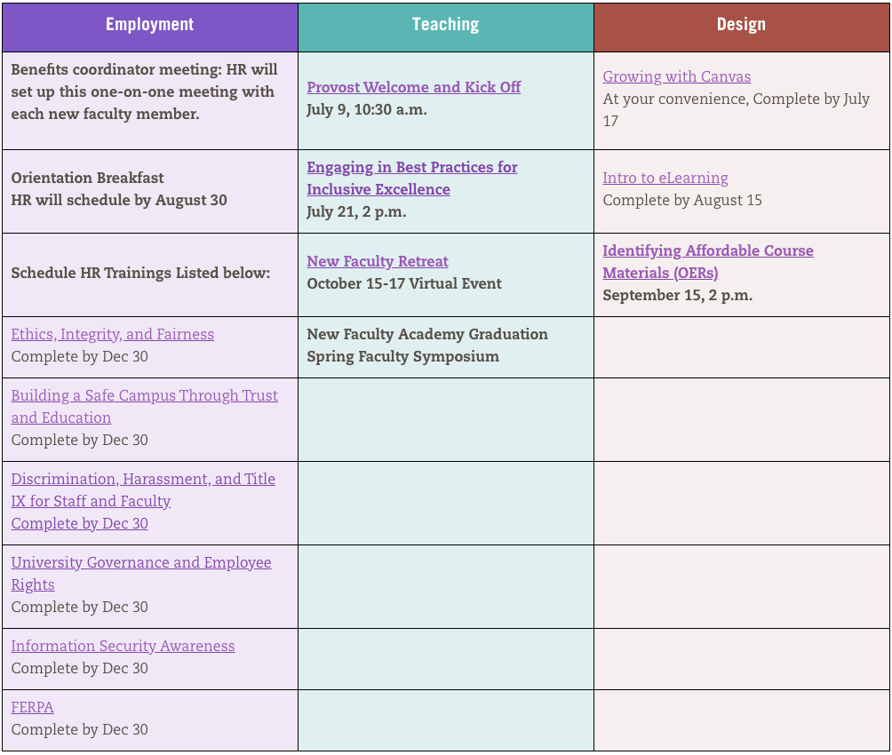
Core Sessions
Complete ALL core sessions by the due date.

Slide 7
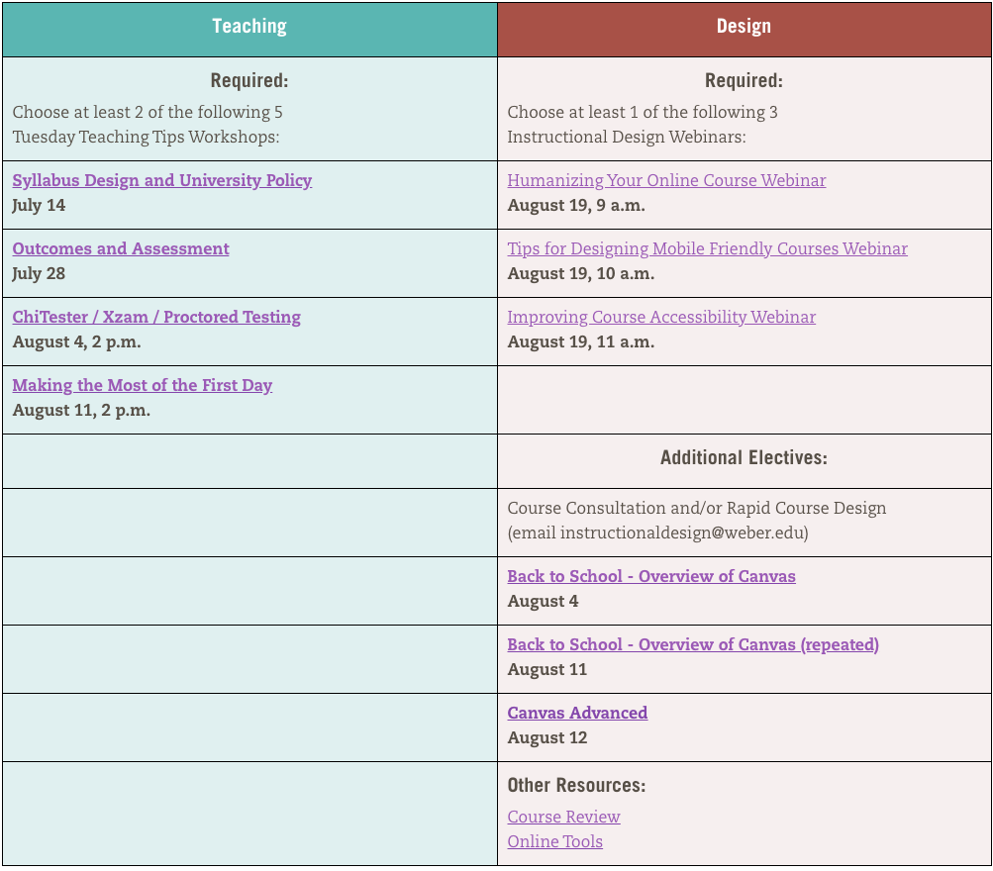
Choose
Your Own Adventure!
Teaching:
Select 2/4
Design:
Select 1/3

Slide 8

What do you know about WSU?

Slide 9
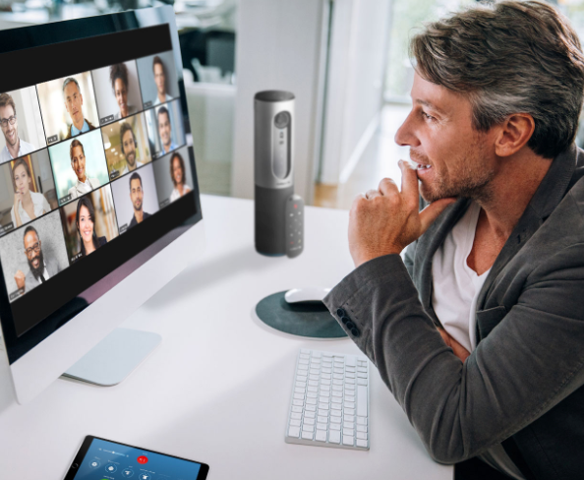
Virtual Icebreaker: 2+4+8
In dyads, you will have three minutes to tell about yourself. Be sure to include something unique or interesting about you.
Remember what your partner said because you will be introducing them to others. Craft a 1-minute “infomercial-type” message based on the information you heard from your partner.
Be prepared to share your 1 minute introductory infomercial about your partner with others.

Slide 10
Virtual Icebreaker: Scroll to Know
The oldest person in the group should get the link for questions from the chat and share their screen showing the questions.
Start scrolling down the page.
Take turns, starting from next oldest to youngest and randomly tell the scroller to ”stop”.
The “stopper” should answer the question that the mouse arrow is pointing to when the scrolling stops. Others can respond if they choose to do so. Repeat the process.
Have fun learning random information about your new colleagues!

Slide 11

Virtual Icebreaker: Thumbs up if….
I will read some statements about things that you may or may not have done.
When I read something that you have done, give us a thumbs up.

Slide 12
Virtual Icebreaker: Teaching Tidbits
The youngest person in the group should look at the questions. The rest of the group members should avoid looking at the document to encourage more spontaneous number selection.
Please limit your responses to one minute each in order for everyone to respond.
Have fun learning about your new colleagues!

Slide 13
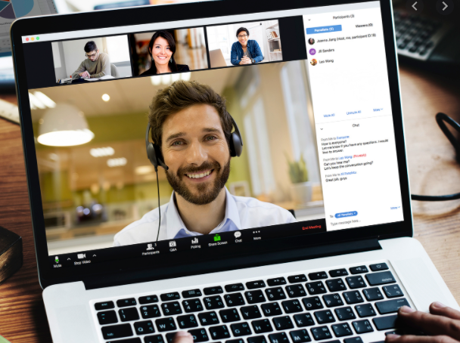
Prompt:
What confidences do you bring to Weber State University?
Write your response in the CHAT.

Slide 14

Prompt:
What concerns do you have about teaching at
Weber State University?
Write your response in the CHAT.

Slide 15

What teaching topics would be useful for your own professional development?
Write your response in the CHAT.

Slide 16
Unpacking the Pedagogy
Classroom Response Systems – Kahoot
Classroom response systems provide an easy way to check on what students have understood from a short lecture, make predictions about material they’ve not yet seen, or the extent to which students are able to apply ideas to a novel question. They can be used to track attendance and class participation. Ask a question that may appear that everyone will have the same answer – but when the results come in, students find that not everyone thinks the same as them. This can lead to a robust discussion.
Icebreakers
Guidelines for Using Icebreakers
•Use icebreakers that facilitate familiarity.
•Use “non-cheesy” icebreakers.
•Avoid having students take massive social risks with people they barely know.
Brainstorming
Brainstorming is an activity in which students list their ideas about a specific concept or topic as quickly as they can without stopping. Brainstorming is a great activity for having students demonstrate what they already know about the topic and can help students develop ideas for solving a problem. Brainstorming also encourages creativity by providing a variety of topics for later discussion (Major, Harris & Zakrajsek, 2016, pp. 215-217).
Small Group Discussion
Students work together in small groups of four to six students to discuss a topic. Small groups may be used in a class of any size. Although having a classroom with tables facilitates small group discussion, tables are not necessary, and many faculty successfully use small groups in fixed-seat auditoriums. Research points to the notion that smaller groups for discussion may lead to greater outcomes in student learning when compared to students who participate in whole class discussion. (Major, Harris & Zakrajsek, 2016, p. 45)

Slide 17
Upcoming Events
Date | Time | Topic
Tuesday, July 14 | 2:00 | Syllabus Design and University Policy
Wednesday, July 15 | 1:00 | Teaching with Zoom (Hands-on Session)
Tuesday, July 21 | 2:00 | Inclusive Excellence
Tuesday, July 28 | 2:00 | Outcomes & Assessment
Wednesday, July 29 | 1:00 | Teaching with Google Meets & Big Blue Button (Canvas). (Hands-on Session)

