Slide 1


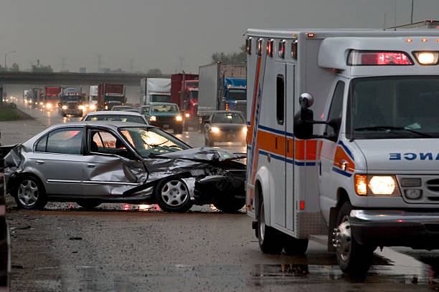


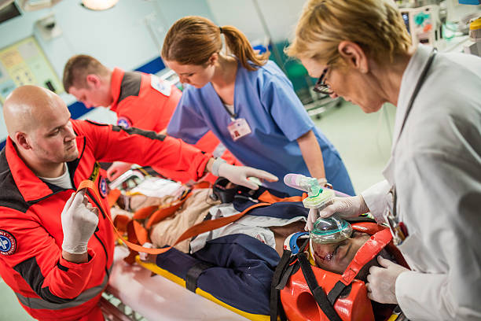
Trauma Nursing in the Baccalaureate Program
Mitchell Standing, MSN, RN, CEN, TNCC; Deon Openshaw, MSN, RN, TNCC
METHODS
Students will improve their ability to manage trauma patients through study and application of authentic learning activities. Students will:
Background:
Traumatic injury is a leading cause of morbidity and mortality. Trauma is a complex and demanding subspecialty of nursing. While most of the focus of trauma training is for ER and ICU nurses, (often months after they are hired) lower acuity specialties receive little to no trauma focused training, even though they receive these patients. Complications from traumatic injuries can develop hours to days post-injury, and the need for rehabilitative care can extend for months after. Providing care for traumatically injured patients requires critical thinking and collaboration as a member of a care team.
PURPOSE
The trauma nursing course will teach students how to evaluate, care for, prevent/mitigate further injury to, and collaborate in the care of trauma patients. The course strategy includes authentic learning methods to promote real-world critical thinking and confidence within the trauma care team.
SUMMARY
Using these authentic learning strategies, students will learn how to approach trauma nursing in a uniform and systematic way that maximizes the effectiveness of interventions. Students in multiple disciplines will also gain a greater understanding of how each group functions, their capabilities, and limitations.
Create a case study based off of a fictional character. Students will choose a fictional character who sustained a traumatic injury and investigate what kinds of injuries this patient sustained.
Learn trauma specific assessment methods, such as A-I and Glasgow coma scale.
Designing a trauma sheet. Students will build a trauma sheet and fill it with details specific to their chosen trauma patient.
Study traumatic injury by body system. Student will study injuries based on body system and see how these injuries may or may not apply to their patient.
Evolve the case study. Once the trauma chart is completed, students will pass their patient off to another group, who will write up a complication and the management of that complication based off of the patient’s injuries.
Interact with other disciplines. Through the course, students will have the opportunity to share their case study with students from other disciplines. These students will describe to the nursing students what their goals will be and how they would carry them out. This will enable discussion between the groups about how best to coordinate care for optimal patient outcomes.
Explore unique populations. Students will watch recorded experts and study about how to manage traumatic injuries for obstetric, geriatric, pediatric, and bariatric patients.
References
Sweet, V. (2018). Emergency Nursing: Core Curriculum (7th ed.). St. Louis: Elsevier
Centers for disease control and Prevention. (2022, September 6). FASTSTATS- leading causes of death. Centers for Disease Control and Prevention. Retrieved December 8, 2022 from https://www.cdc.gov/nchs/faststats/leading-cause-of-death.html
Liu, H. –Y. (2021). Effect of interdisciplinary teaching on collaborative interactions among nursing student teams in Taiwan: A Quasi-Experimental Study. Nurse Education Today, 106, 105083. https://doi.org/10.1016/j.nedt.2021.105083
Teixeria Lopes, M. C., de Aguiar, W., & Yamaguchi Whitaker, I. (2019). In-hospital complications in trauma patients accordin to injury severity. Journal of Trauma Nursing, 26(1), 10-16. https://doi.org/10.1097/jtn.0000000000000411
Sheff, Z. T., Engbrecht, B. W., Stone, J., Kleumper, J., & Conley, S. (2022). Evaluation of a nursing-focused training and education stragety for a facility transitioning to a level 1 pediatric trauma center. The Journal of Continuing Education in Nursing, 53(9), 405-410. https://doi.org/10.3928/00220124-20220805-06

