Slide 1
Writing for the Web
Presented By
Sara Lleverino & Georgia Ferguson

Slide 2
Why is Web Writing Different?
Visitors are in a hurry
Visitors come with a task in mind
Text is harder to read on a screen

Slide 3
5-Second Rule
What are the following pages about?
Notes:
You’ll have 5 seconds to scan the content.

Slide 4


Slide 5
What was the content?

Slide 6
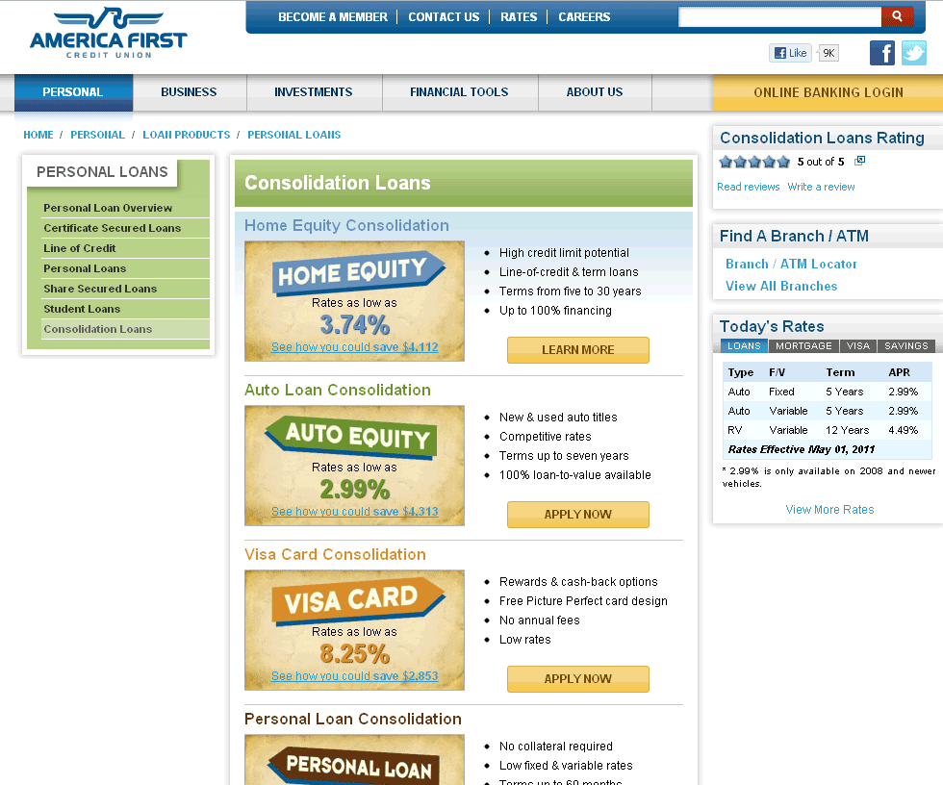

Slide 7
What was the content?
Notes:
Mention fivesecondtest.com

Slide 8
Scanning Content Faster
Why could you tell me more about the 2nd page?

Slide 9
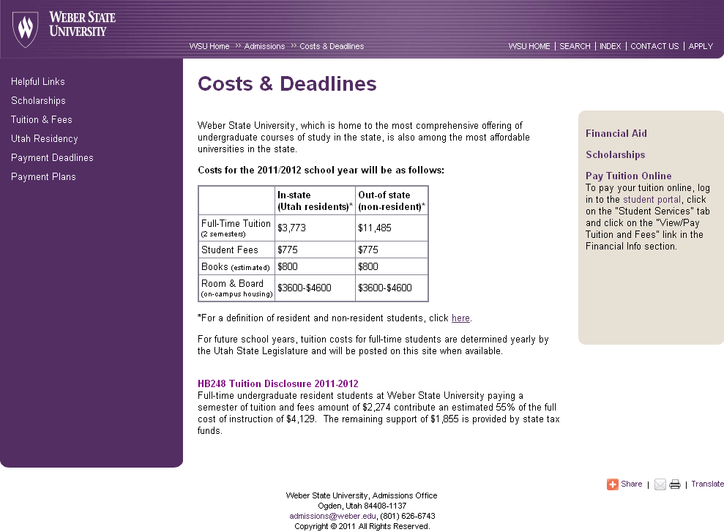
Elements You See First
Title
Table
Links
Heading

Slide 10
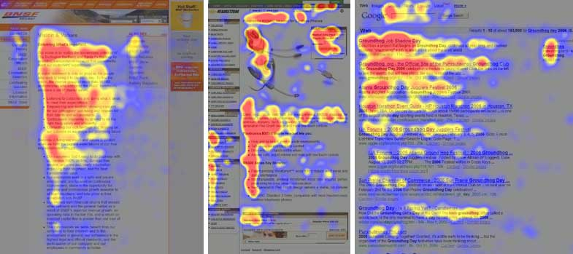
“F” Pattern
Notes:
Based on eye-tracking devices, visitors generally scan the page in a typical “F” pattern. The pattern is created by the user scanning the title of the page and then scanning down and reading the headers of each section. There will also be spots where users have sometimes looked in the right-hand column of the page, although that area is usually scanned after the title and headings.

Slide 11
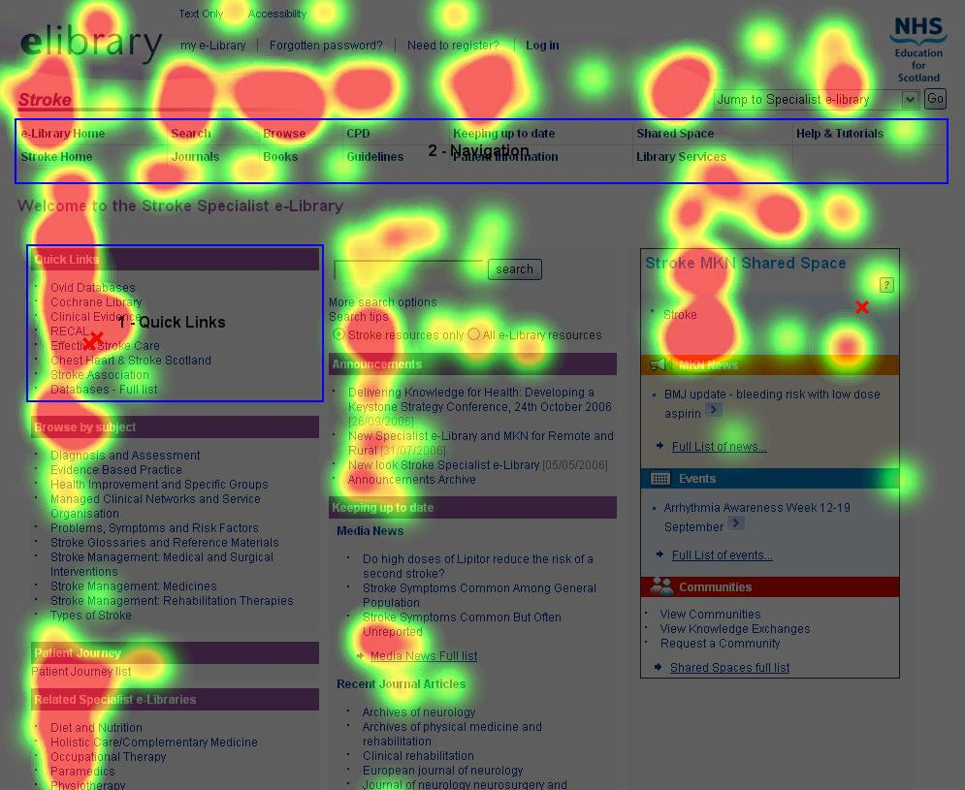
“F” Pattern
Notes:
The pattern isn’t reserved for an exact spot on a page. It occurs within the main content area of the page. Notice how the pattern appears here within each column, although the first column is most heavily viewed.

Slide 12
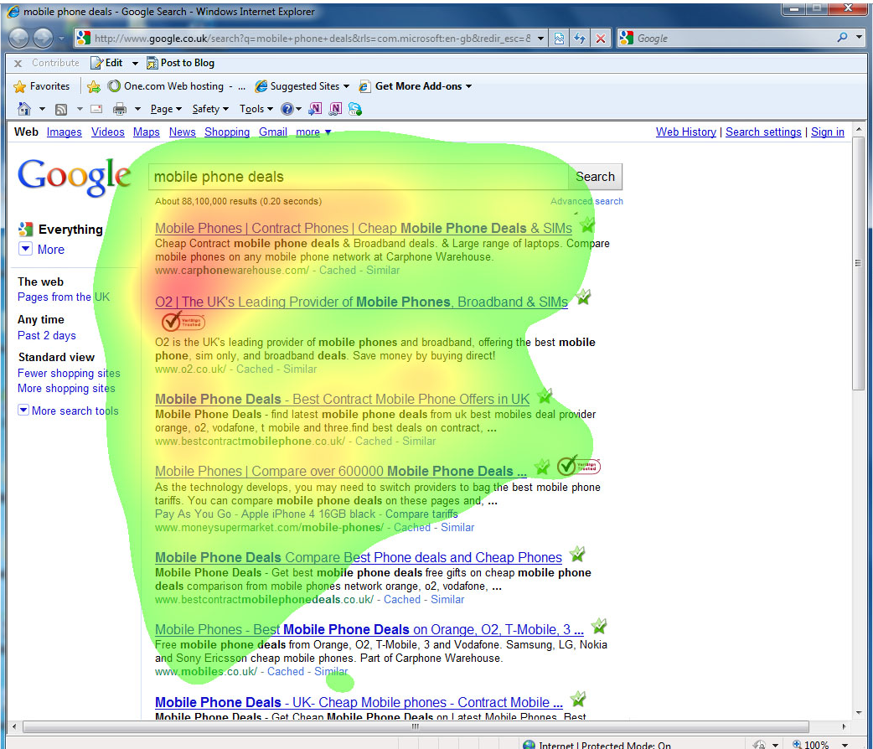
“F” Pattern
Notes:
Here the pattern is concentrated within the content area. Also notice how the items toward the top are more heavily viewed than those further down.

Slide 13

9 Guidelines For
Ninja-Like Content

Slide 14

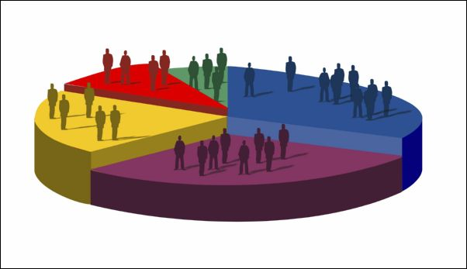


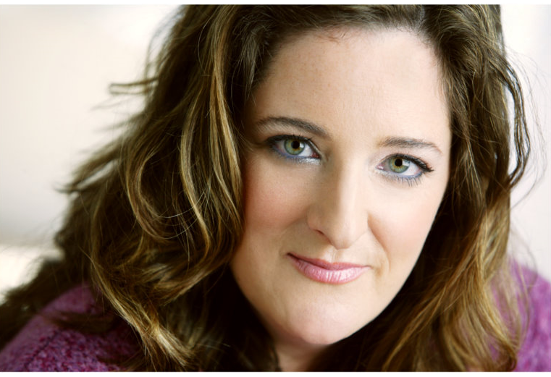
1. Determine Audience
Notes:
Cell phone companies were marketing a fancy phone to higher-ed professionals just to find out it was teenagers who were actually buying the phone.
Choose 1-3 primary audiences (preferably one) Because you can’t be all things to all people. How?
Who’s registering?
What are their demographics?
What time of day are they visiting?
What browsers are they using?
Who do you think this will appeal to?

Slide 15
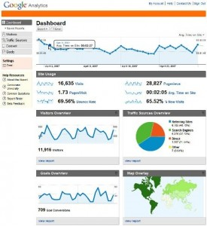
We have a stat for that

Slide 16

2. Create Personas
What’s the persona’s name?
What’s his/her age?
Marital status?
Career?
Hobbies?
Reason for coming to the website?

Slide 17

Persona 1

Slide 18
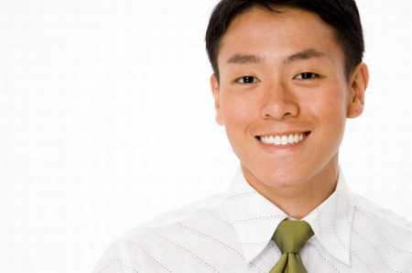

Persona 2

Slide 19

Persona 3

Slide 20
3. Content
Why Do Users Come to your site?
  Perform a specific task; Make it easy to find their answer
  Use the 80/20 rule
What Questions Do My User Have?
  Think of your site like an information booth
  Make a list of your most common questions
  Use the information you’ve gathered to create Personas
Volunteers?
Notes:
Information Booth: if a user walked up to your information booth and asked you a question, you would want to answer their question as directly as possible without a lot of runaround.
Ask a volunteer to answer these questions about their own site.

Slide 21
4. Consider the Keywords
Cloze Test: A way to delve into the twisted minds of your users
Analytics & Other Tools

Slide 22
Cloze Test 1
The admissions office will ___________ your application and will ____________ you if you are required to take a placement exam __________ to signing up for classes. A placement exam is a _________ test to ___________ your knowledge and skills in certain ___________. It's our way of making sure you don't end up taking __________ you don't need.
1
2
3
4
5
6
7

Slide 23
Actual Wording
The admissions office will process your application and will notify you if you are required to take a placement exam prior to signing up for classes. A placement exam is a simple test to gauge your knowledge and skills in certain subjects. It’s our way of making sure you don’t end up taking classes you don’t need.

Slide 24
Cloze Test 2
Weber State is a(n) ______________ university. You must submit your high school ___________ or equivalent documentation to be considered for ___________. ACT/SAT scores are not required, but will help determine your ________________ in Math and English ________________.
1
2
3
4
5

Slide 25
Actual Wording
Weber State is an open-admission university. You must submit your high school transcript or equivalent documentation to be considered for enrollment. ACT/SAT scores are not required, but will help determine your placement in math and English courses.

Slide 26
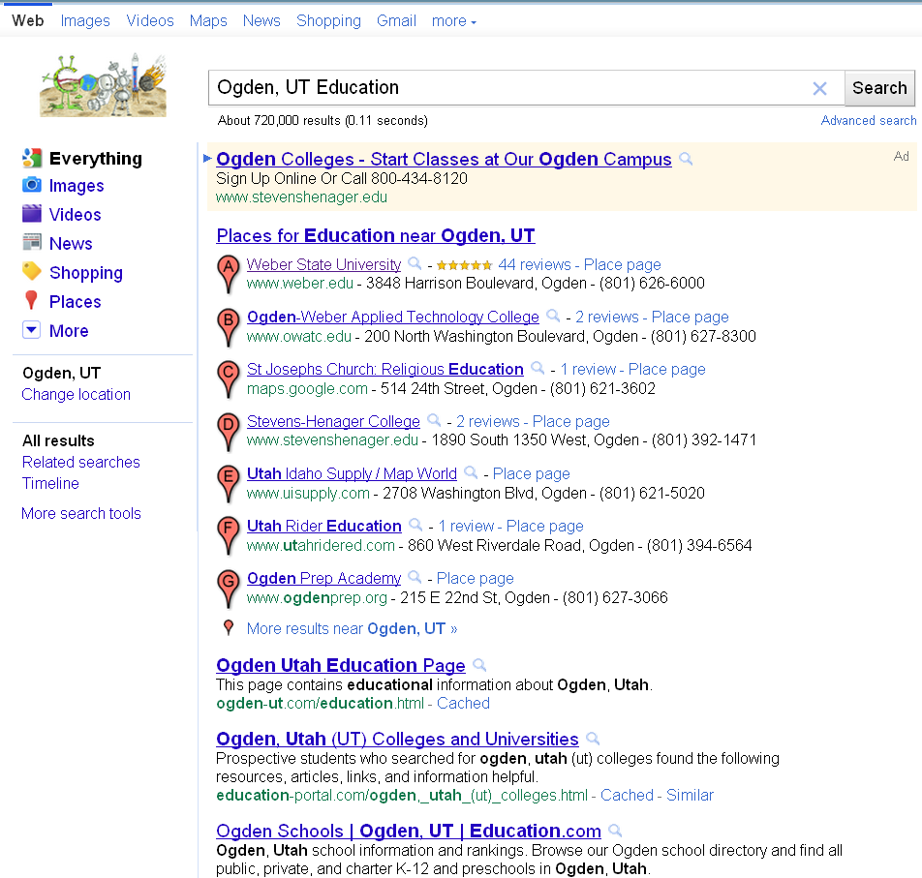
SEO(Search Engine Optimization) & Keywords
What makes a good keyword?

Slide 27
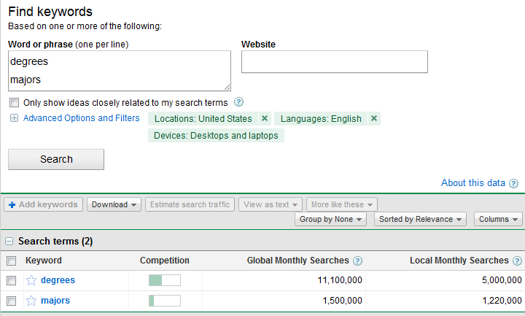
Google Keyword Tool
adwords.google.com/select/KeywordToolExternal
  Compares popularity of words and phrases

Slide 28
5. Write Good Titles & Headings
Headings That Work
Headings That Don’t Work
Calls to action
  “Register for the Conference”
  “Sign up for a Class”
  “Pay Your Tuition”
Clear Statements
  “Withdrawing From a Class”
  “How to Pay for Your Class”
  “Applying for Financial Aid”
Questions Users Might Ask
  “What is Self-Paced?”
  “How do I Apply for Financial Aid?”
  “What is Chi-Tester?
Internal names, ambiguous words, clever titles
  “Program Administration”
  “Faculty” (is this for faculty or about faculty?)
  “Wildcat Learning”
Notes:
With each of your headings and titles, it is critical that they contain the keywords your users are looking for.

Slide 29

6. Write Scannable Content
Get right to the point
  Think “topic” not “book”.
No fluff – less is more
  Follow the 80/20 rule. Put up what
  80% of your visitors are there for.
I don’t need all this. How do I find just the part I need today?

Slide 30
6. Write Scannable Content (cont…)
Most important content first
Easy-to-scan formatting
  Tables
  Lists
  Charts/graphs

Slide 31
Six guidelines for focusing on your essential message
Give people only what they need.
Cut! Cut! Cut! And cut again!
  Cut out words that talk about your organization
Start with the key point. Write in inverted pyramid style.
Break down walls of words
Market by giving useful information.
Layer for different needs.

Slide 32
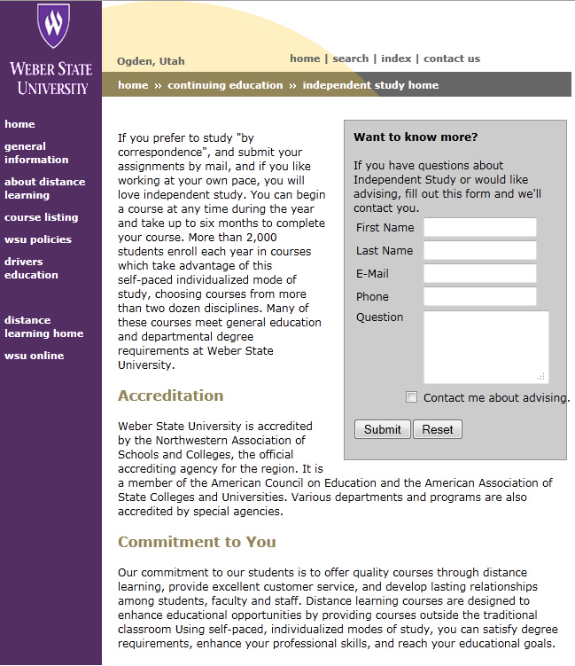

Before
Giant block of text to wade through
Do the visitors really care about this? Probably not.
This should be obvious
Should this be home page content? (80/20 rule)
Notes:
This website was created from an archive of information that was simply copied and pasted up on the web.

Slide 33
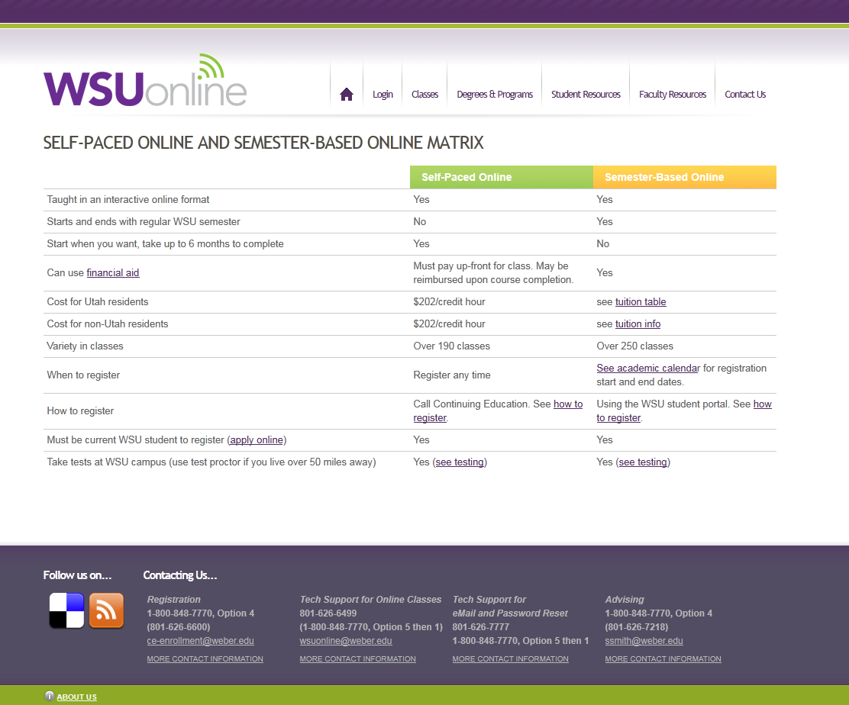

After – no fluff
Easily Scannable
Accreditation info layered onto another page

Slide 34
7. Use Semantics
Mark items appropriately
  Headings
  Table headers
  Lists
Does the document make sense without any styles applied?
  Think of an outline for a report
Notes:
To comply with web standards and accessibility, items on your web page need to be properly marked (coded). The title of the page should be a “heading 1.” The top-level headings within the document should be marked as “heading 2.” Headings under those should be “Heading 3,” etc.
The idea is that the structure of your document makes sense not only to a screen reader who can’t see the style of your layout, but it also makes sense to a search engine.

Slide 35
8. Write to One
Write like you are talking to one person (In the second person like a conversation)
Write for a lower comprehension reading level

Slide 36
9. Review Before Publishing
Proofread!
  Spelling
  Grammatical errors
  understanding
Notes:
You should proofread your stuff not only to make sure it’s accurate, but to make sure it’s clear. Better yet, have someone else do it.

Slide 37
Other Ninja Tips
Don’t use “click here”
  “To see a list of online courses, click here.”
  “Online Courses” (keywords should be linked)
Don’t use offensive colors to draw attention
  Red text
  Lime green backgrounds
  Etc.
Layer your websites. The home page is a gateway page.
Be positive!
Notes:
Writing for a lower reading comprehension makes it easier to read and scan quickly even if the user is capable of higher-level reading.

Slide 38
Other Ninja Tips
Don’t write in all capitals
Don’t underline anything but links. Use italics sparingly.
Use a sans-serif font
Write in active voice (most of the time)
On the web, a one-sentence paragraph is fine but lists and tables may be better.
Don’t center text
Allow breathing room (white space) between topics
Photos should be relevant
Notes:
Writing for a lower reading comprehension makes it easier to read and scan quickly even if the user is capable of higher-level reading.

Slide 39
Blog Writing
“If people aren’t talking about you, they’re not talking about you for a reason. And the reason isn’t that they dislike you. They’re not talking about you because you’re boring.” ~ Seth Godin

Slide 40
Tips for blog writing
Choose the right topic for your target audience. Use your personas and write to them!
  http://www.chinesedrywallproblem.com

Slide 41
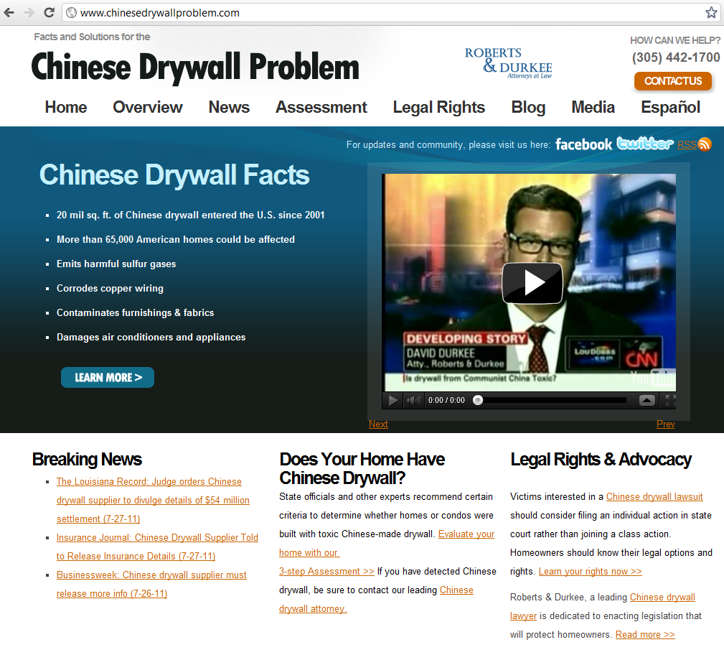
Notes:
This website was originally a blog post about Chinese Drywall from a law firm. It became such a heavily hit blog post that they created an entire site about it with blog posts related to it (more opportunities for search engines to pick it up). It resulted in huge success for the law firm.

Slide 42
Create calls to action
If you want people to comment, invite them to do it.
If you want people to subscribe, don’t assume that they’ll think to do it themselves, ask them to. If
If you want people to buy something – give them a way to do it.
If you want people to come back tomorrow, give them some motivation to do so and show them how to remind themselves.
If you want a vote on Digg or StumbleUpon – ask.

Slide 43
Transforming Text-Heavy Content
Read document thoroughly to get main points
Highlight keywords
Make short lists of main points leaving out all fluff
Make headings for main points
Could text be presented with lists, tables, boxes, etc?
Create your content then leave it and read it again another day

Slide 44
Text-Heavy Content
Transfer Students
Whether you’ve graduated from a two-year college or are making a move from another university, it’s important to find the right place to complete your degree.
With more than 215 undergraduate majors—the largest and most comprehensive offering in the state—and an increasing number of master’s programs, Weber probably has the degree you want. There’s even a way to design your own program of study. For a list of available programs of study, click here.
Is Weber the right fit for you? Browse this site for the information you need to get ready and get into Weber. We want you to succeed in this journey. Please contact us at (801) 626-6050 or at recruit1@weber.edu with any questions that you may have. We are here to help.
Would you like to come and check out WSU in person? Click here to schedule a campus visit. Or come chat with us as we visit the following schools:
Dates and times TBD.
Ready to apply for admission to WSU? Click here!

Slide 45
Web Friendly Format
Transfer Students
Majors, Minors, Degrees & Programs
Majors and minors
Certificates
Flexible degree options
Master’s programs
Contact Us
(801) 626-6050
recruit1@weber.edu
Interested In Campus?
Schedule a campus visit
Chat with us as we visit the following schools:
More than
215
Undergraduate Degrees
Apply for Admission
School | Date | Time
Morgan High School | May 11, 2011 | 7:30 AM
Ben Lomond High School | May 12, 2011 | 7:30 AM
Northridge High School | May 13, 2011 | 7:30 AM
Bonneville High School | May 16, 2011 | 7:30 AM
Fremont High School | May 17, 2011 | 7:30 AM
Notes:
No fluffy, meaningless text
No paragraphs

Slide 46
Your Turn
Rewrite the provided text.
If you would include information that you don’t have available, just make a note of what you would add (or make it up for this exercise)
Notes:
Hand out exercise sheets and paper/pens. Work with others if you would like.

Slide 47
Keep your personas in mind
Think of the persona that is appropriate for this web page
  Since we don’t know for sure, make an educated guess for this exercise.

Slide 48
http://bit.ly/iDPGe9
This link contains the text
for the writing exercise
(also provided in your handout)

