Slide 1
2019 Dean & Department Chair Retreat

Slide 2
Environmental
Scan

Slide 4
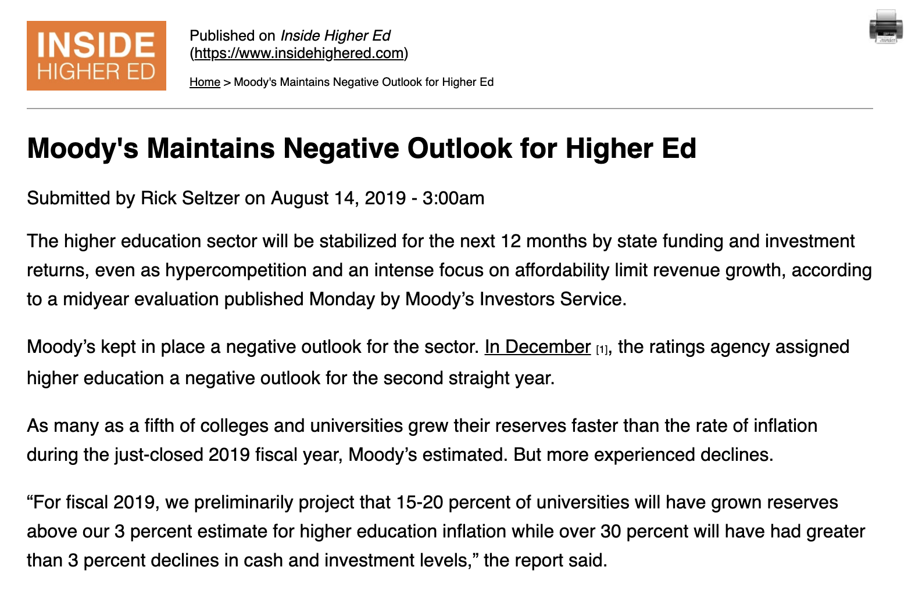

Slide 5
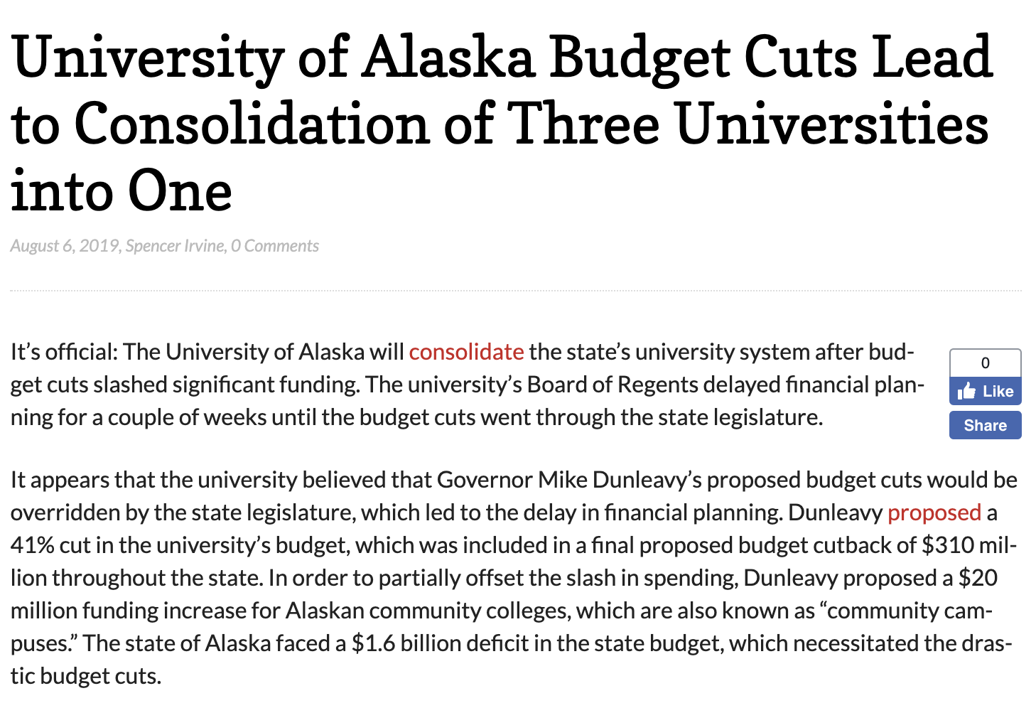

Slide 6
Credit Hours | SUU Original Tuition/Fees | SUU Revised Tuition/Fees | SUU % Change | WSU Tuition/Fees | Above/Below SUU
3 | $1,277.75 | $900.00 | -42.0% | $1,064.09 | $164.09
6 | $2,360.75 | $1,800.00 | -31.2% | $1,787.48 | -$12.52
9 | $3,443.75 | $2,700.00 | -27.5% | $2,510.87 | -$189.13
12 | $3,888.75 | $3,600.00 | -8.0% | $2,993.13 | -$606.87
15 | $4,041.75 | $3,900.00 | -3.6% | $2,993.13 | -$906.87

Slide 8
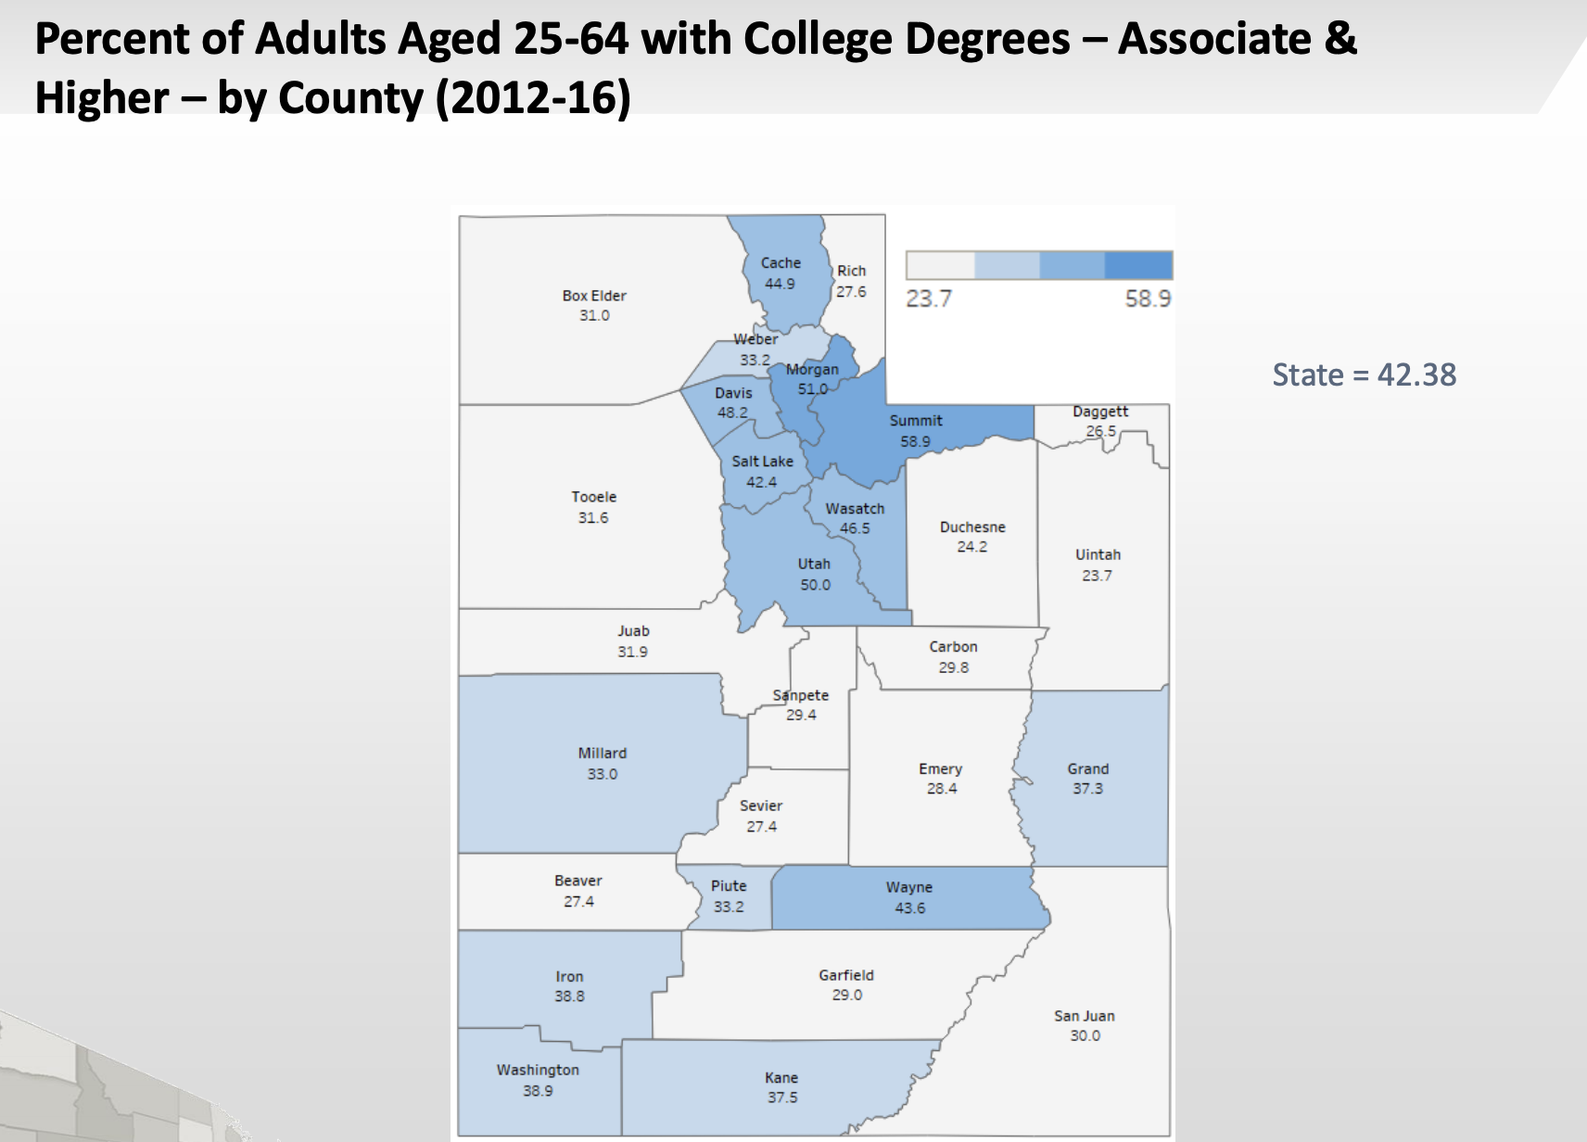

Slide 9
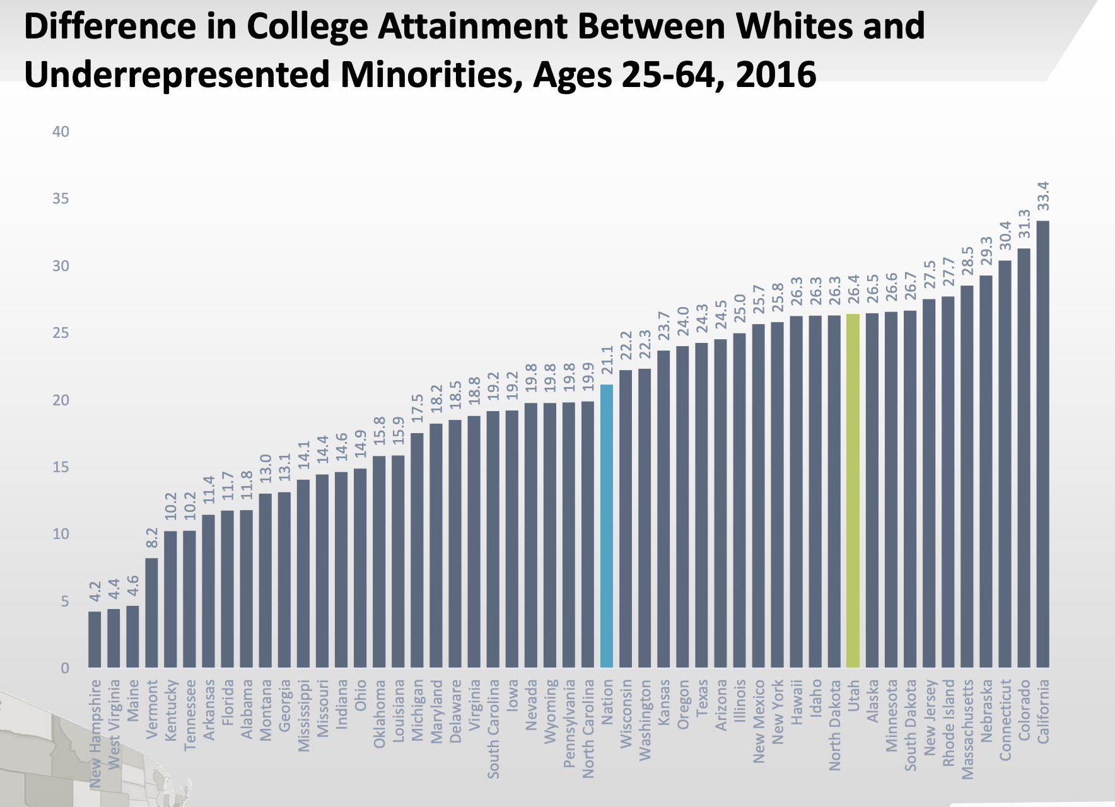

Slide 10
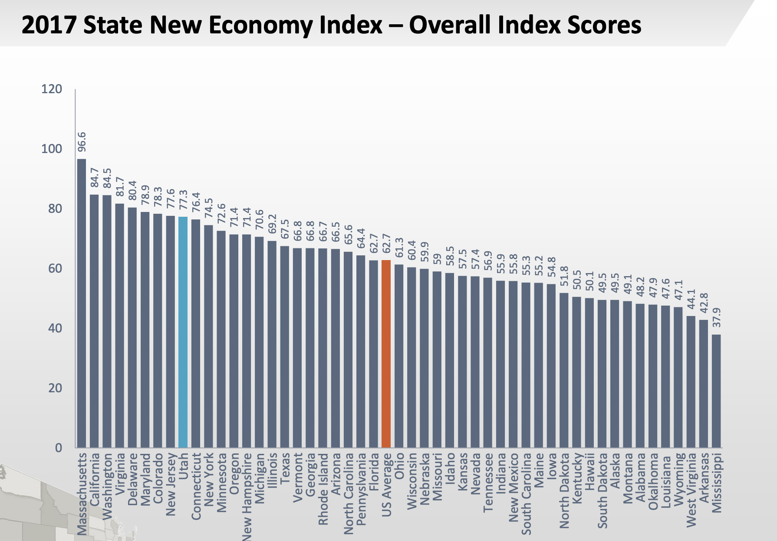

Slide 12
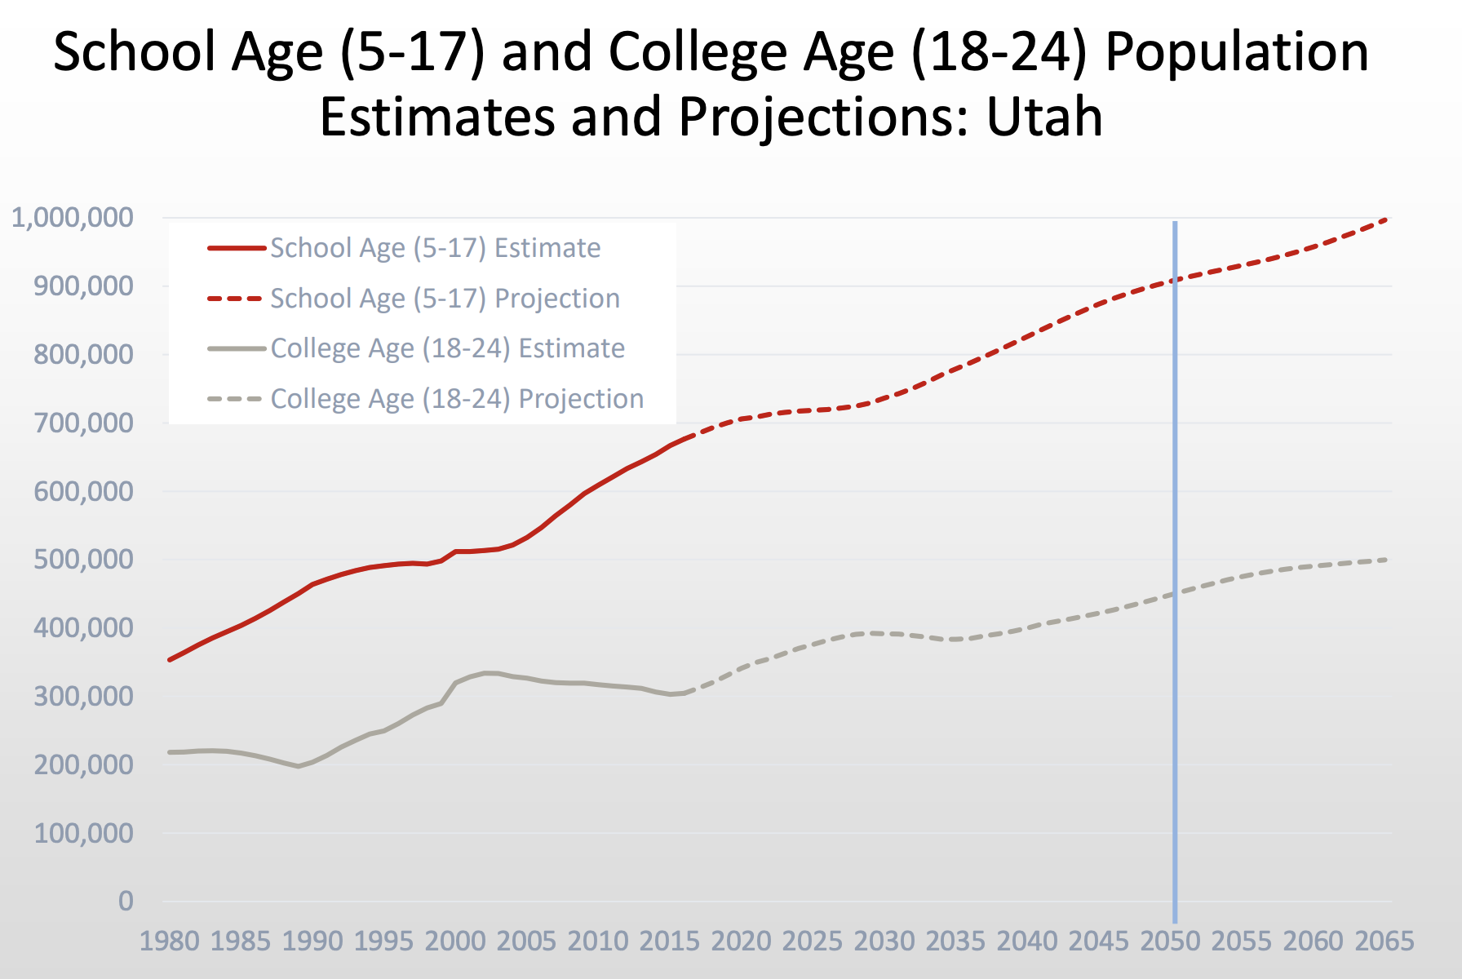

Slide 13
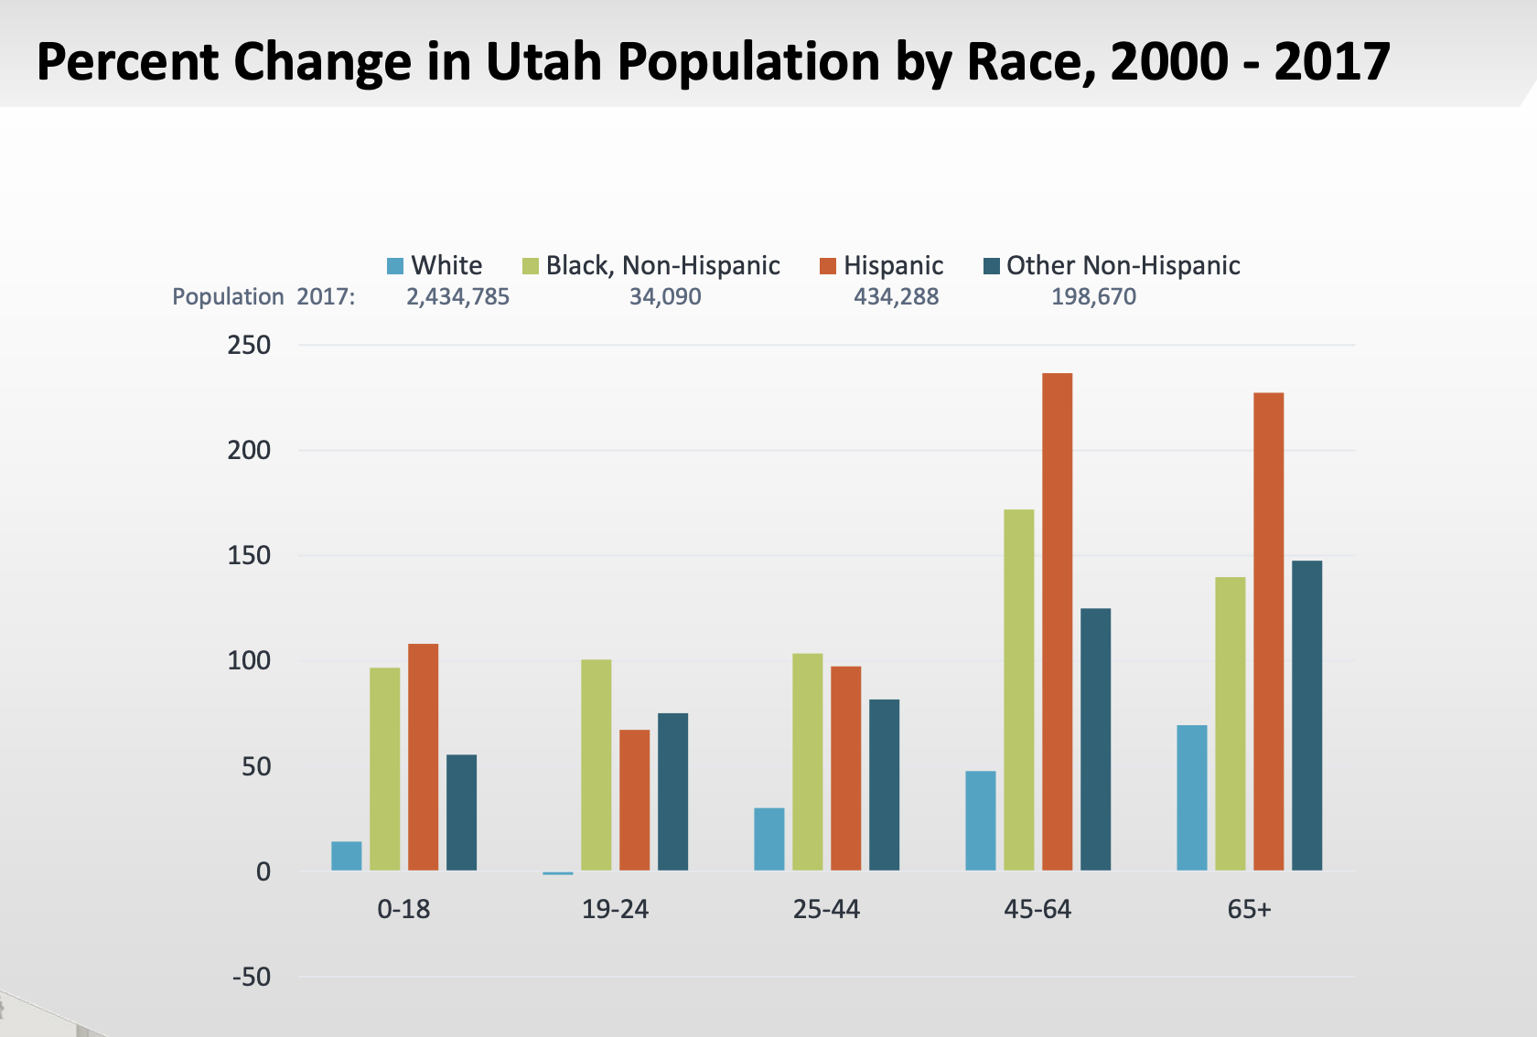

Slide 15
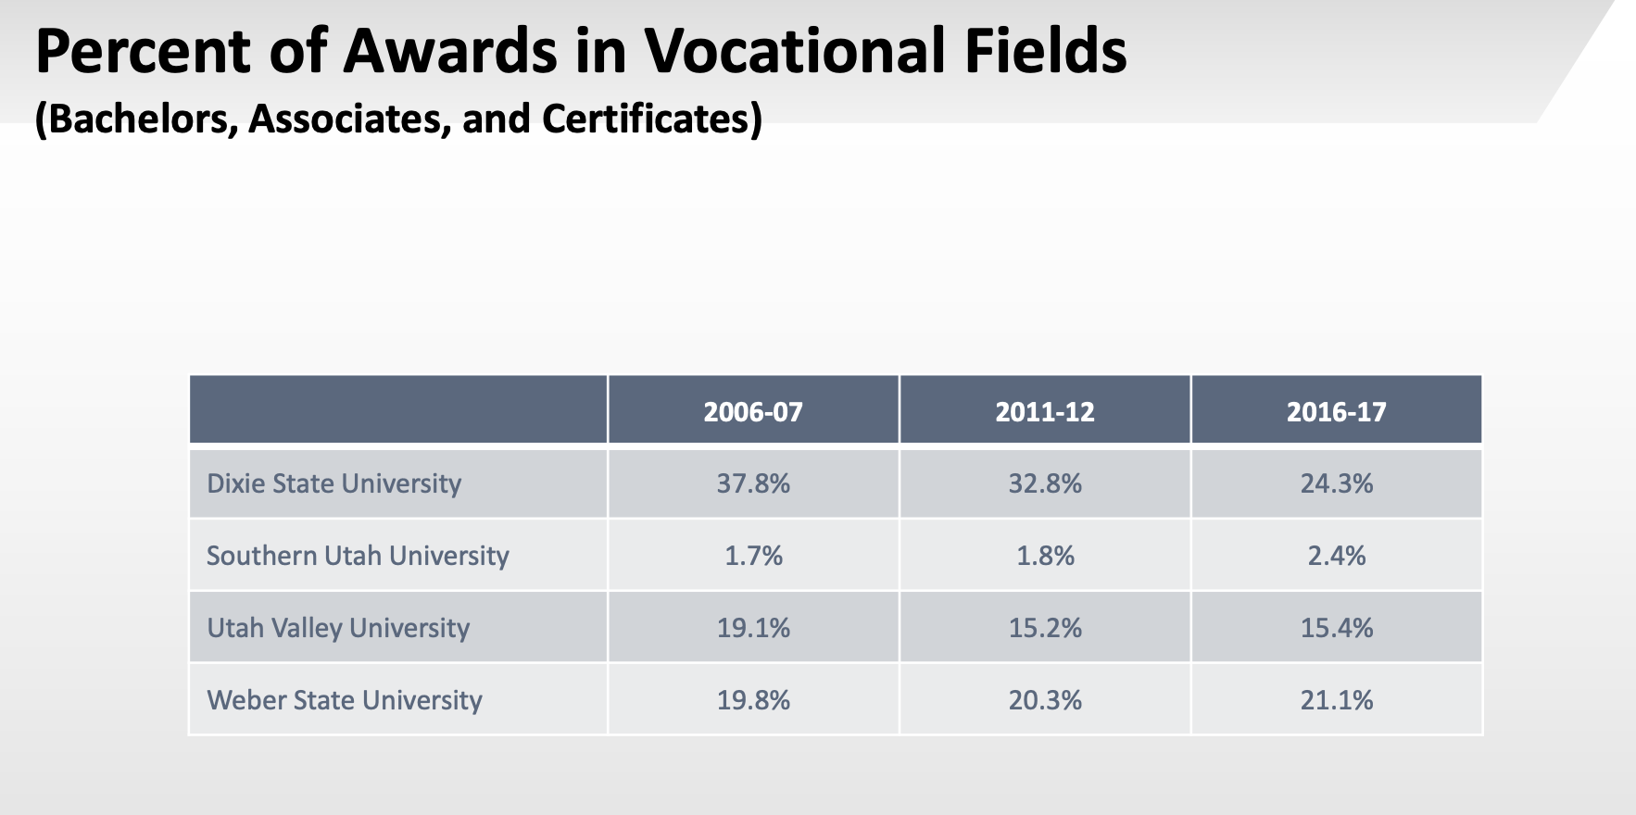

Slide 16
Higher Education Strategic Planning Commission

Slide 18
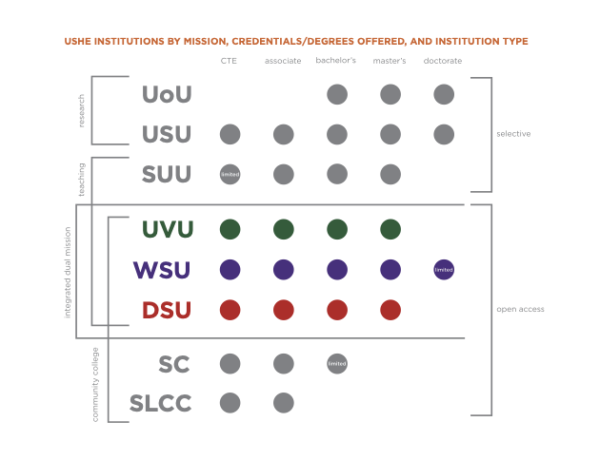

Slide 19
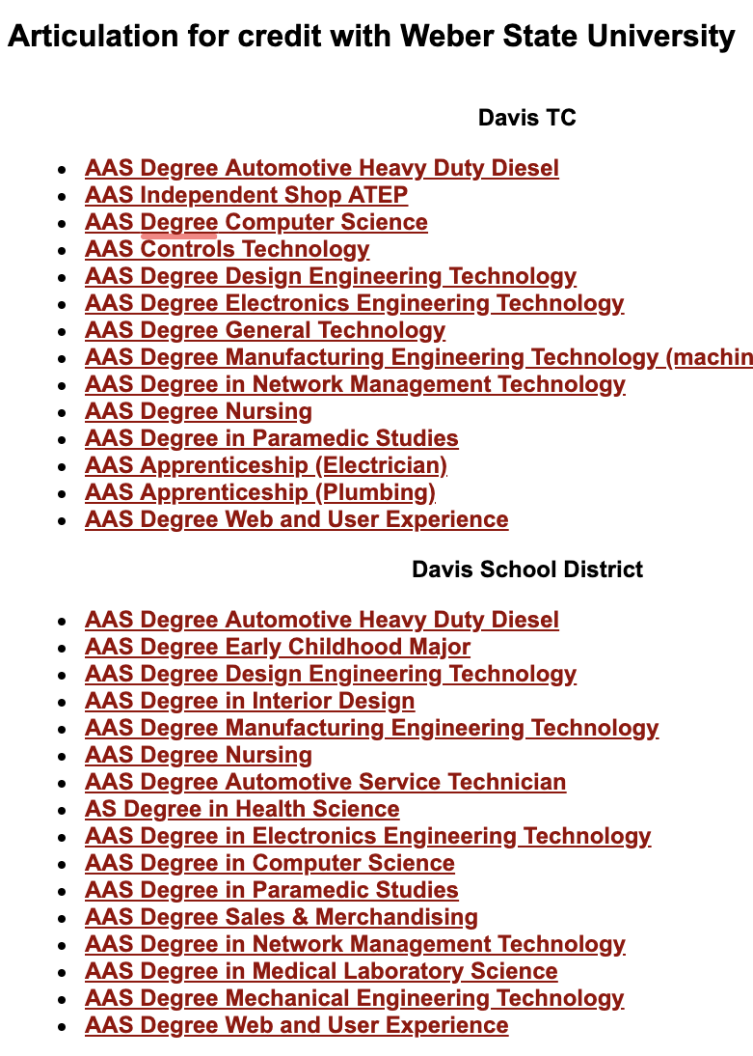
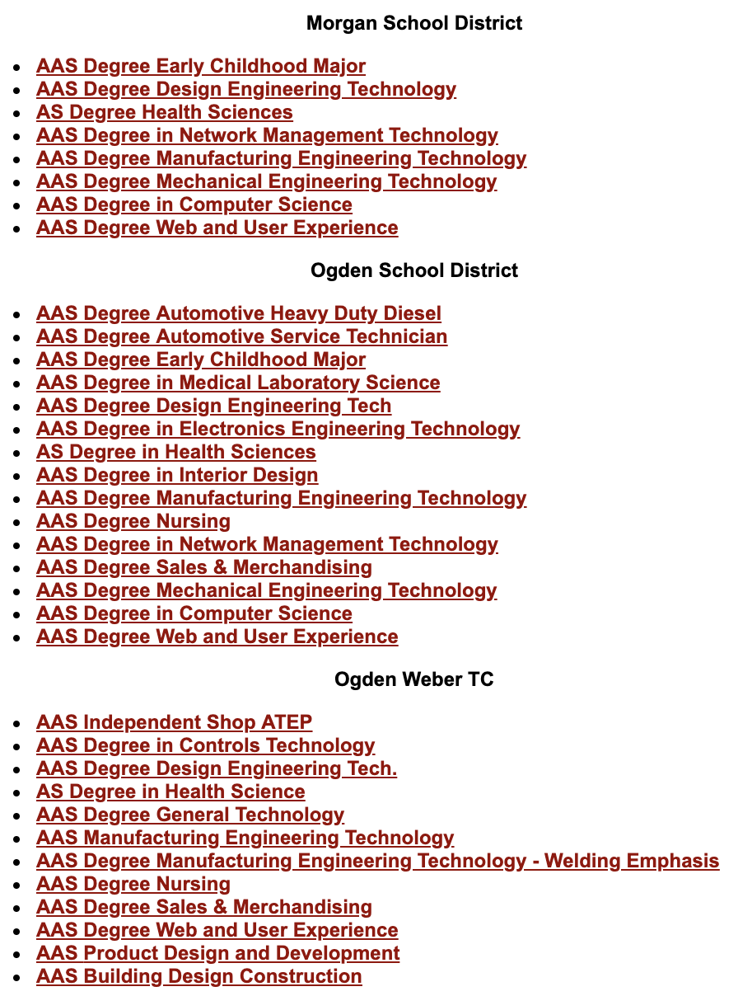

Slide 20
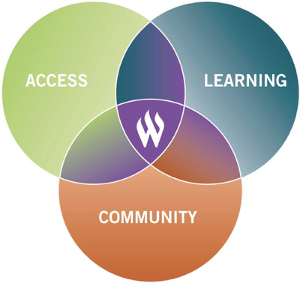
Weber State Core Themes

