Slide 1
Using SmartGrant as a PI
Administer Your Proposal, Access Fast Grant Forms
& Manage Awards
SmartGrant Training Series

Slide 2
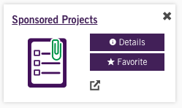
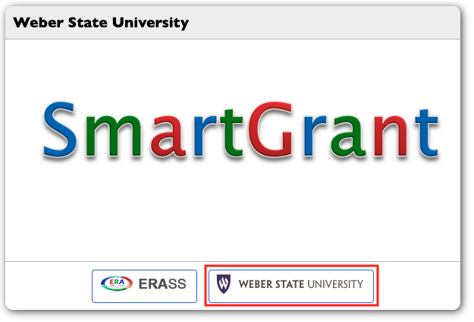
Login to SmartGrant
1. Access SmartGrant via the eWeber application
2. Click the “Weber State University” icon on the bottom right and sign in using your WSU login credentials—Duo approval will be required

Slide 3
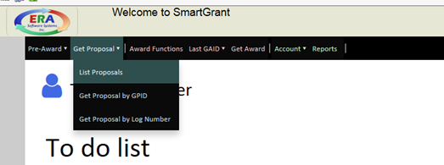
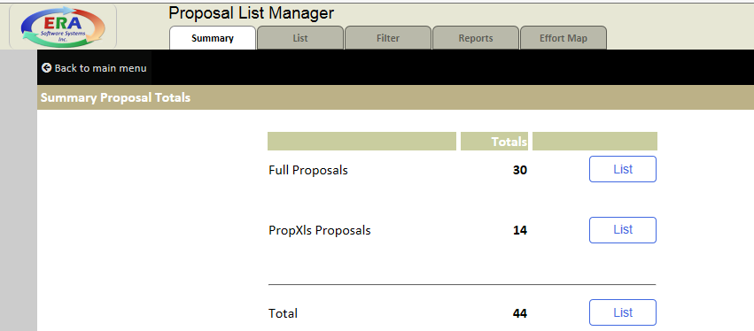
Accessing Your Proposals
1. Select in the menu “Get Proposals” 🡪 “List Proposals”
2. The Proposal List Manager screen will display

Slide 4
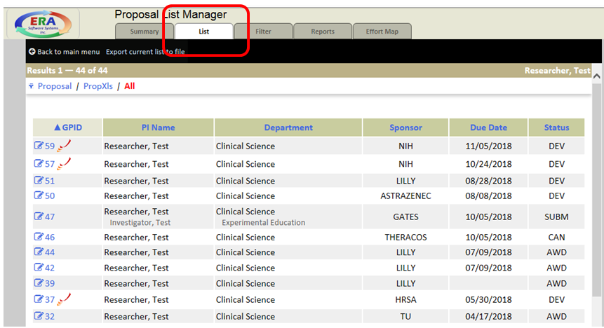
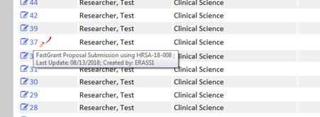
Accessing Your Proposals
3. Click the “List” tab
4. Proposals are listed by descending GPID number (or grant proposal identification number). A GPID with the symbol next to it indicates a federal submission to Grants.gov. If the GPID number is known, locate the GPID in list and click on the GPID to open the proposal. If the GPID number is not known, hover your mouse over the GPID to see the proposal title.

Slide 5
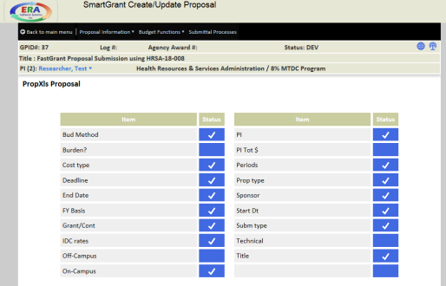
Accessing Your Proposals
5. Upon clicking a GPID, the proposal will open and the SmartGrant Create/Update Proposal screen will display.

Slide 6
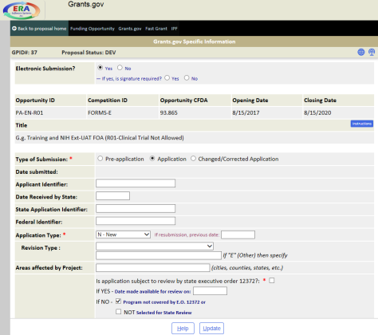
Grants.gov Forms
1. Open your GPID. To access the federal forms, select the menu path of “Submittal Processes” 🡪 “Print Forms”
2. The Grants.gov screen will display with funding opportunity, opportunity instructions, and questions completed. If empty and no opportunity selected, reach out to the Office of Sponsored Programs for assistance.

Slide 7
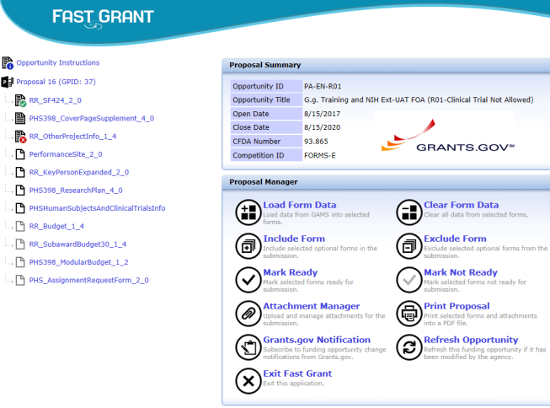
Grants.gov Forms
3. To access the Fast Grant screen with forms, select the menu path of Fast Grant.
4. The Fast Grant screen will display with all the required and optional forms as associated with the selected funding opportunity. Dark color form icons indicate REQUIRED forms. Light color form icons indicate OPTIONAL forms (but user will need to decide if needed for their submission).

Slide 8
Grants.gov Forms
5. Forms status indicator for PI information:
a. Empty form with no data. Data can be loaded into the form by clicking the Load Form Data function under the Proposal Manager section.
b. Partially completed form. Data included on form but either the form has not been verified by the user or the form is still missing data.
c. No missing data on form. Data included on form passes Grants.gov validation requirements. User should confirm no other data need with form submission. Form can still be edited.
d. Fully completed form. Form is considered “marked ready” for submission. Form can no longer be edited unless user changes status of form to Mark Not Ready under the Proposal Manager section.

Slide 9
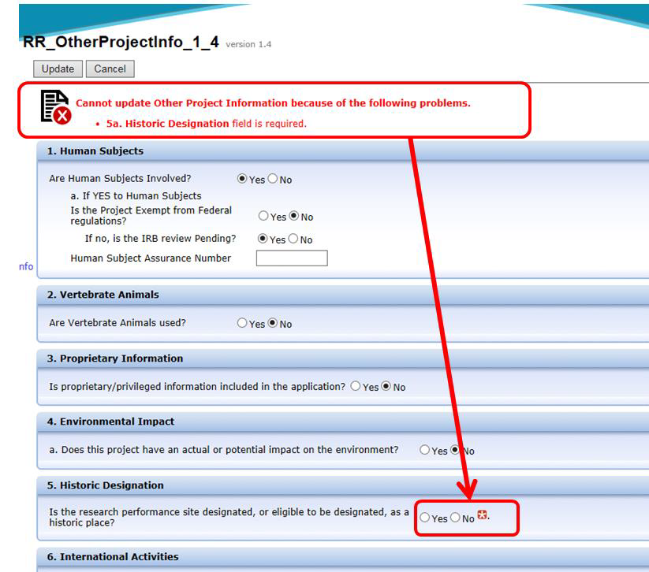
Grants.gov Forms
6. To access and review a form, click on the form name link. The form will either be editable or non-editable depending on the form status. Update forms as needed.
a. Clicking “Update” on a form will indicate if the form is missing required data to pass Grants.gov validation. A red icon will display next to the field missing data or missing a required attachment. Make form changes or add missing data and click “Update” to save form changes.

Slide 10
Grants.gov Forms
6. To access and review a form, click on the form name link. The form will either be editable or non-editable depending on the form status. Update forms as needed.
b. If an attachment is required in a form, a “Select File” button will display next to the field where the file needs to be uploaded.
Clicking on “Select File” will open the “Attachment Manager” window.
Click “Insert New Attachment” to (a) select the appropriate PDF for upload and (b) enter a description for the file. Click OK.
The” Attachment Manager” window will re-display with the uploaded file. Click “Select” button next to file name. The form will re-display with the PDF file link now available. The file name link on the form can be clicked to open and view the PDF.
Click to Update the form again to confirm all data/attachments provided with the form.

Slide 11
Grants.gov Forms
7. Once all forms are marked ready (i.e. with a green circle), click “Print Proposal” to view/print some or all the PDF forms w/attachments.
8. To navigate out of Fast Grant, click “Exit Fast Grant” under the Proposal Manager Section.
9. To navigate out of the proposal and exit SmartGrant, select the menu path of Back to Proposal Home 🡪 Back to Main Menu (selecting to save proposal when prompted) 🡪 Exit (at bottom of SmartGrant page).

Slide 12
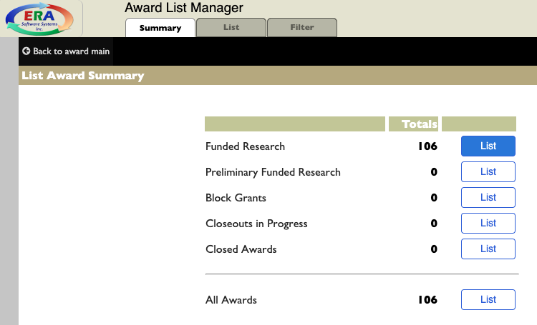
Managing Budget & Burn Rate
1. Find the award to be managed in the post-award (in red text) side of SmartGrant.
Award Functions 🡪 Update Awards 🡪 List Awards
Click “List” next to the Funded Research to bring up the full listing
2. To access specifics on an award, click on the blue ID number on the left.

Slide 13
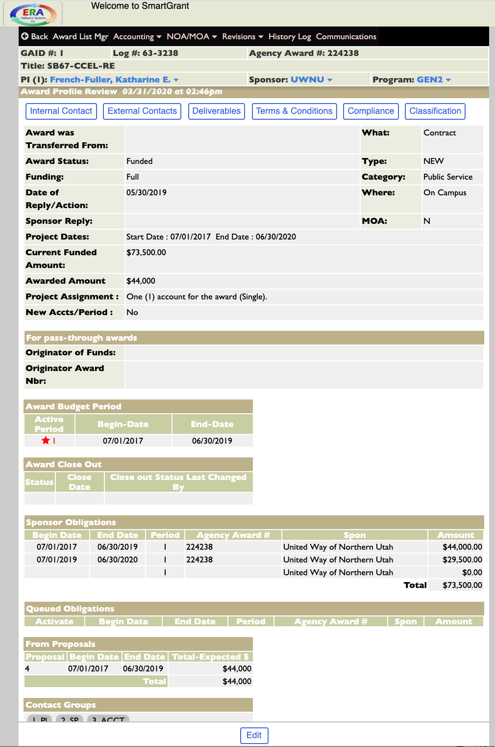
Managing Budget & Burn Rate
3. Find the award to be managed in the post-award (in red text) side of SmartGrant.
Award Functions 🡪 Update Awards 🡪 List Awards
Click “List” next to the Funded Research to bring up the full listing
4. To access specifics on an award, click on the blue ID number on the left.

Slide 14
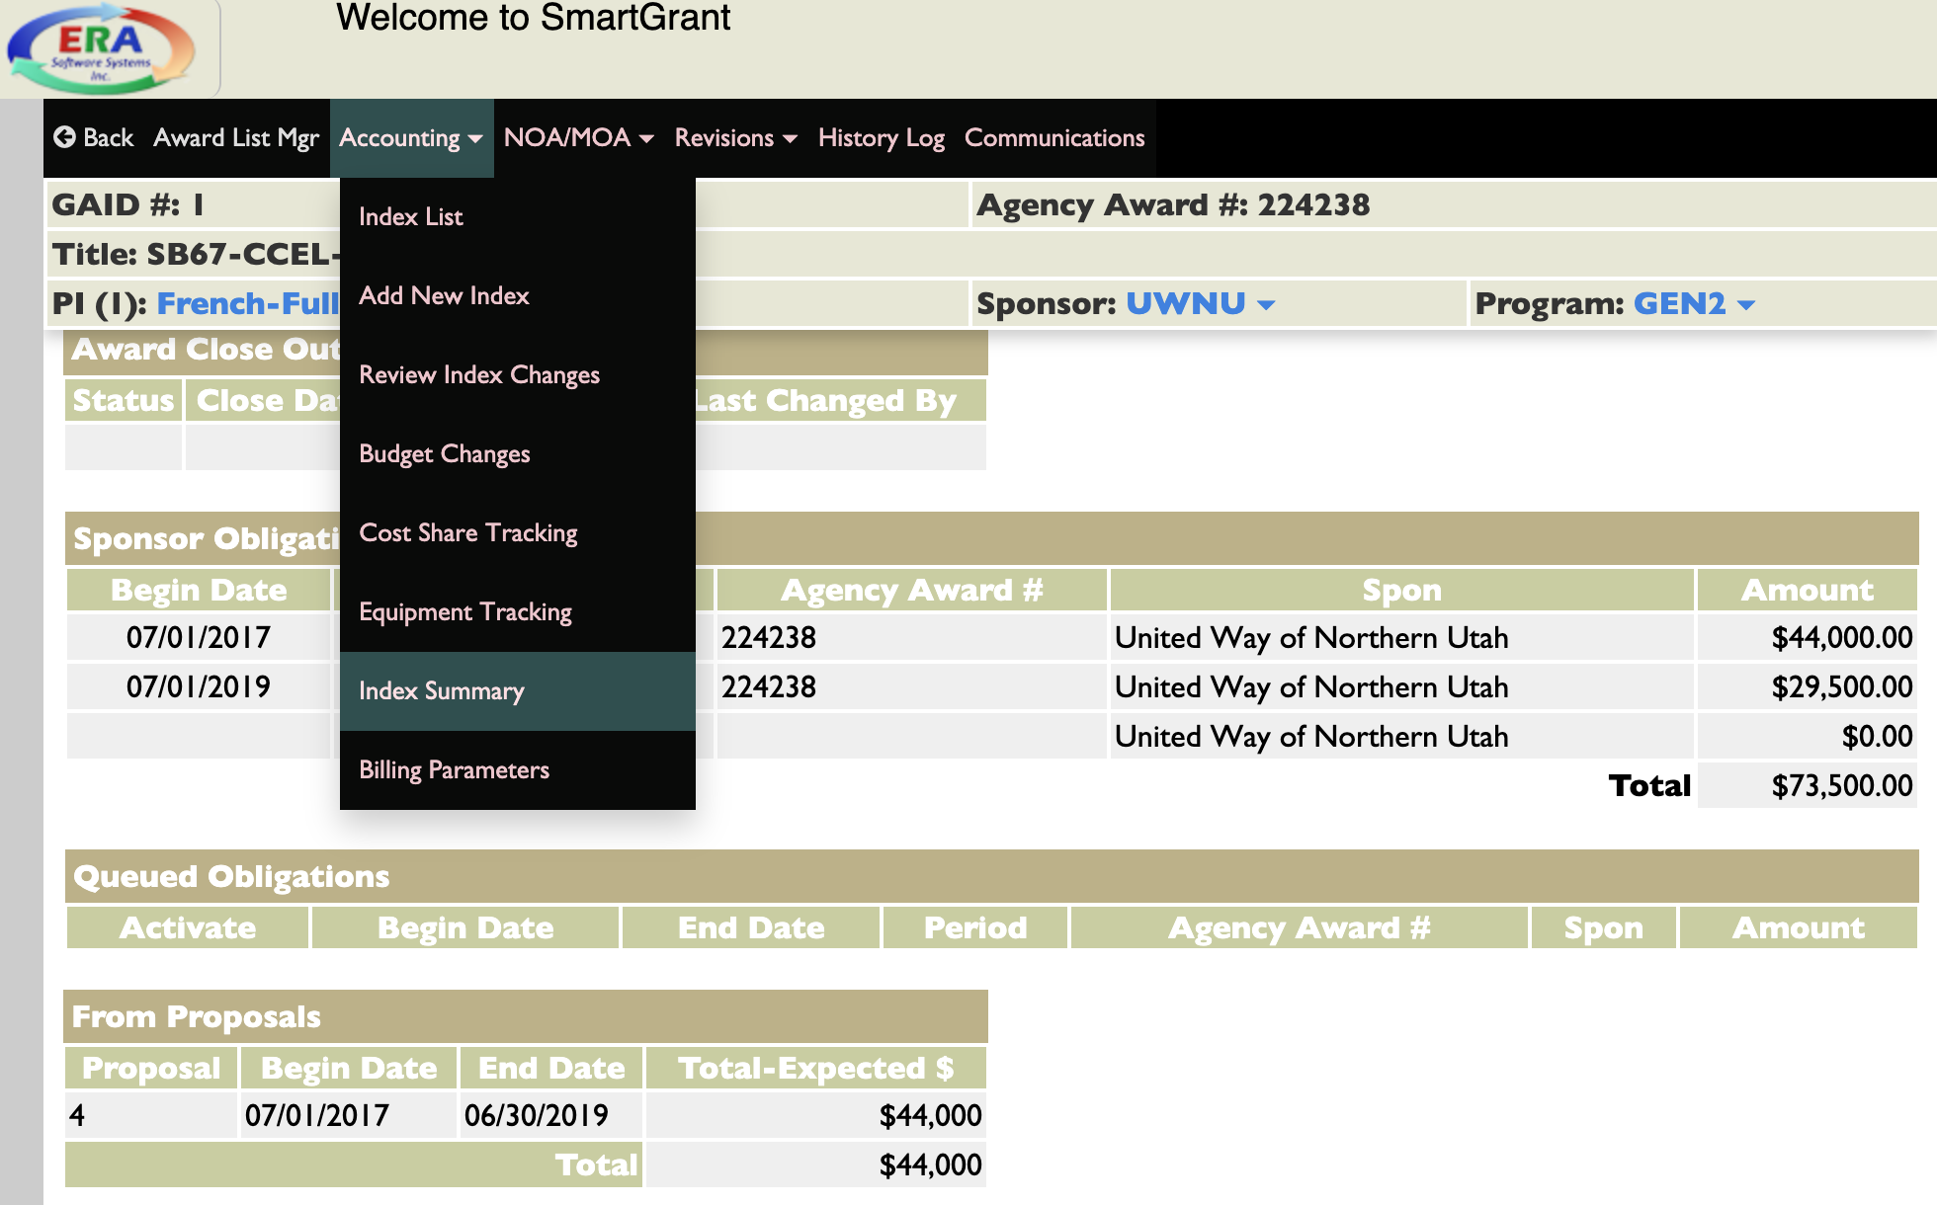
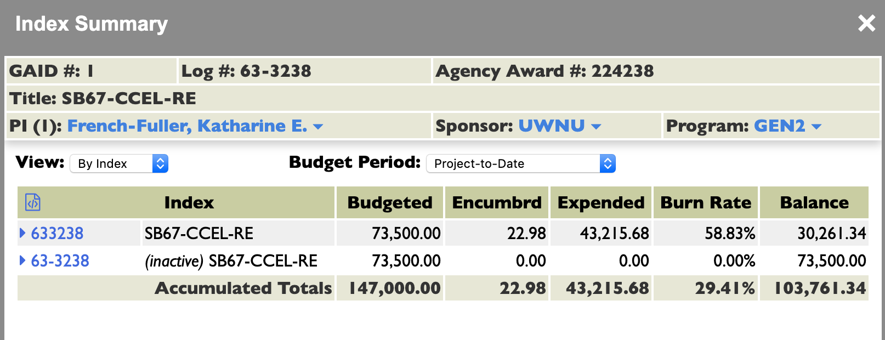
Managing Budget & Burn Rate
5. In the top menu, under “Accounting,” select “Index Summary”
6. This will display the Index Summary View. Select the index number to view.

Slide 15
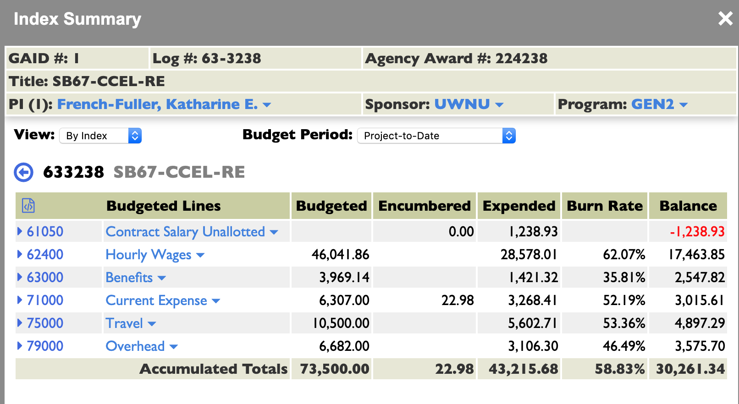
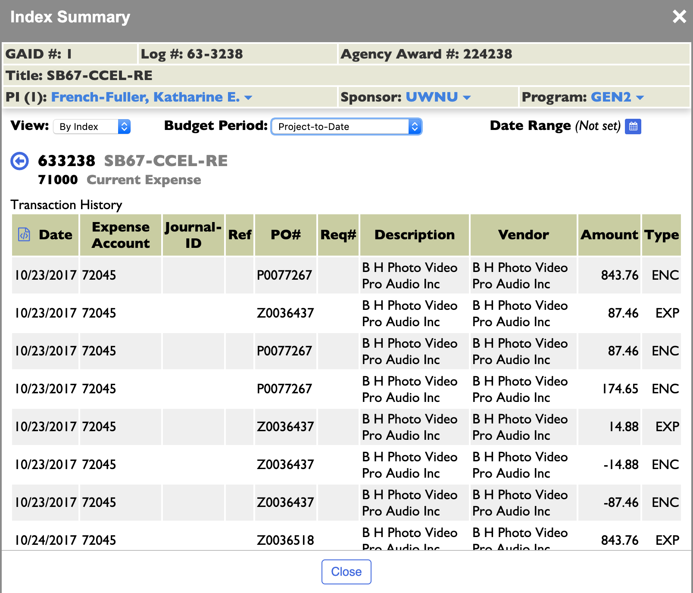
Managing Budget & Burn Rate
7. Here, view sub-code overviews, including burn rates. To view further detail and transactions, select a sub-code. There are filter options for Budget Periods and Date Ranges, if necessary.

