Slide 1


Slide 2


Keely Brinn
DSD Senior Program Manager

Slide 3
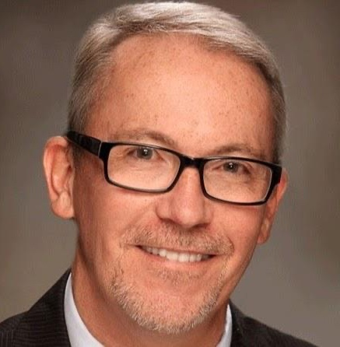
Fred Henderson
NUAHEC Director
Oversees EVERYTHING!
Teaches Classroom Component

Slide 4
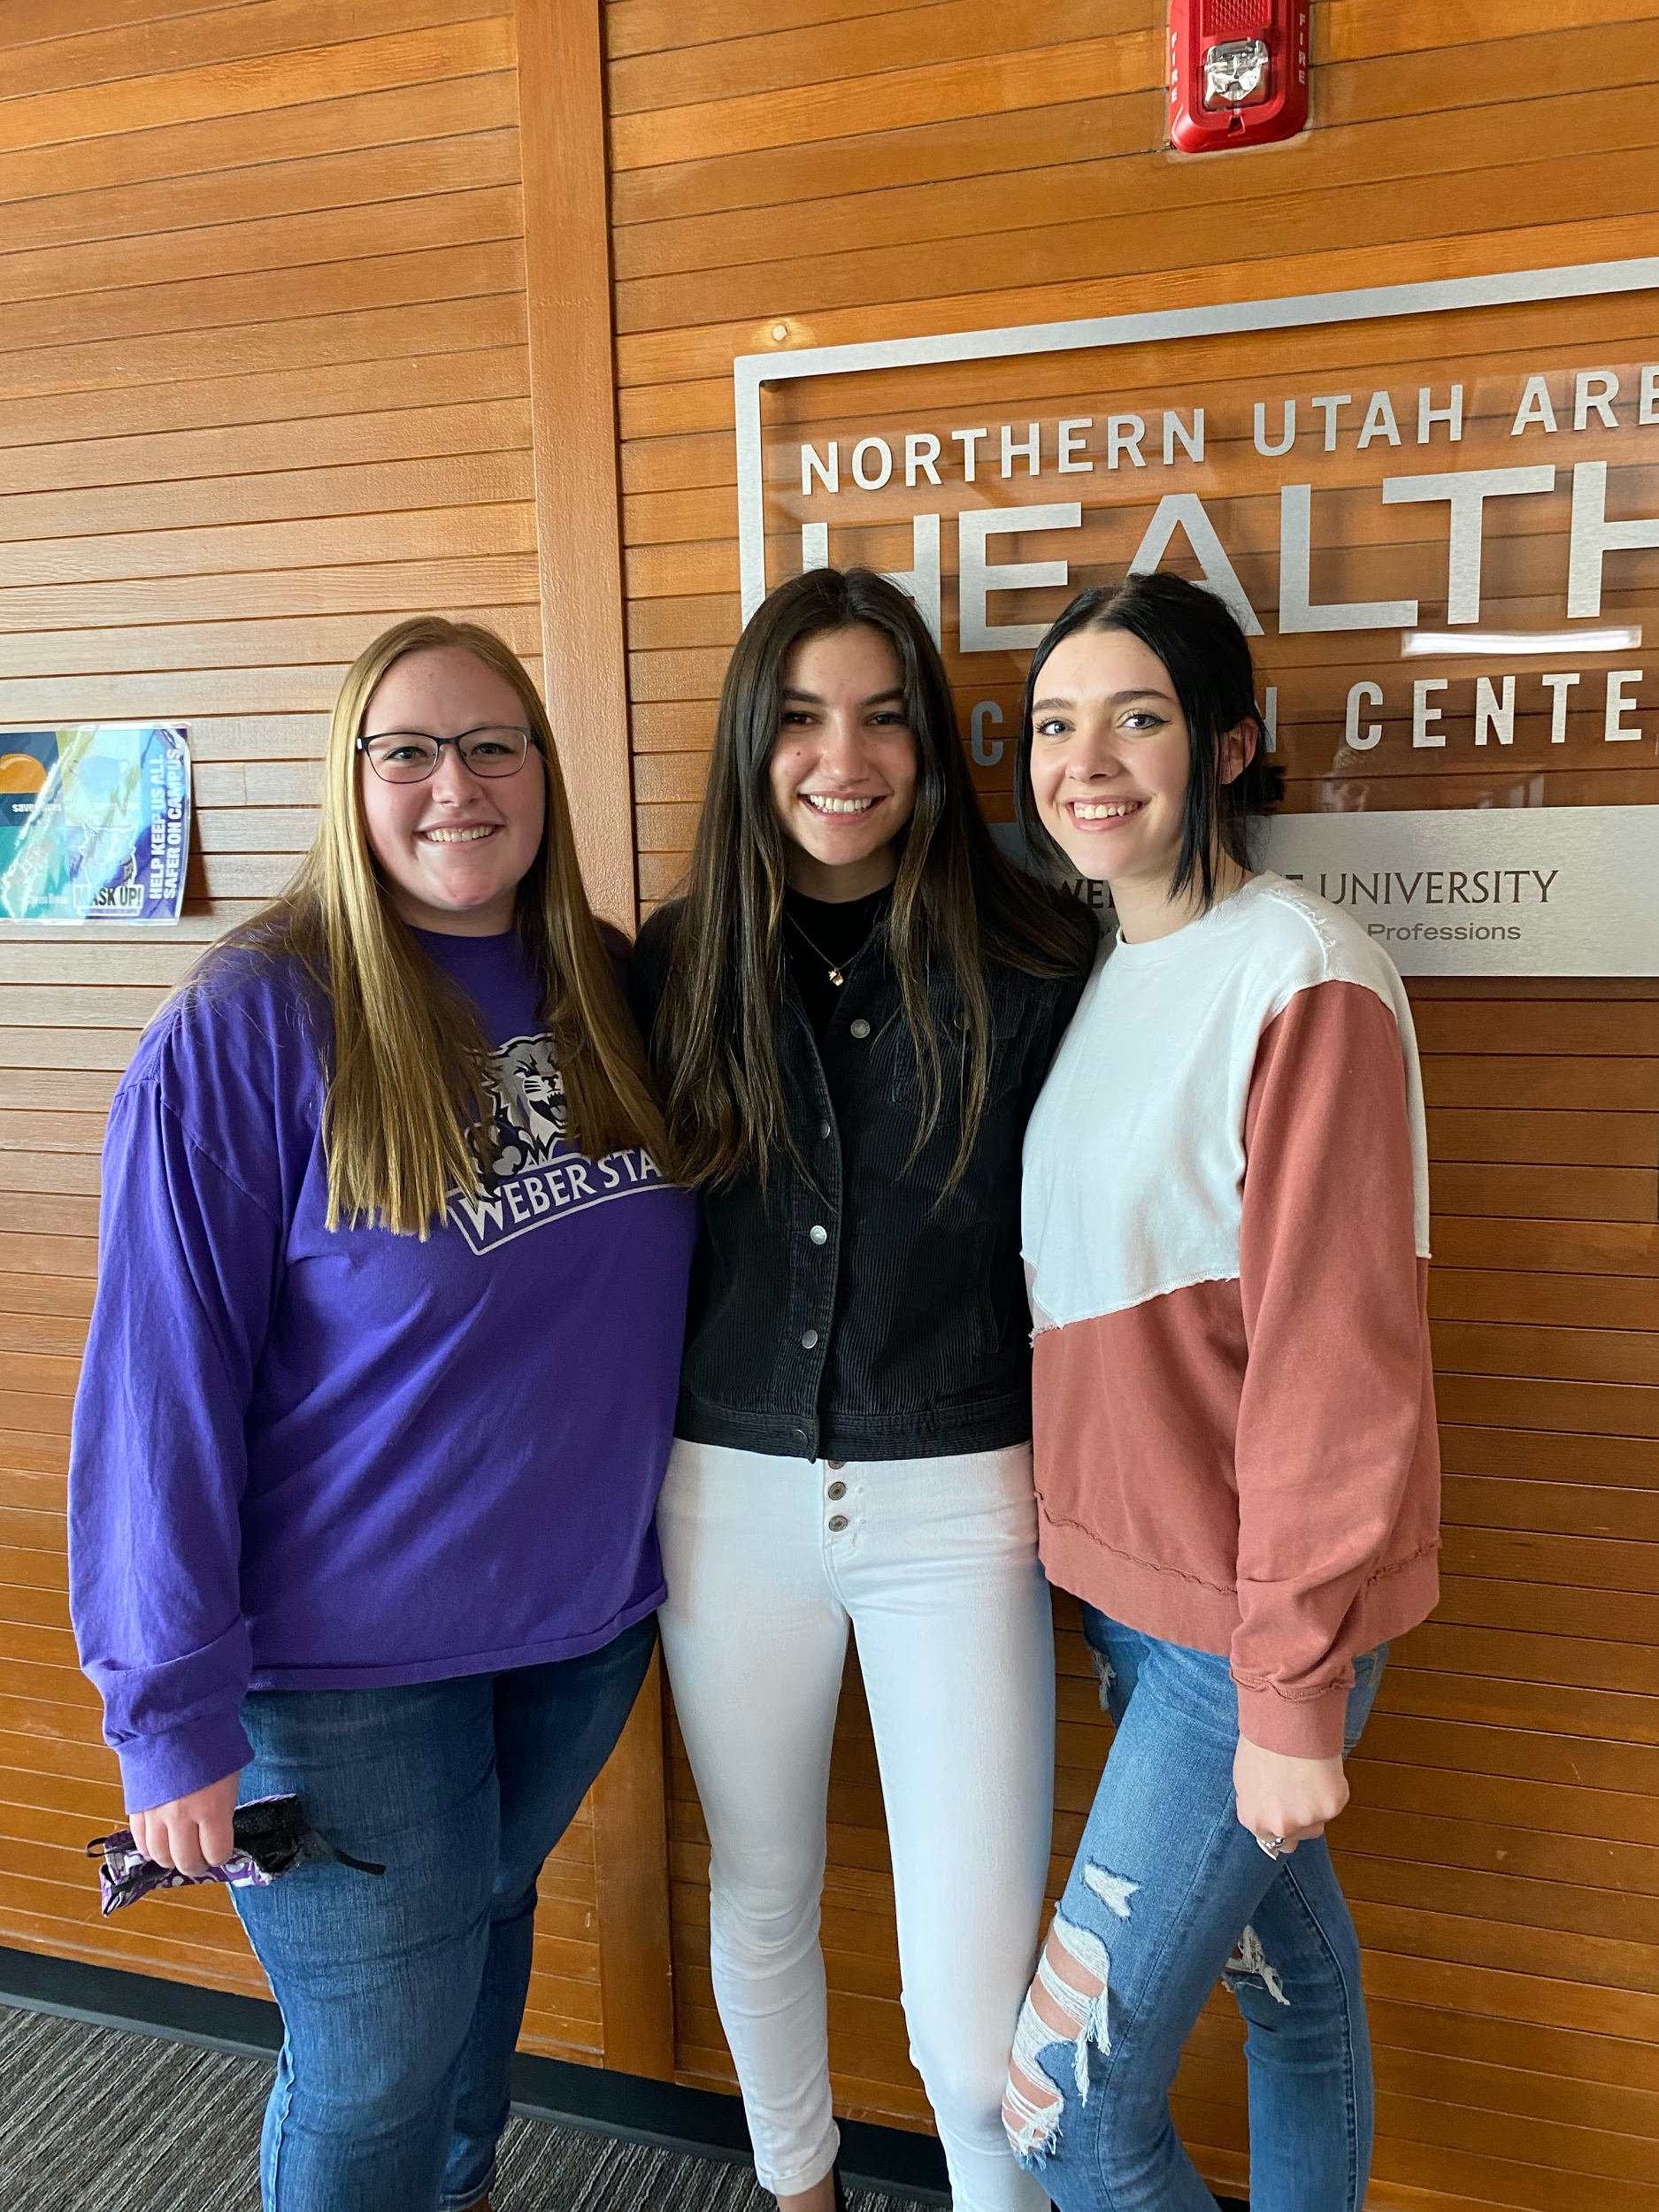

Program Managers
WSD Senior Manager: DSD Senior Manager:
Sydney Carlson Keely Brinn
Program Manager Program Manager
Madelyn Terry Aliya Newman
Technology Manager
Darren Skidmore
Aides in coordinating DSD and WSD classes
Provides office with entertainment

Slide 5

Medical Scholars
You Gain:
    Knowledge
    Skills Training
    CAREER Discovery
Cost: $200 + $20
    Personalized Scrubs
    Parking Pass
    Suture Pad
    Concurrent Credits

Slide 6
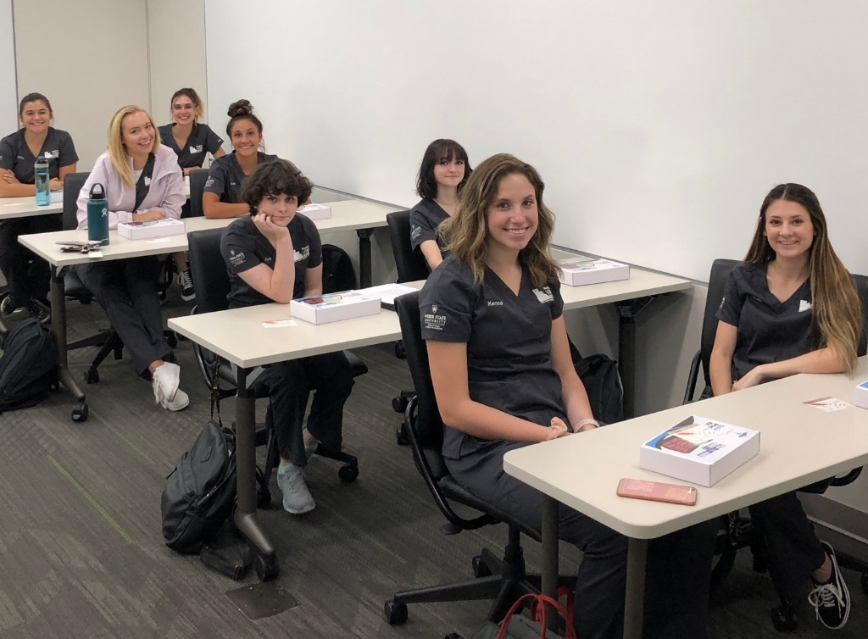
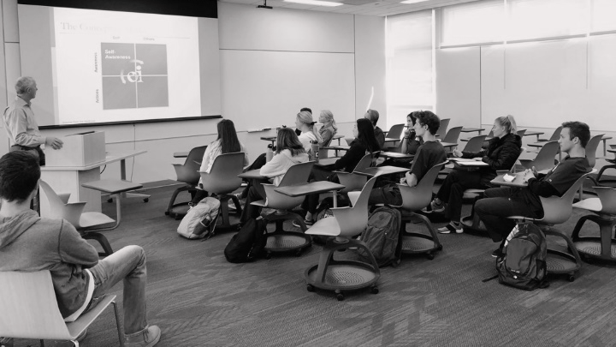
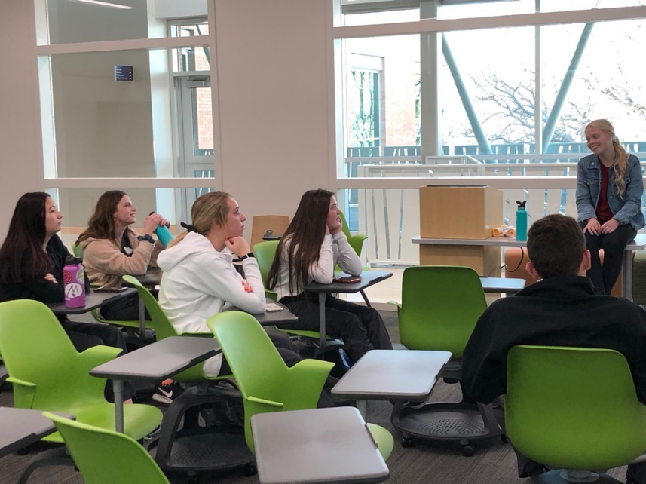
- Classroom -
HTHS 1103 Introduction to Health Careers and Care in a Diverse Society
Libs 2904
Concurrent Enrollment Credit
  4 credit hours
  Two periods, A day & B day

Slide 7
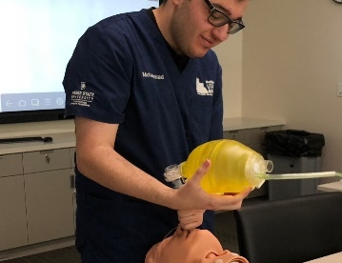
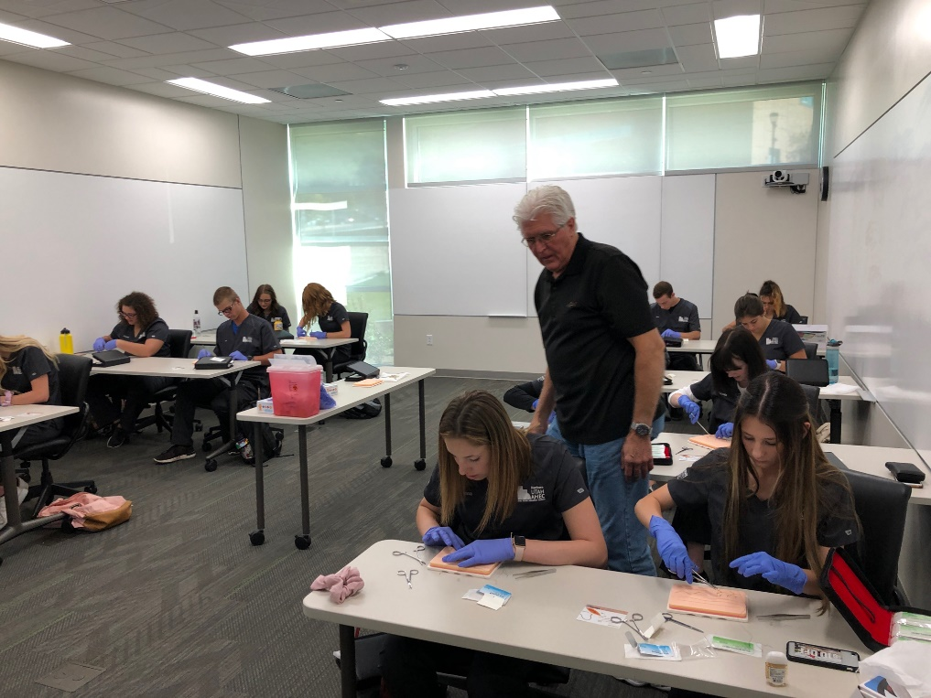
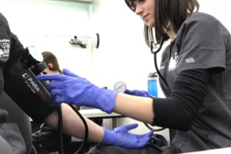
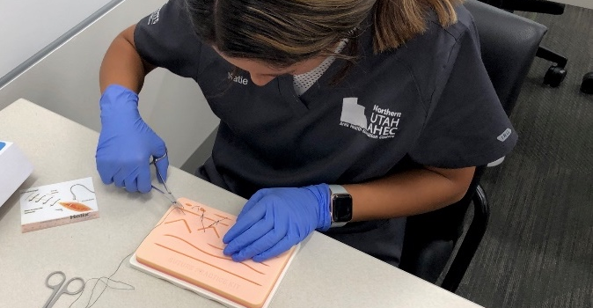
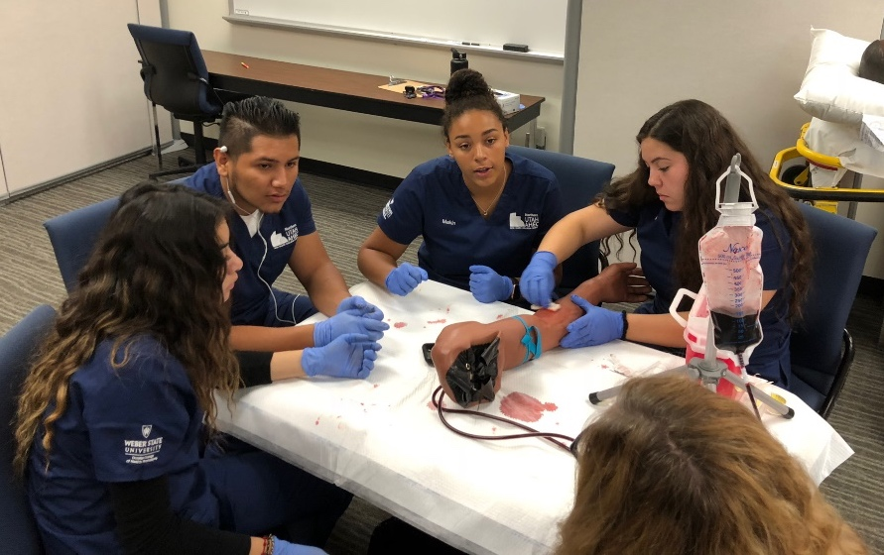
- Skills -
Vital Signs
Suturing
Intubation
IVs

Slide 8
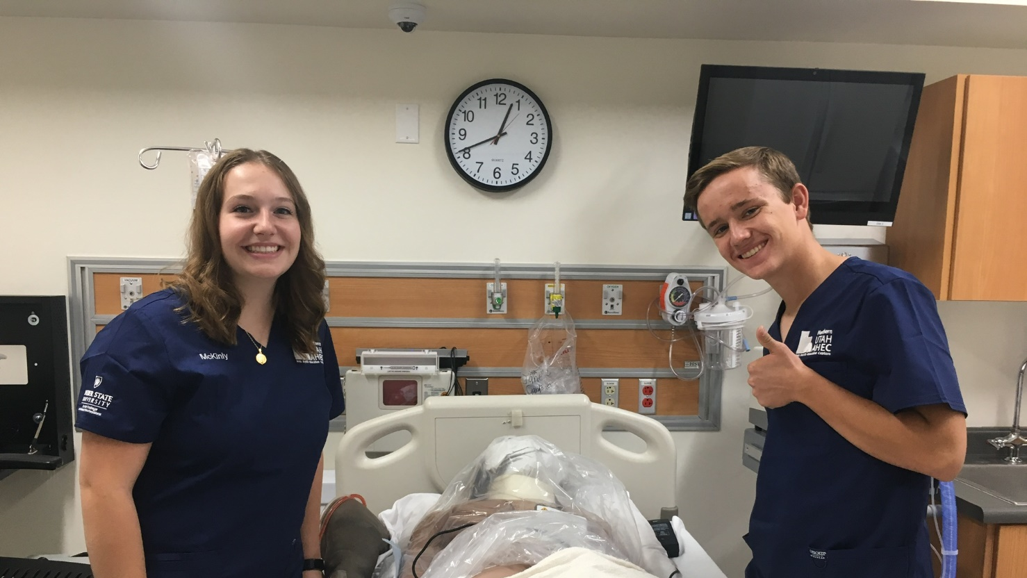
- Job Shadow-
Several Health Fields
All aspects of the clinics
  Cardiology
  Calton/Harrison
  Endocrinology
  Ear Nose Throat
  General Surgery
  Internal Medicine
  OBGYN

Slide 9
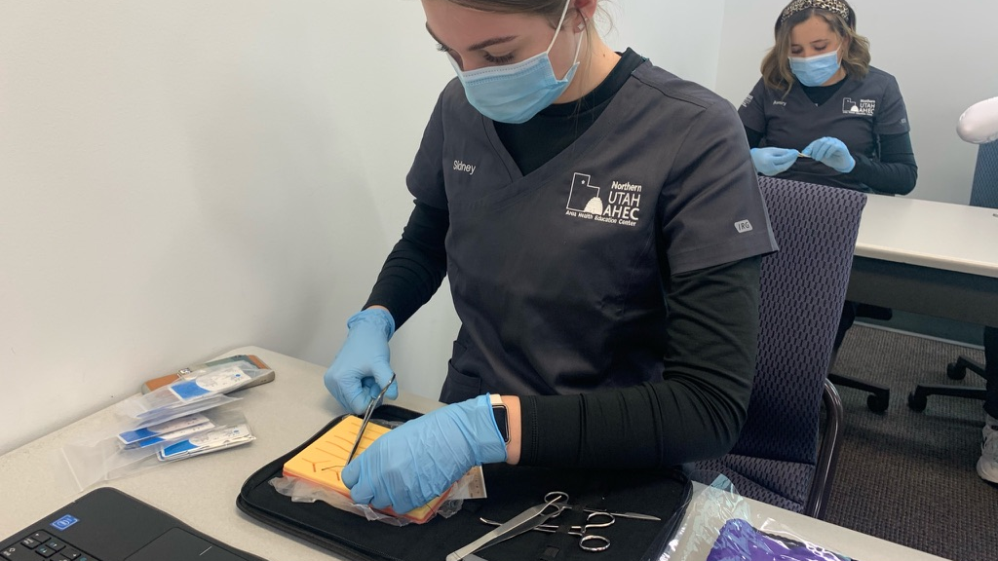
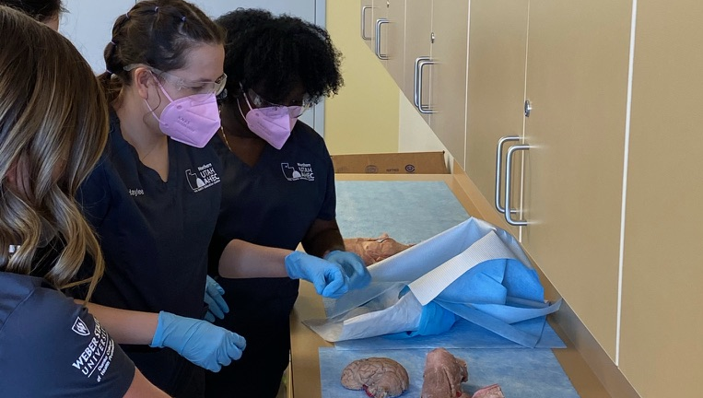
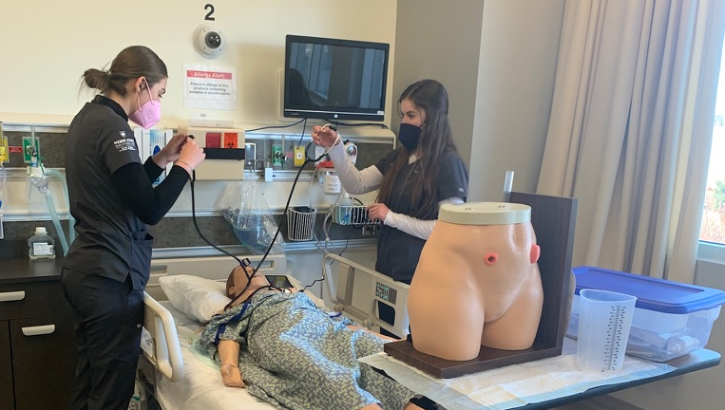
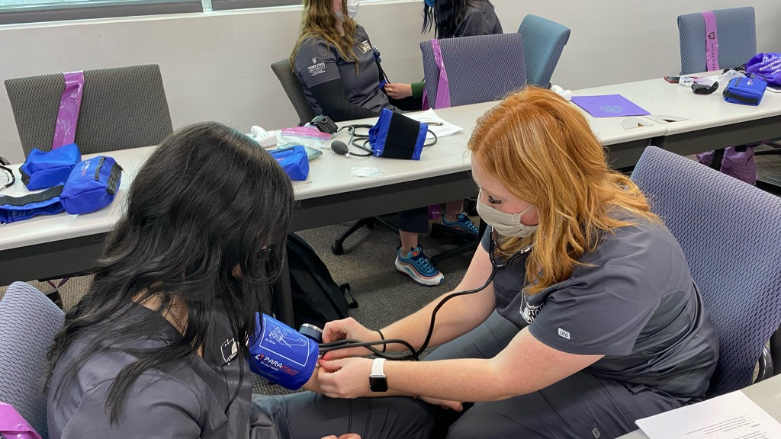
Northridge Scholars

Slide 10
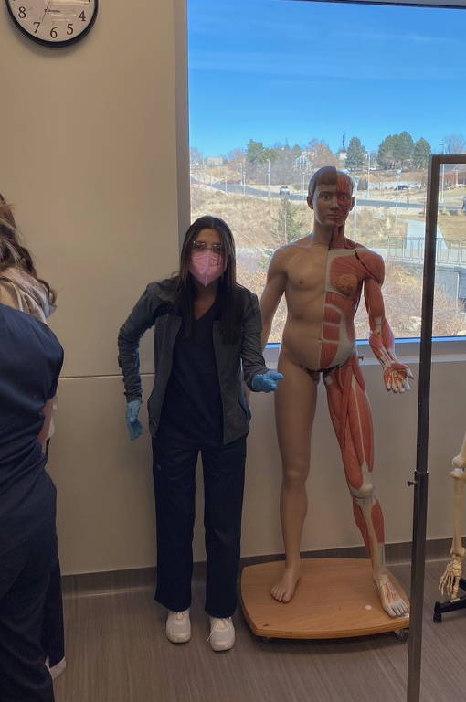
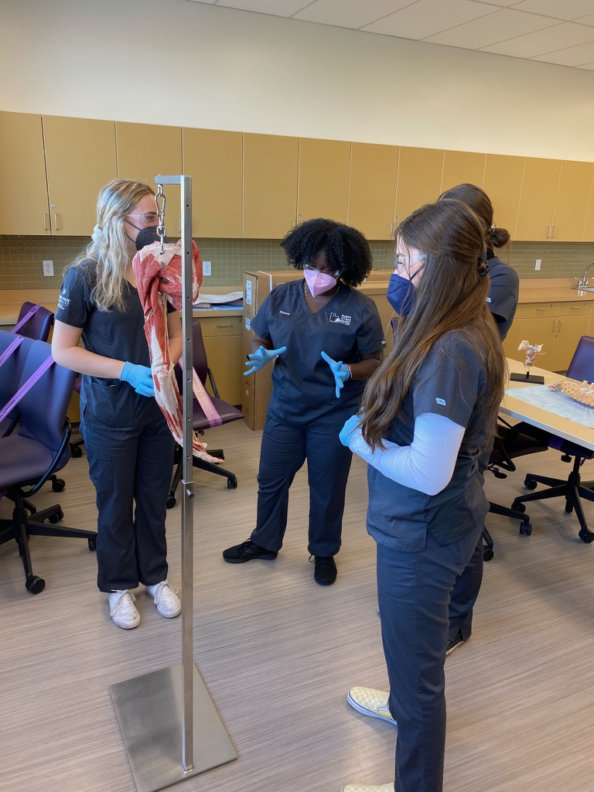
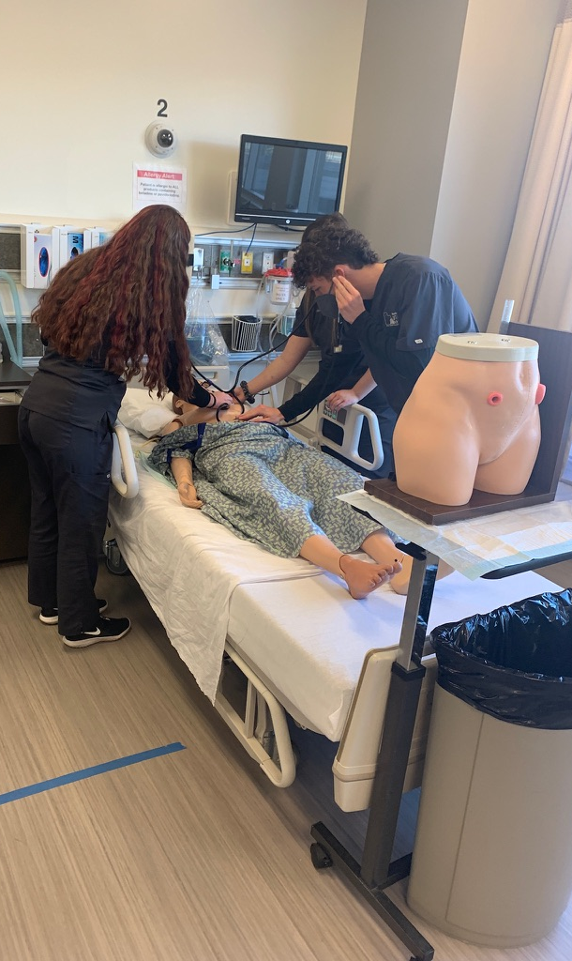
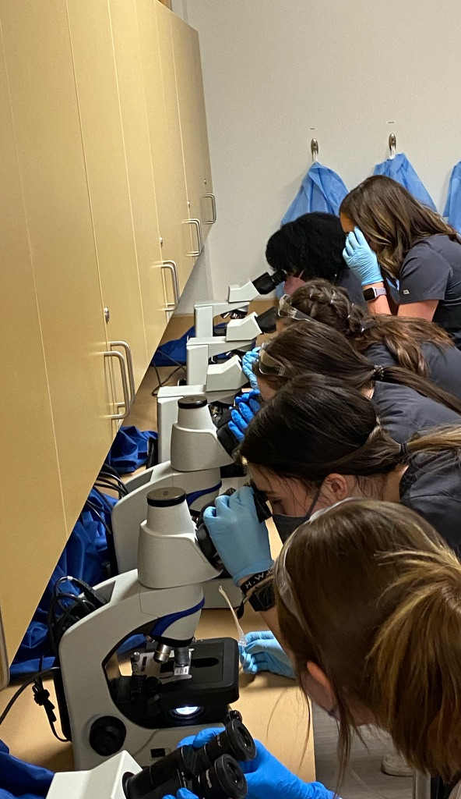
Davis Scholars

Slide 11
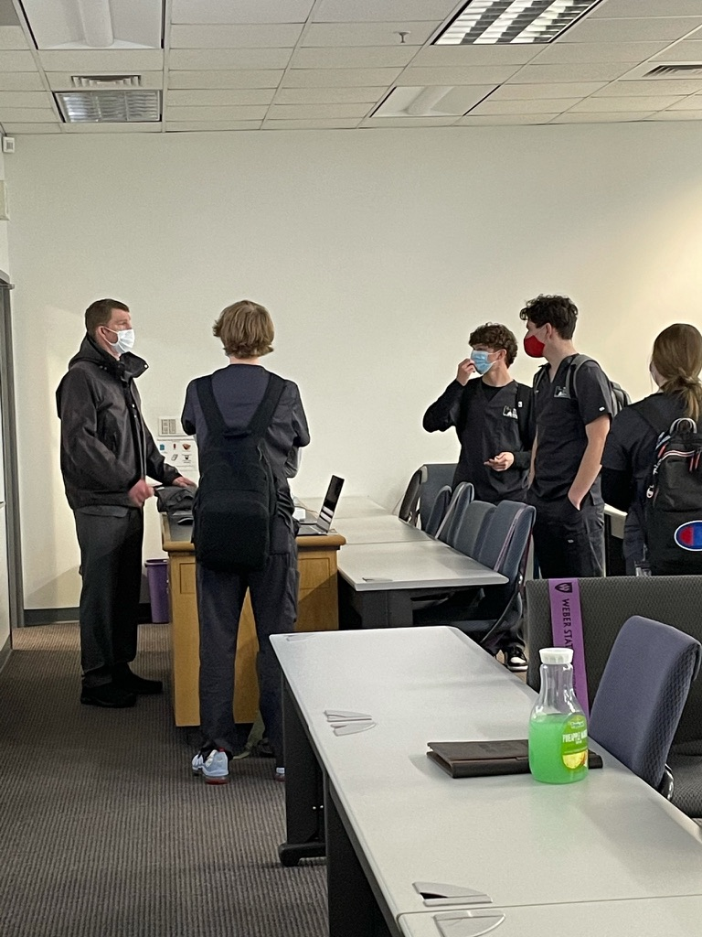
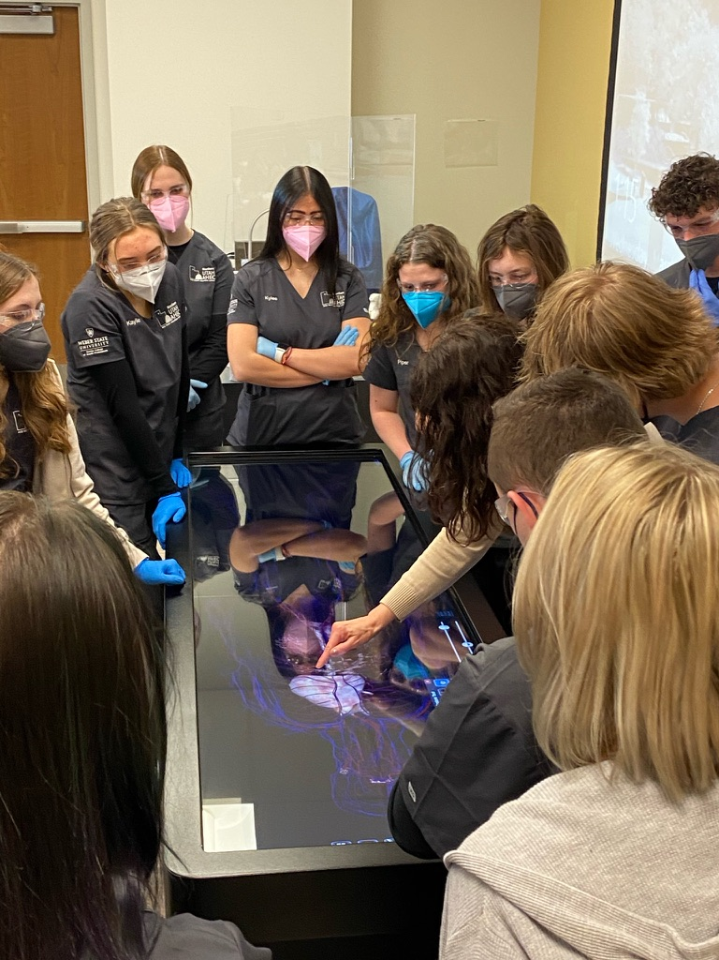
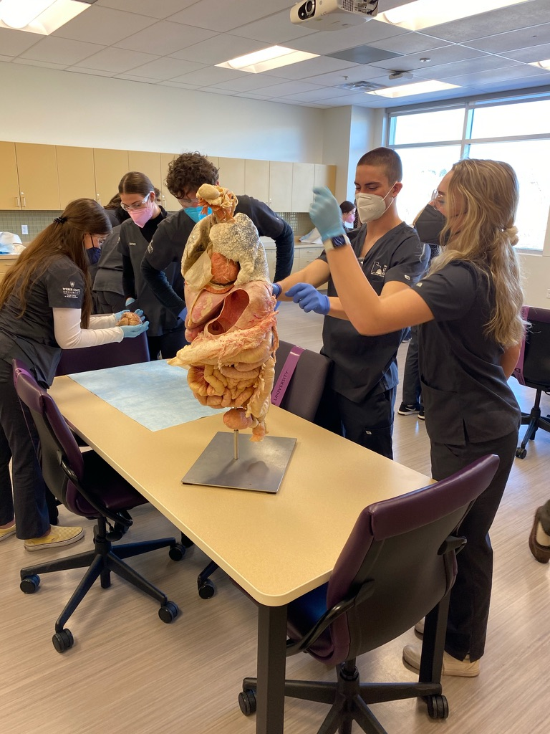
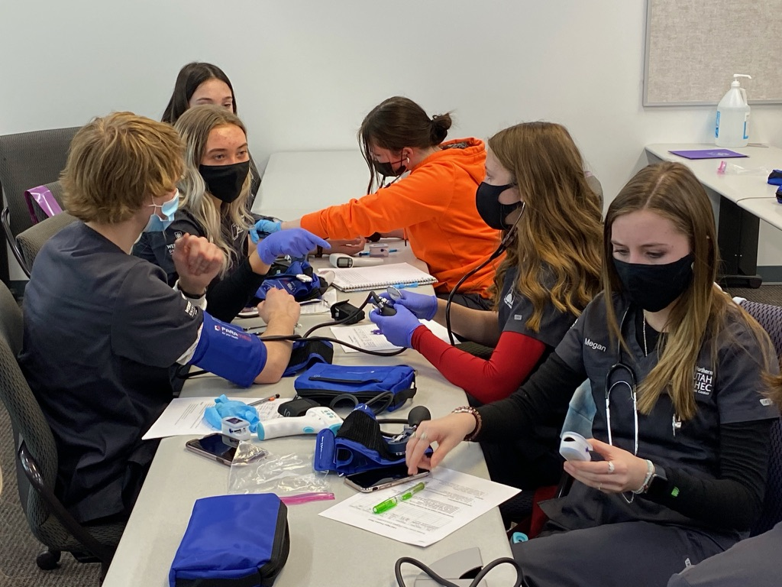
Syracuse Scholars

Slide 12
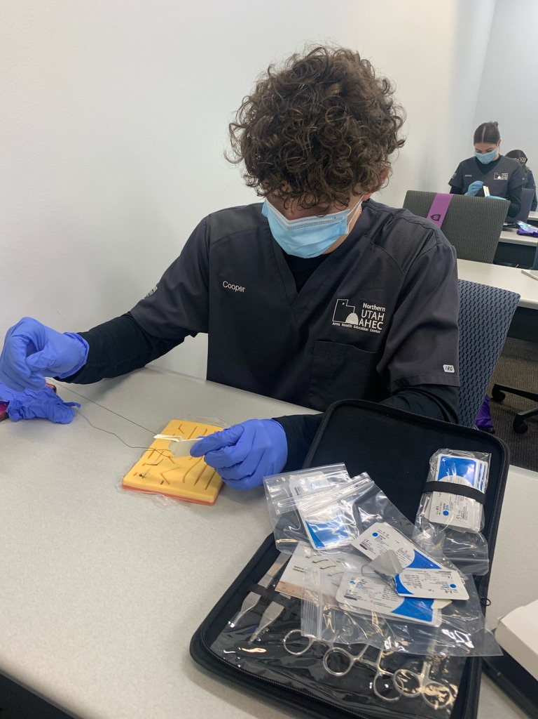
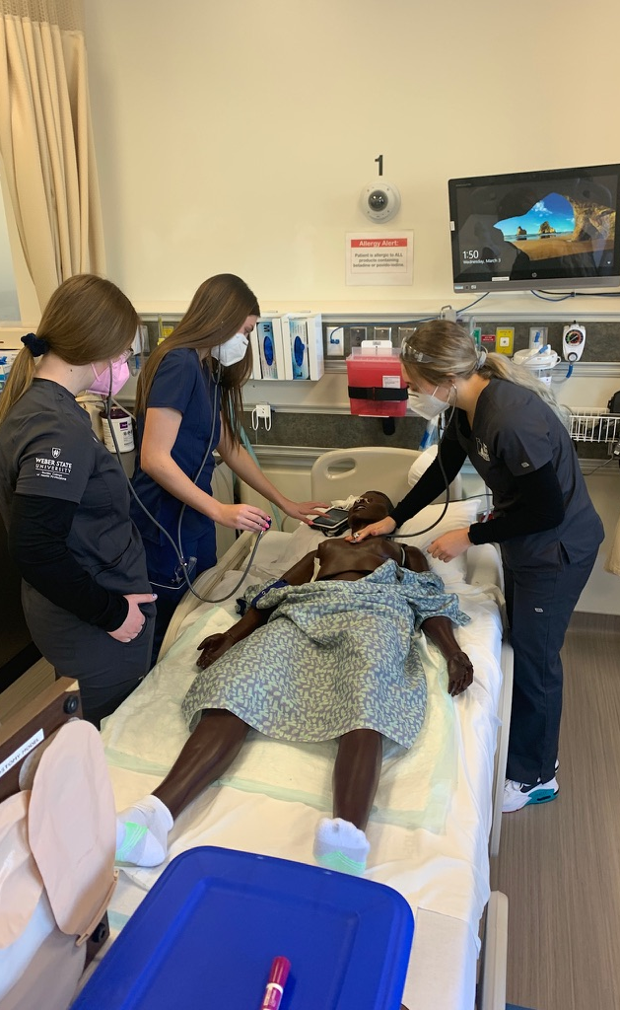
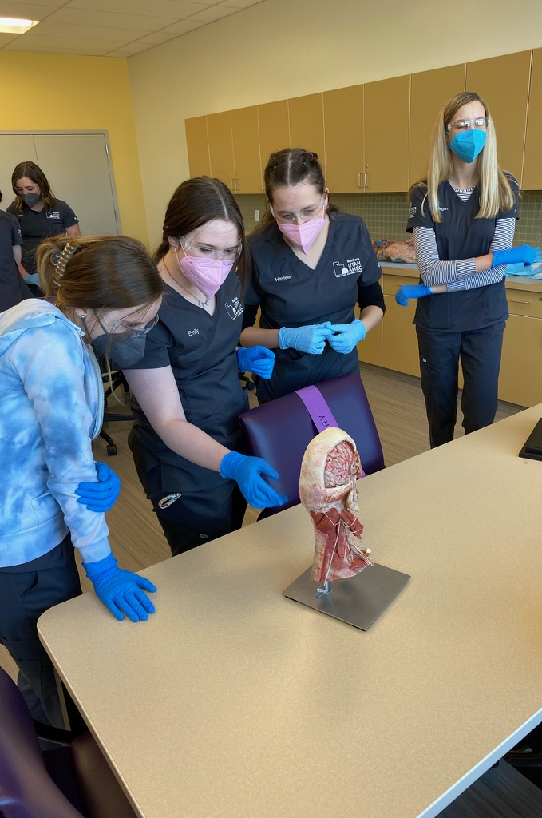
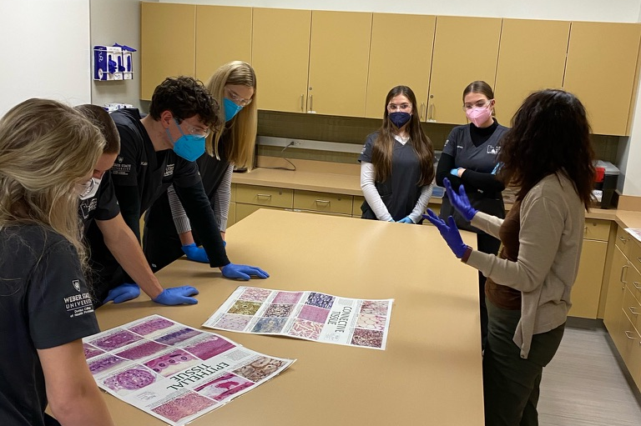
Layton Scholars

Slide 13

Scholar Testimony

Slide 14

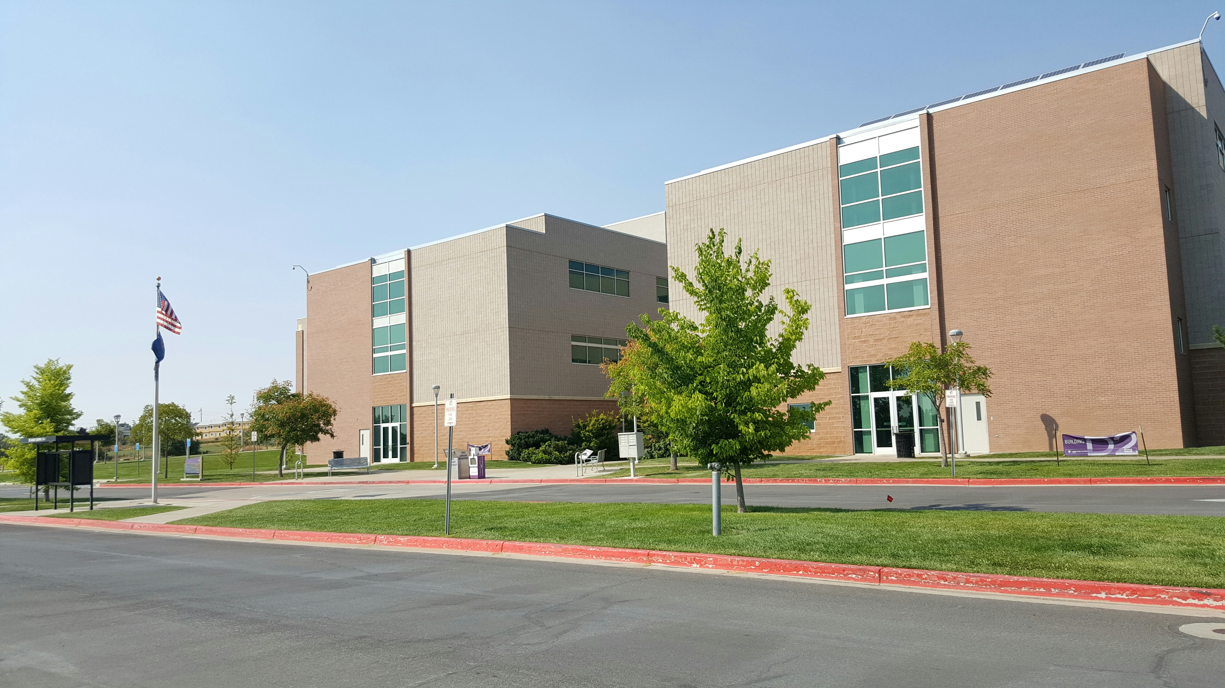


WSU Davis Campus
Building D2
Keely Brinn: Text: (801) 425-8129 Email: keelybrinn@weber.edu
https://www.weber.edu/NUAHEC
@NUAHEC

