Slide 1

Weber State University Open Enrollment 2025-26

Slide 2





Presenters

Slide 3

Questions?

Slide 4
Traditional Plan Medical Premium Changes (Per Pay Period)
Traditional Advantage/Summit | 2024-25 | 2025-26
Single | $39.23 | $41.43
Employee +1 | $80.88 | $85.43
Employee +2 | $107.97 | $114.06

Slide 5
Star HDHP/HSA
Single - $3.00
Double -$6.00
Family -$8.00
Deductibles
Single - $1650
Double/Family - $3300

Slide 6
Dental Plan Premium Changes
EMI Premier PPO | 2024-25 | 2025-26
Single | $3.15 | $3.24
Employee +1 | $5.60 | $5.77
Employee +2 | $10.35 | $10.66

Slide 7
Vision Plan
Premium Changes
VISION | 2024-25 | 2025-26
Single | $3.10 | $3.10
Employee +1 | $5.90 | $5.90
Employee +2 | $9.40 | $9.40

Slide 8
Do you want to make changes?
Don’t Forget…
Once you start, you have to finish the whole enrollment

Slide 9
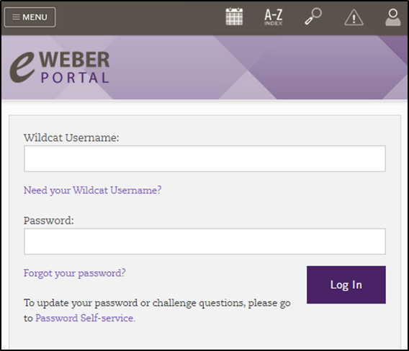
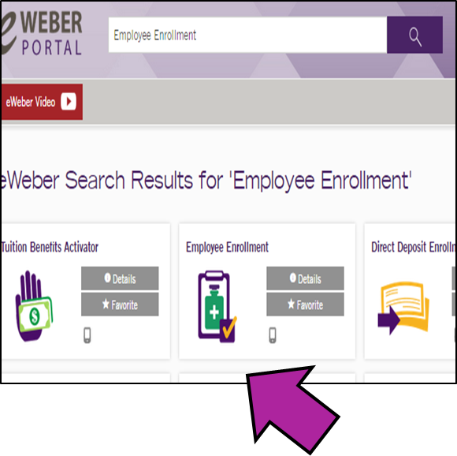
How to use the Open Enrollment App

Slide 10
Don’t forget to verify your dependents information!
Name spelling
Birthdays
Social Security numbers
If something looks wrong, please let us know

Slide 11
Don’t see your dependent listed?

Slide 12
Flex Spending
Want to enroll or re-enroll in Flex? This must be done every open enrollment.

Slide 13
If you want to enroll in or cancel your legal plan
Contact MetLaw directly to make the change. This can only be done during Open Enrollment

Slide 14
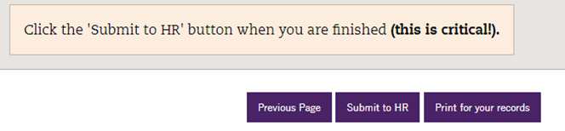

Make sure to submit to HR at the end of the enrollment process

Slide 15


Let your co-workers know where they can complete their on-line open enrollment if they’re feeling a little lost.
The HR website has detailed instructions and lots of extra information.

Slide 16



RETIREMENT

Slide 17


Slide 18
Blomquist Hale

Slide 19
Wellness Program Home and Auto Insurance Discounts Bookstore Discounts Use of facilities Tuition Benefit UTA Bus Pass

Slide 20
Thank you!
Visit Weber.edu/human resources

